Slide 1
Equatorial Inertio Gravity Waves and Diurnal Variations During DYNAMO:
Observation and Simulation
Yongqiang Sun, Michael Ying, Shuguang Wang, Fuqing Zhang
Group meeting
07-19-2013

Slide 2
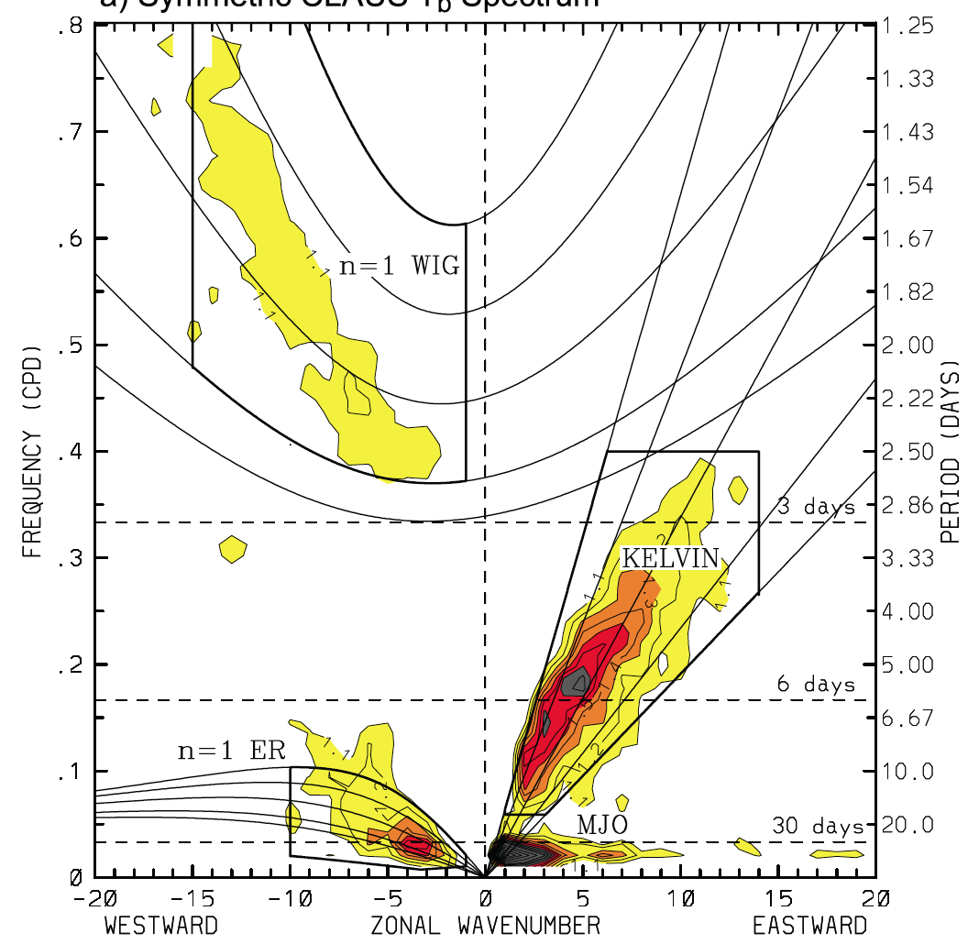
2-Day
Wheeler and Kiladis 1999
Kiladis et al. 2009

Slide 3
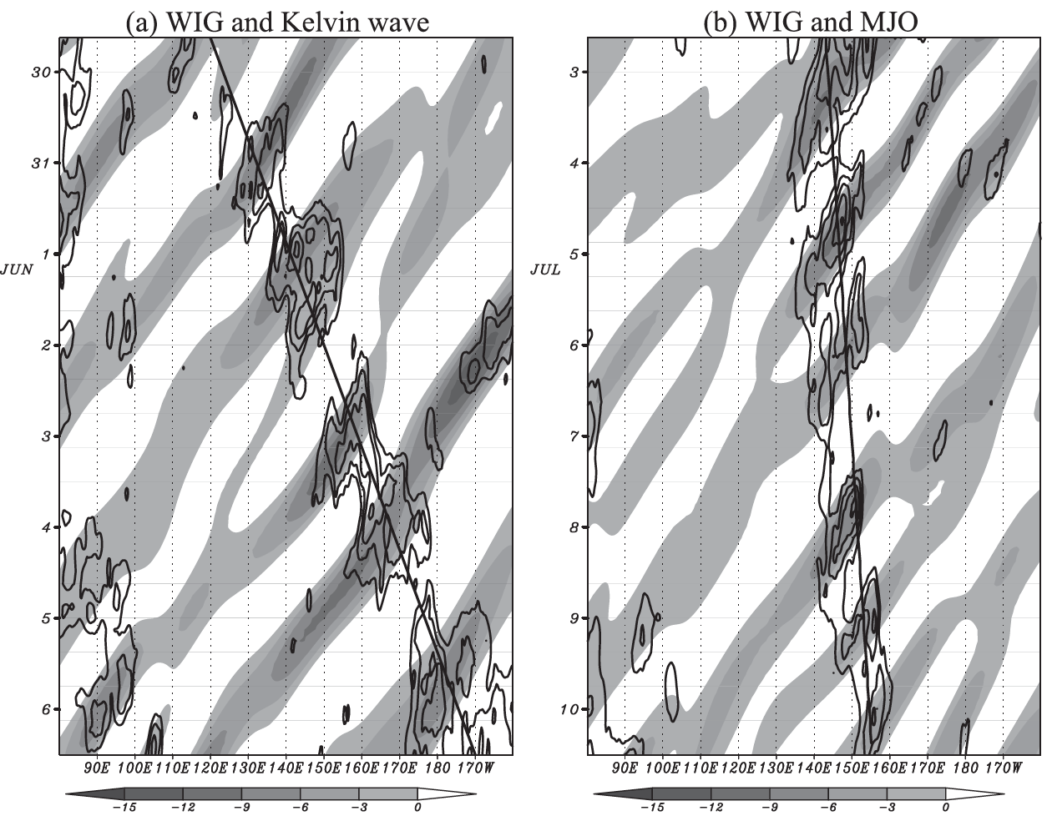
Motivation:
Some recent studies have drawn our attention to the role of high-frequency waves in the MJO (e,g; Kikuchi and Wang 2010, Yang and Ingersoll 2013).
––– MJO is well known for its multiscale structure. Previous observations show strong westward propagating inertio-gravity (WIG) waves during active phase of MJO (Chen et al. 1997).
––– While MJO surely modulates the WIGs, it is still unknown if there is any up-scale feedback from the WIGs to the MJO.
Filtered WIGs (shaded) within a) Kelvin waves ; b) MJO waves. (Kikuchi and Wang 2010)

Slide 4
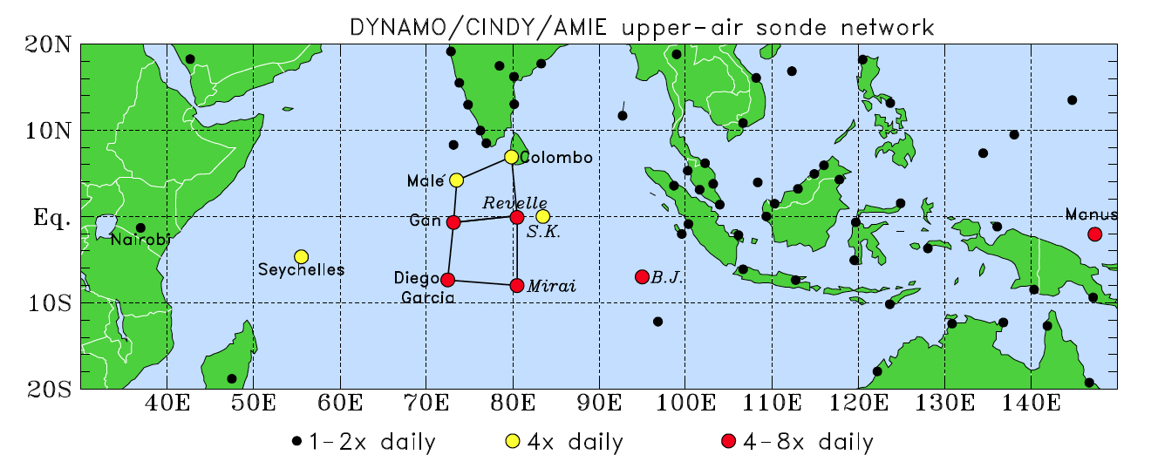
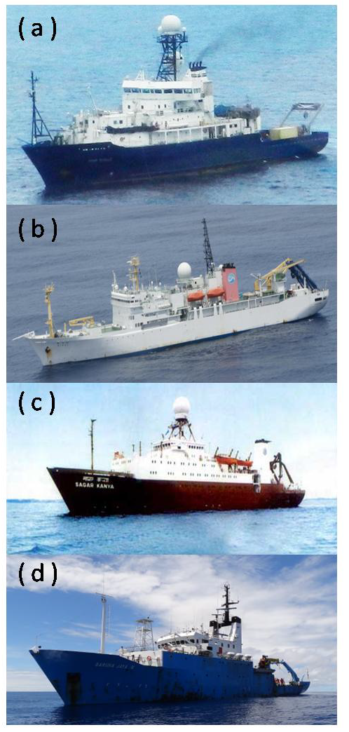
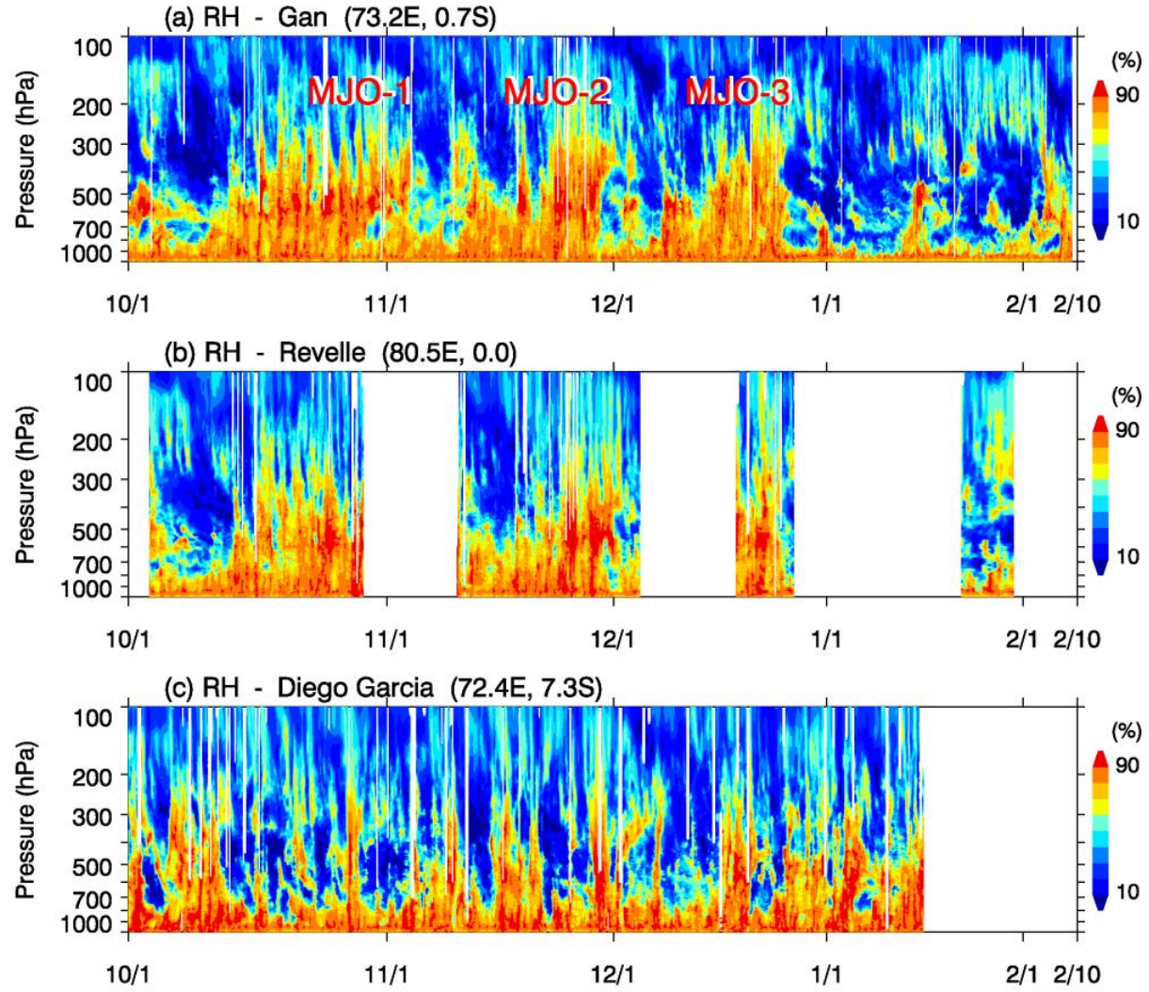
Motivation:
Sounding network during DYNAMO (Johnson et al 2013)
A example showing the observed relative humidity during DYNAMO from three stations. Three MJO events can be identified during DYNAMO period.
Notes:
DYNAMO project provide an excellent chance to study the multiscale interaction with in MJO.
Detailed information about DYNAMO can be found here. (http://www.eol.ucar.edu/projects/dynamo/)
We are going to explore the 3-hourly sounding data and the high resolution CMORPH data (8km, hourly) to study the higher frequency WIGs and diurnal variations during the DYNAMO period. Simulation results using WRF will also be compared. (Focus on the first events here. detail of the simulation can be found at the notes).
Detail of the model:
The model (WRF 3.3.1) is cloud-permitting with 9-km grid spacing and 45 vertical levels up to 20 hPa. To prevent circulation drift, we use spectral nudging of 2000 km wavelength in the horizontal for wind, temperature, moisture and geopotential height. No cumulus parameterization is used in the model.

Slide 5
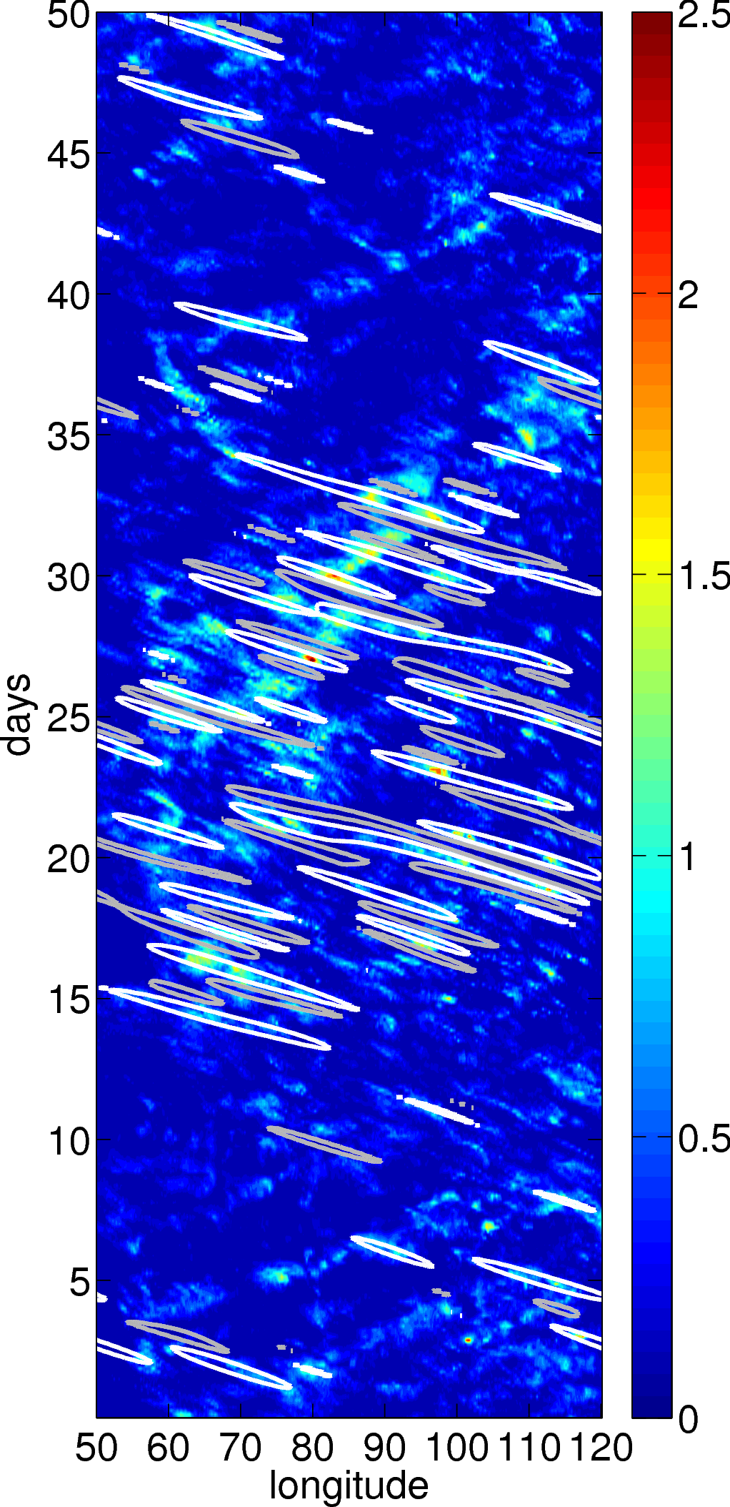
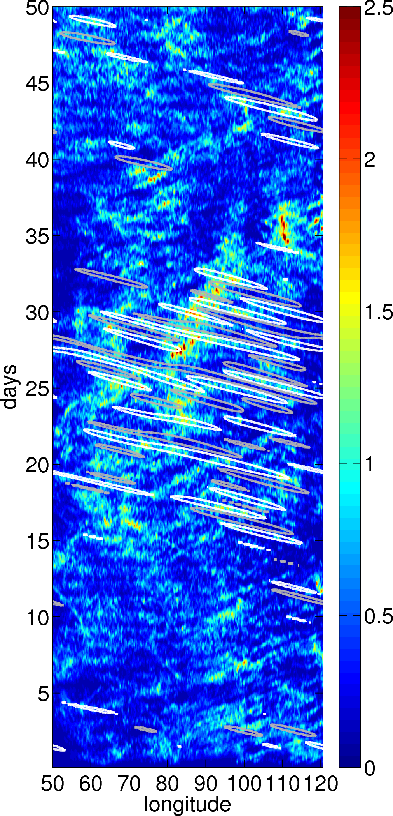
Overview (simulation):
a) CMORPH
b) WRF
MJO-1
MJO-1
Time-longitude diagrams of (a) CMORPH 8 km and (b) WRF-simulated 9 km precipitation during the 2011-10-01 to 2011-11-20 period. White (positive) and grey (negative) contours show the filtered westward propagating inertio-gravity wave.
The dash line marked a phase speed of 5m/s.
Notes:
A complete MJO event was captured by both the observation and simulation (Fig. 1)
The WIGs are clearly more strong during the active phase of MJO.
The model produce much more precipitation than the Obs (nearly twice).

Slide 6
Overview (wave spectrum):
(a) Symmetric/Background
CMORPH
WRF
(a) Anti-Symmetric/Background
CMORPH
WRF
Space-time spectra (Using method of Wheeler and Kiladis 1999) of observed and simulated precipitation. Reference lines of dispersion relation (shallow-water He=12, 25 and 50m) are shown.
Notes:
Similar to Tulich and Kiladis (2012), the westward interio-gravity wave (WIG) signal can have a wavelength and period as small as 500 km and 8 h, respectively. This figure also shows a strong diurnal variations in the WIG region of the observations, which means there is a strong westward propagating diurnal cycles in the Obs.
The simulated results generally agree with the observations, except that the eastward signal is much stronger.

Slide 7
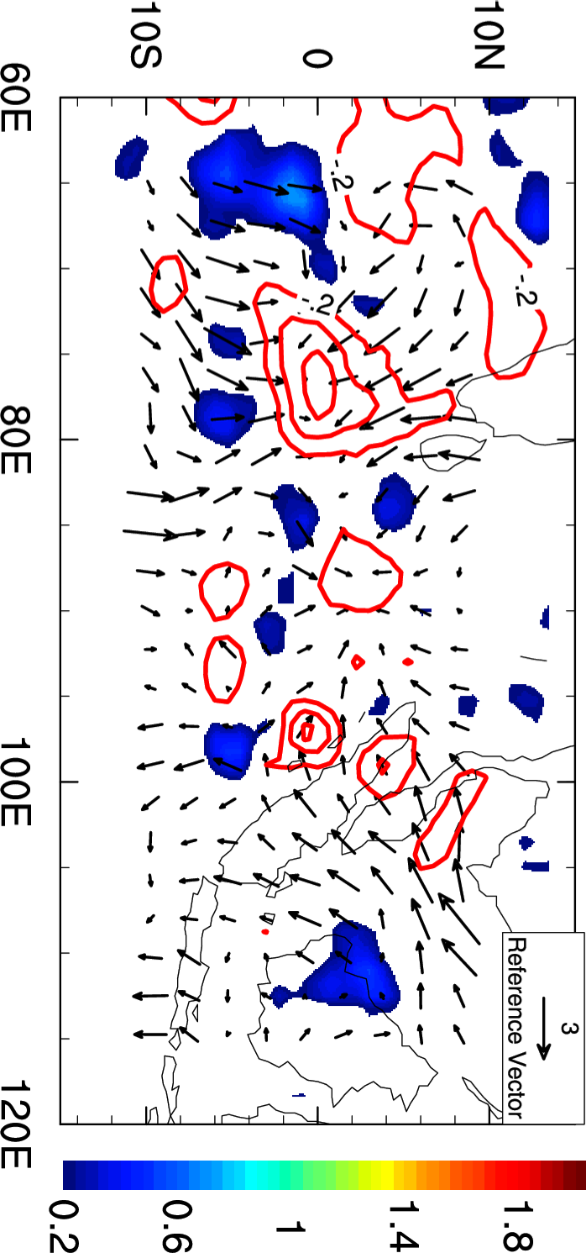
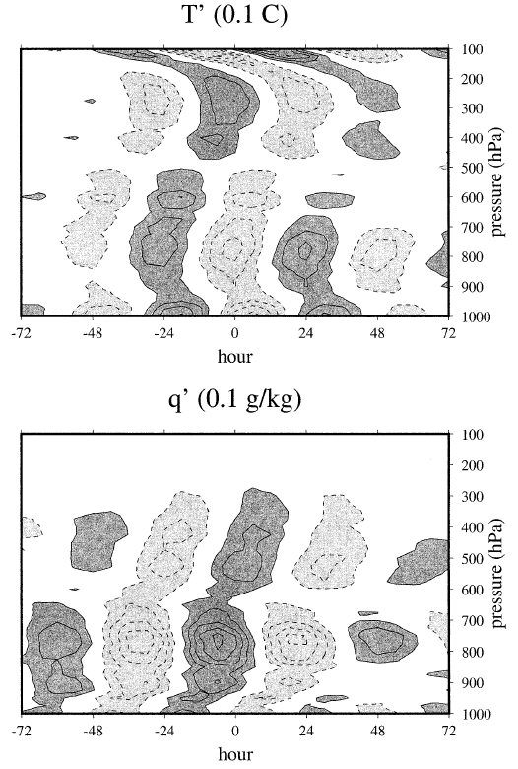
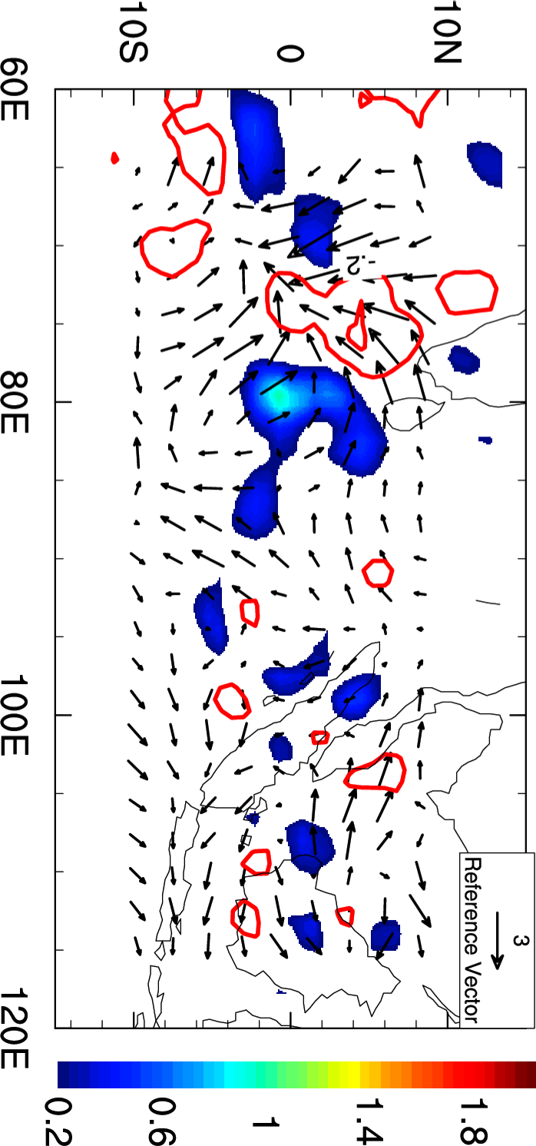
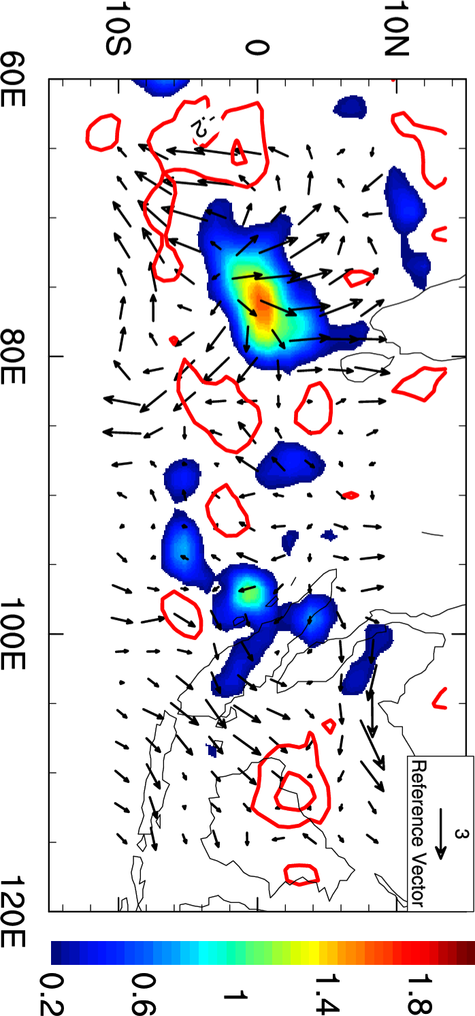
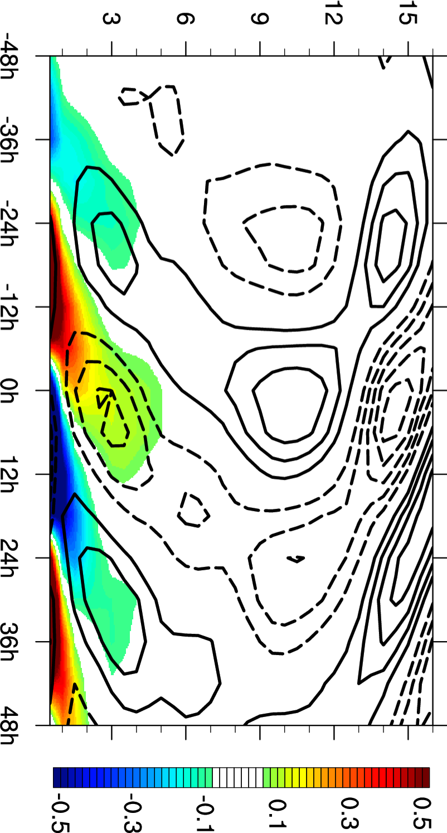
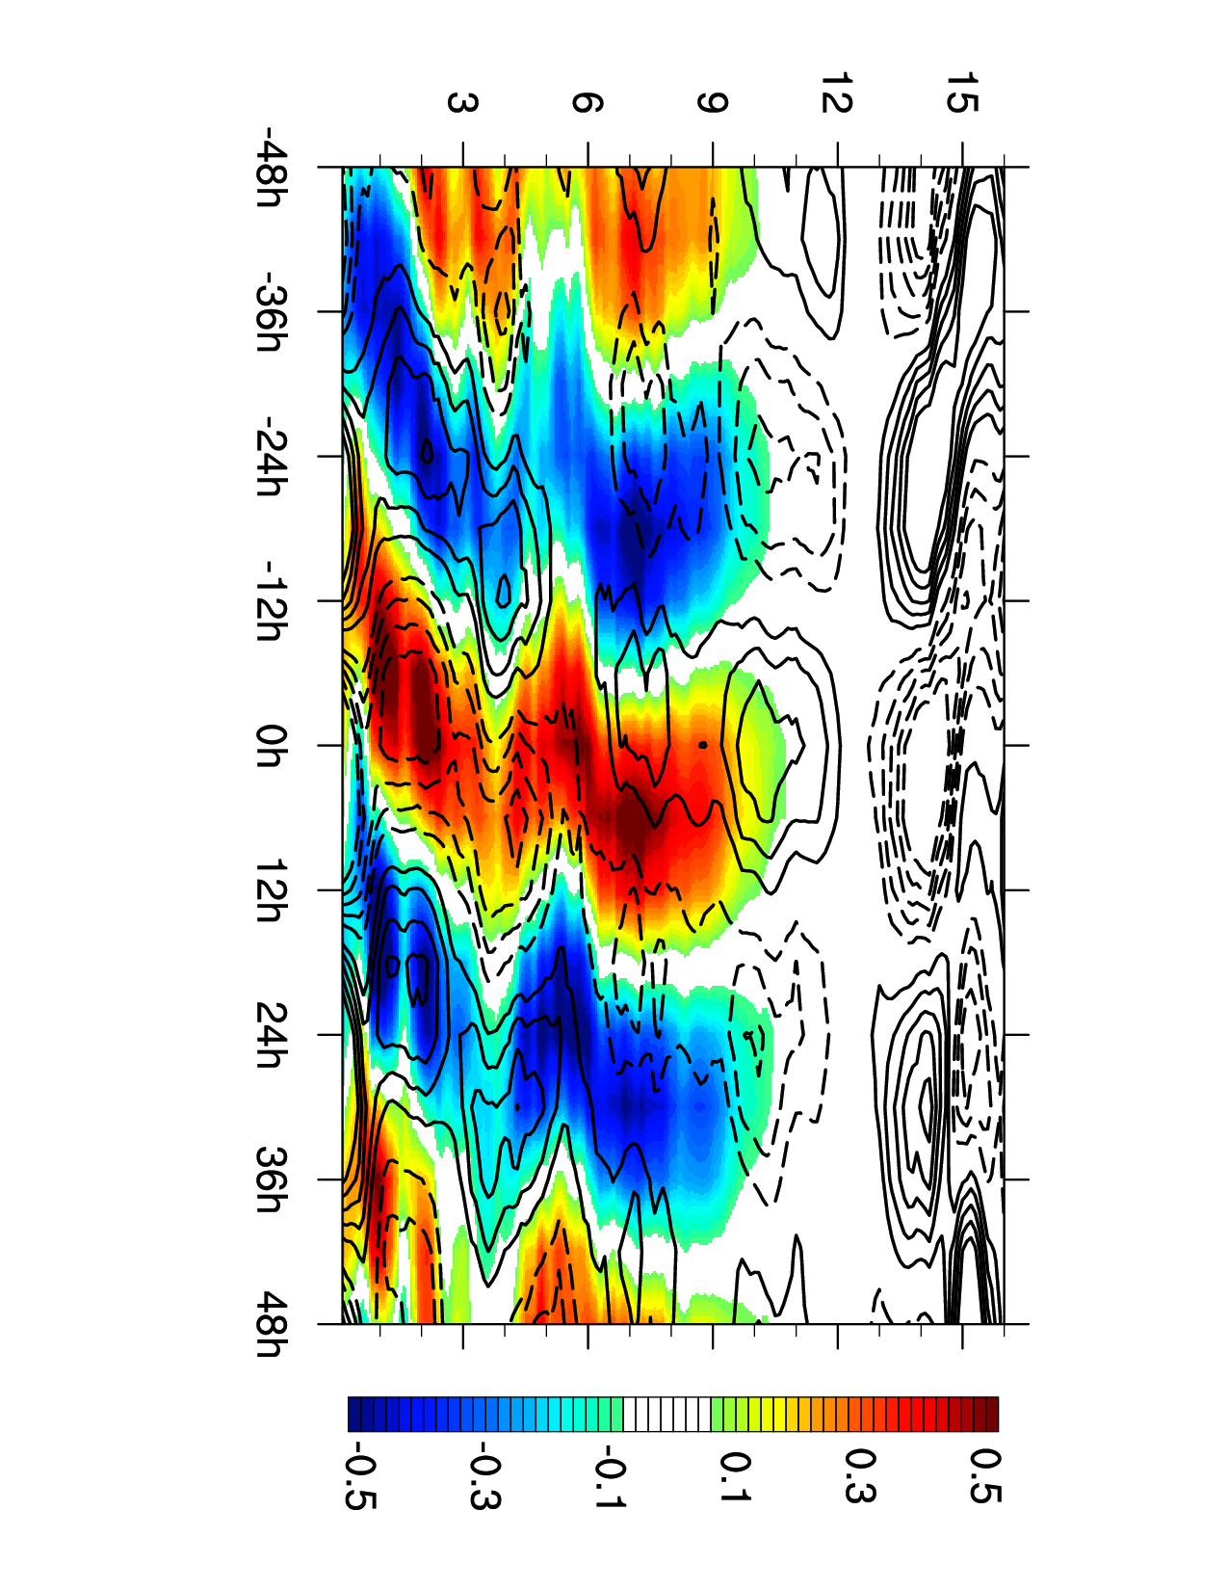
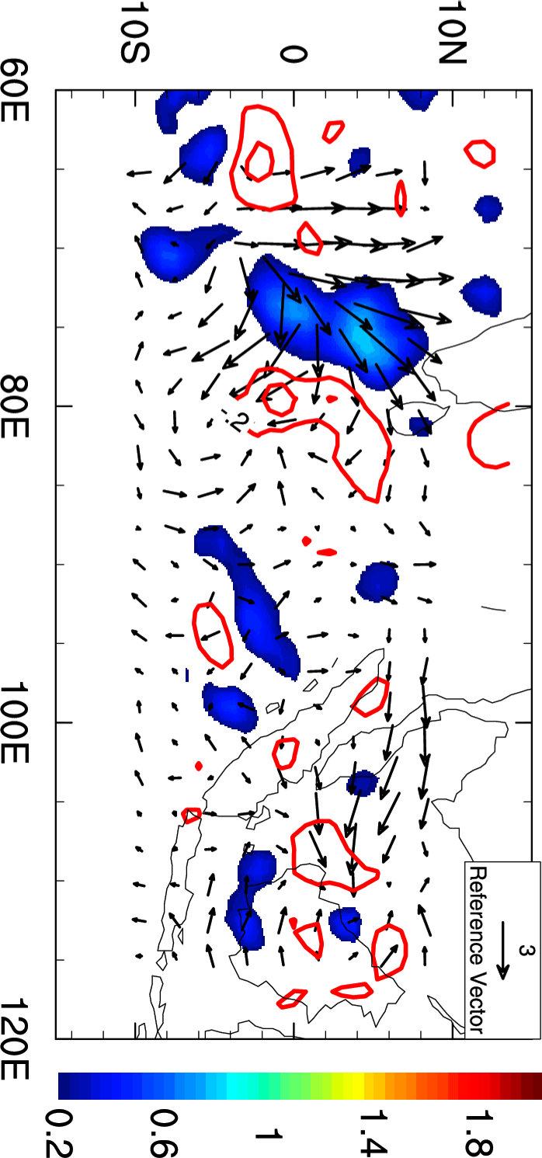
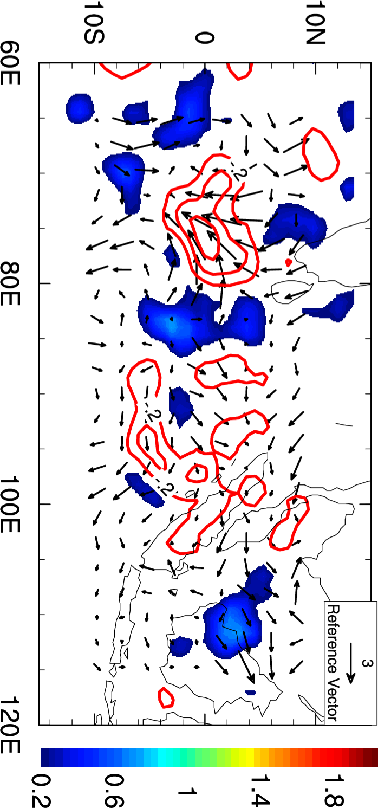
Results (WIG structure):
-24h
-12h
0h
(a) Gan
(b) WRF
12h
24h
Fig. 3: Composite vertical structure of 2-day waves (temperature in contours and specific humidity in shadings) using (a) Gan island sounding data; (b) WRF simulation. Results are obtained from lagged linear regression of raw data onto 1.5~3 day band pass filtered precipitation time series for a set of 50 base point on the equator.
Notes:
The vertical structure of a typical WIGs is shown below from the Gan sounding data. The wave is accompanied by a temperature dipole and a quick buildup of moisture from the lower to upper levels.
The WRF simulation captures the temperature dipole and buildup of low-level moisture well. However, upper-level (6-9 km) moisture shown in the sounding, possibly due to a mid-level stratiform region, is absent from the simulation.

Slide 8
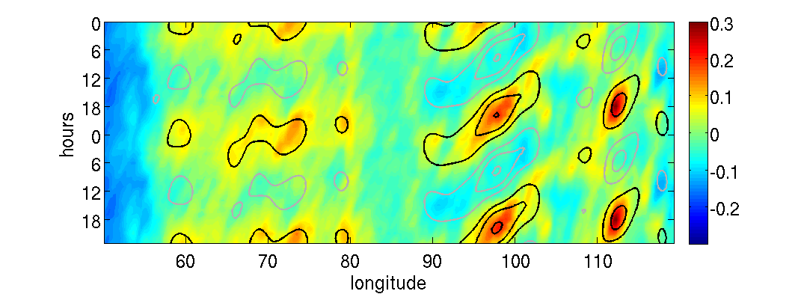
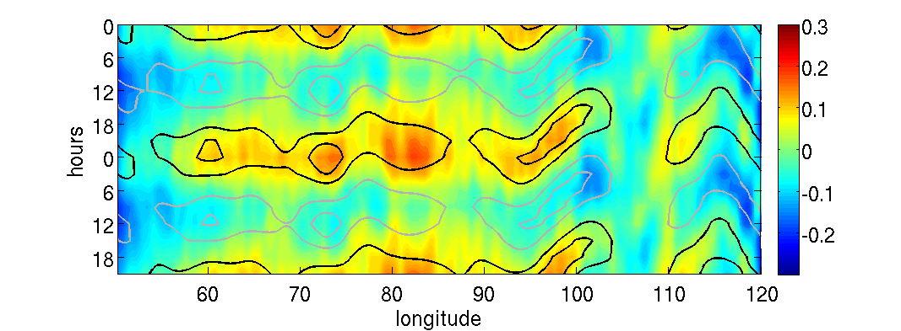
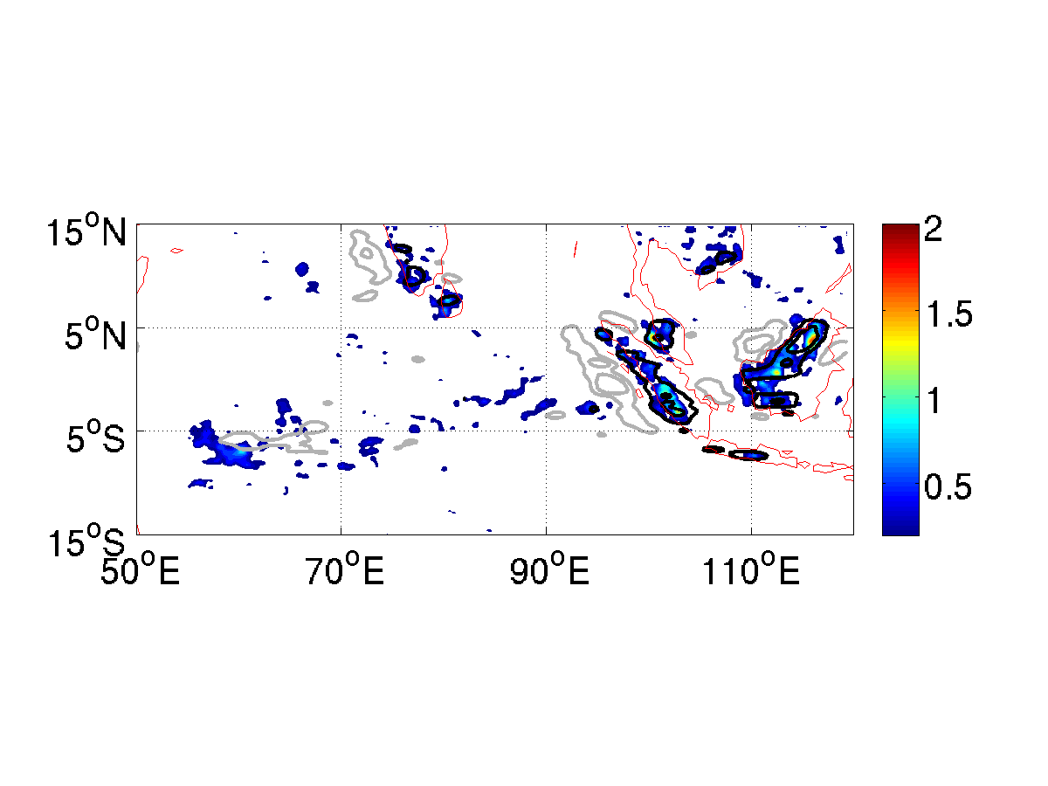
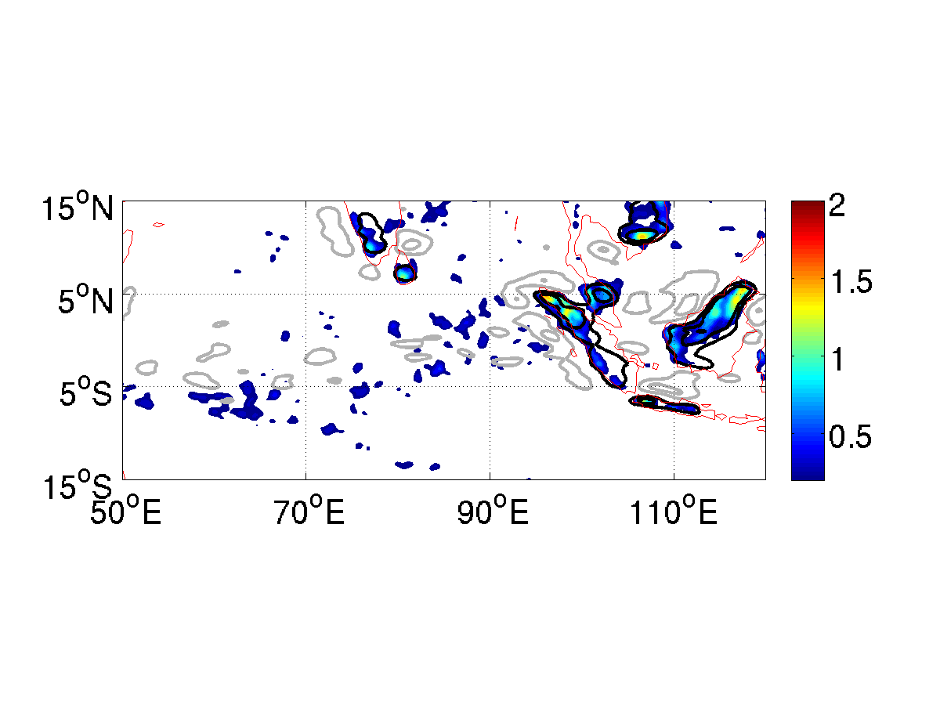
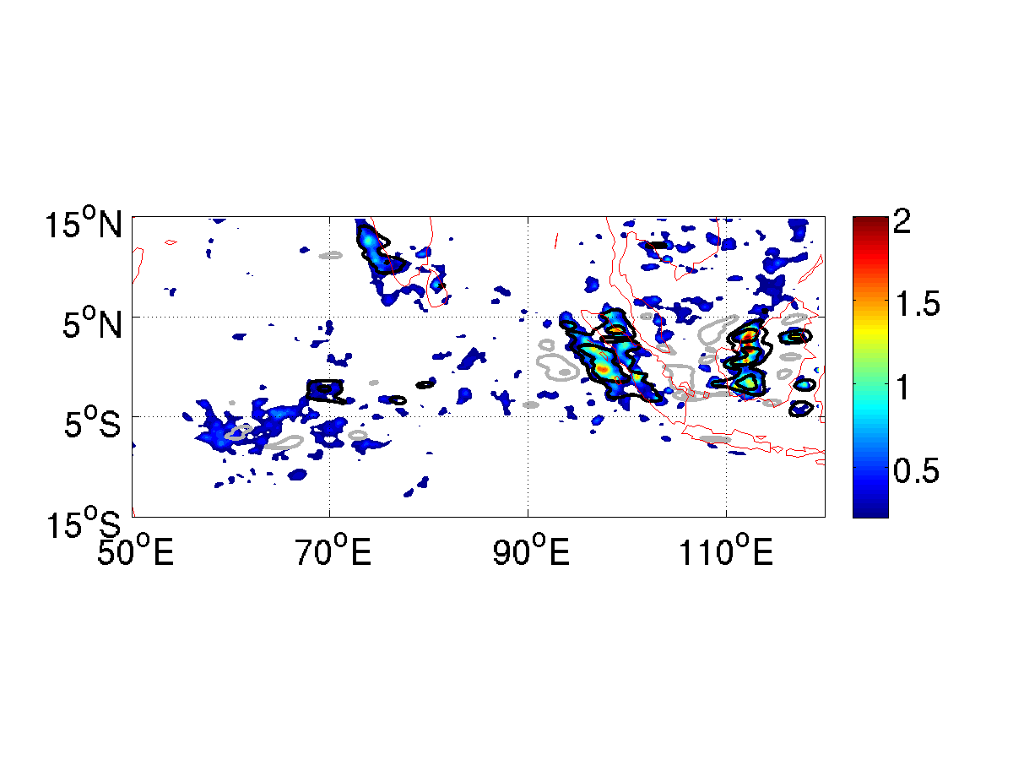
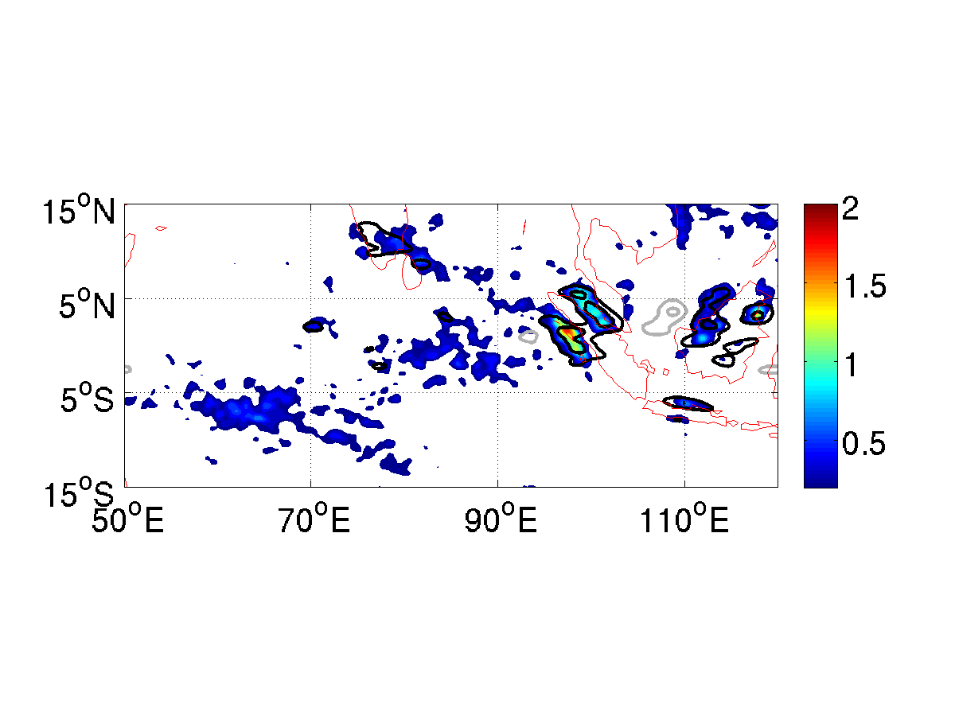
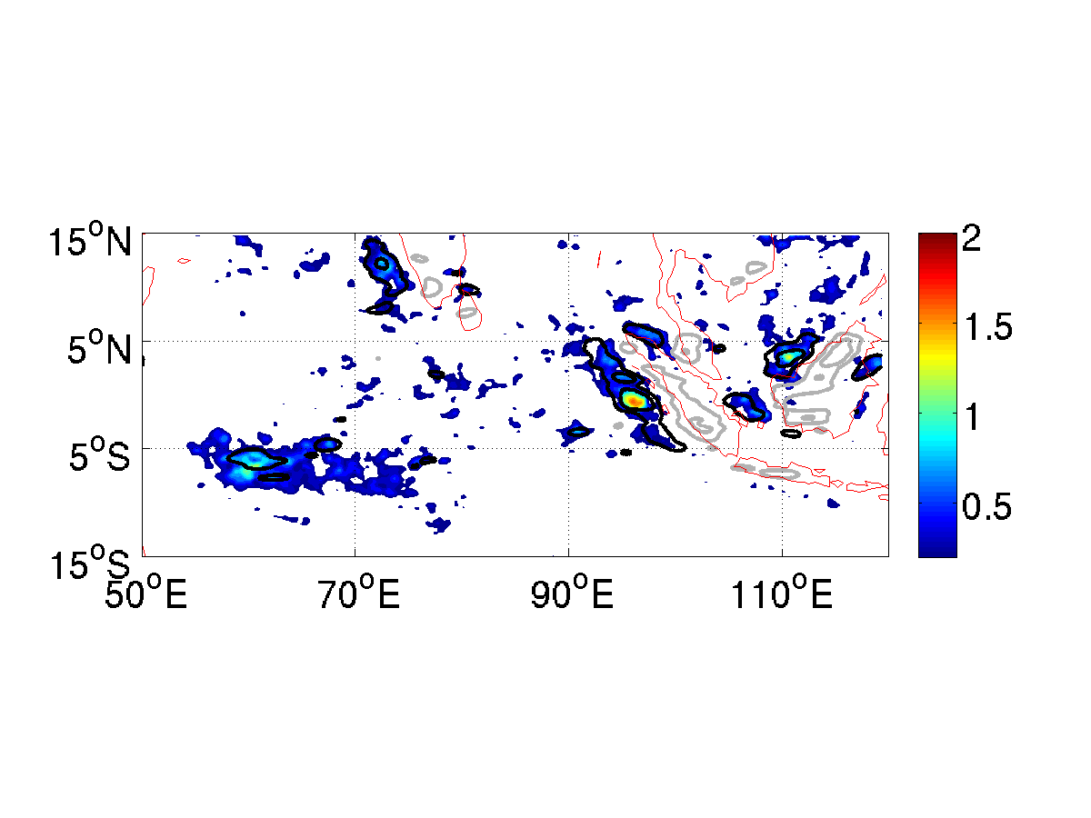
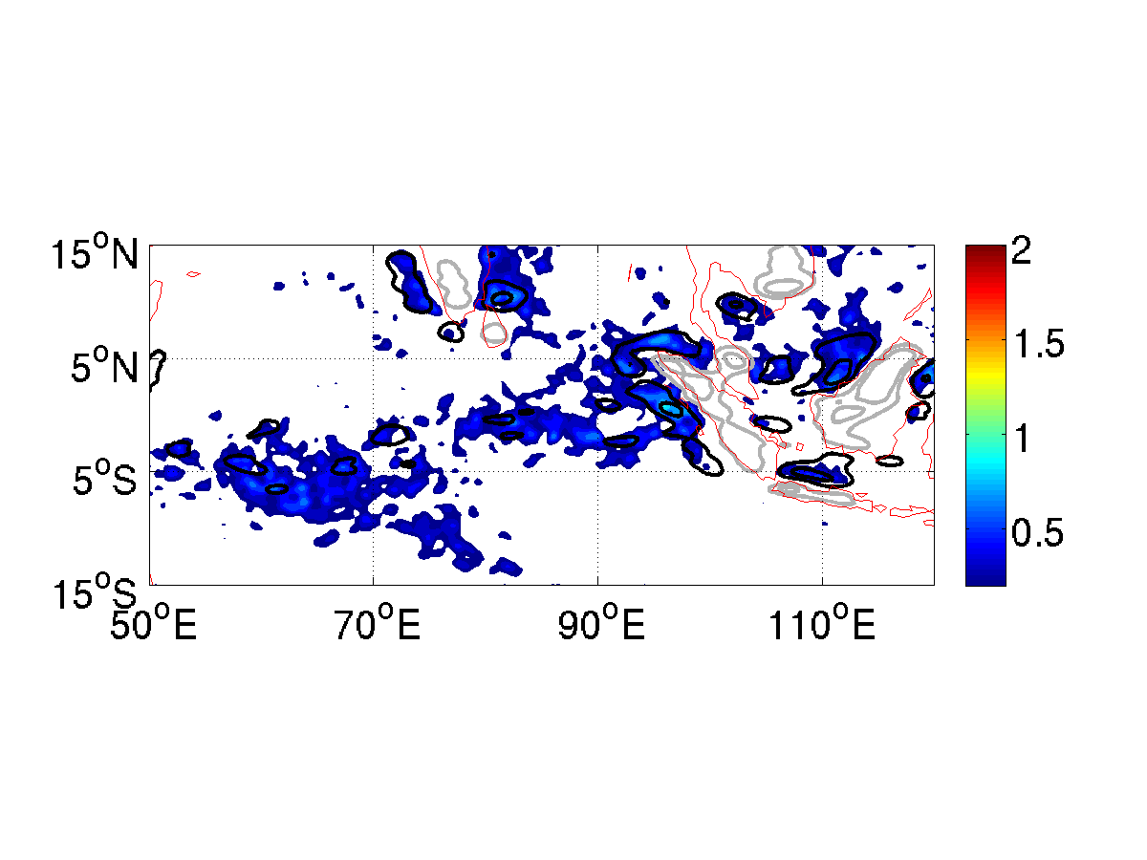
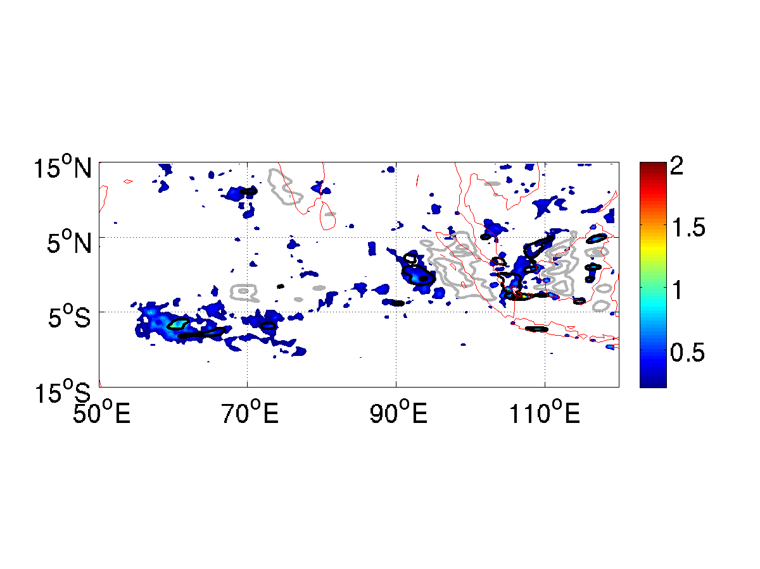
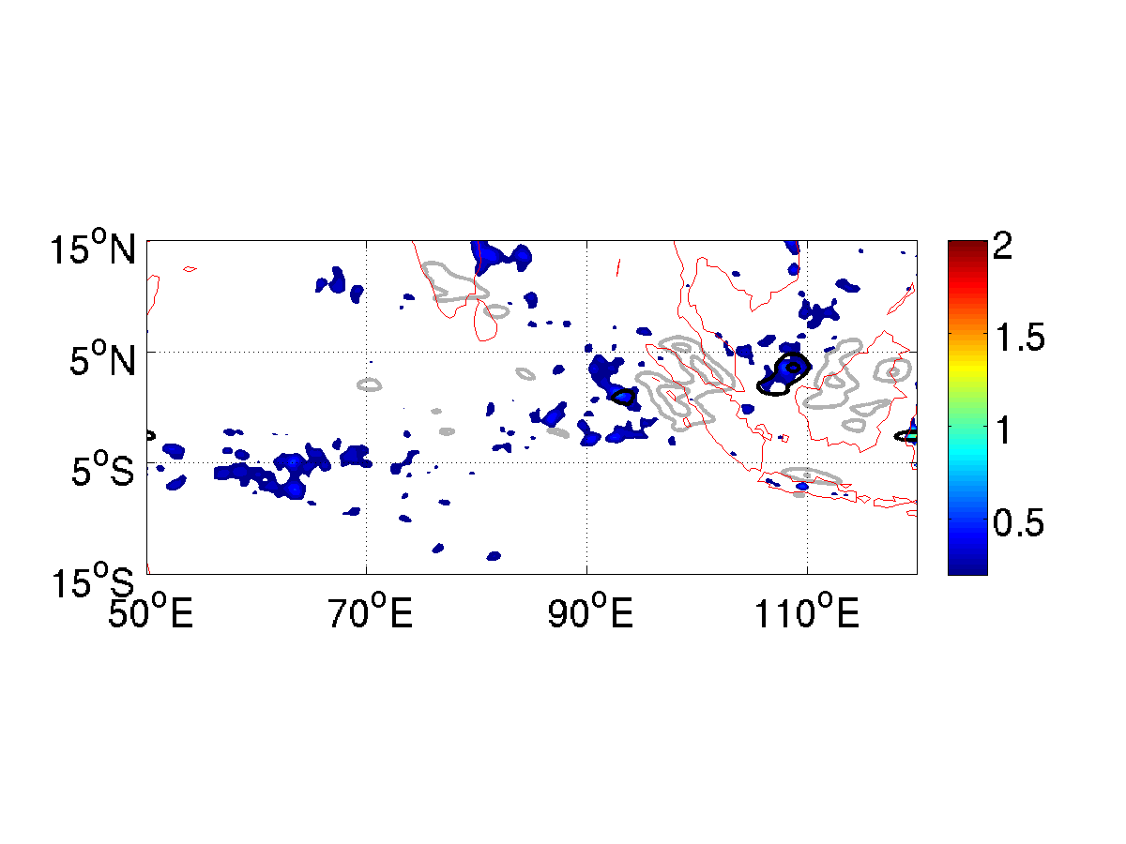
Results (Diurnal Variations):
The westward propagating diurnal variations over the maritime continental region (~100°E) are represented well by the model. The model, however, overestimates the precipitation over the Indian Ocean
CMORPH
WRF
Time
(UTC)
12
18
00
06

Slide 9
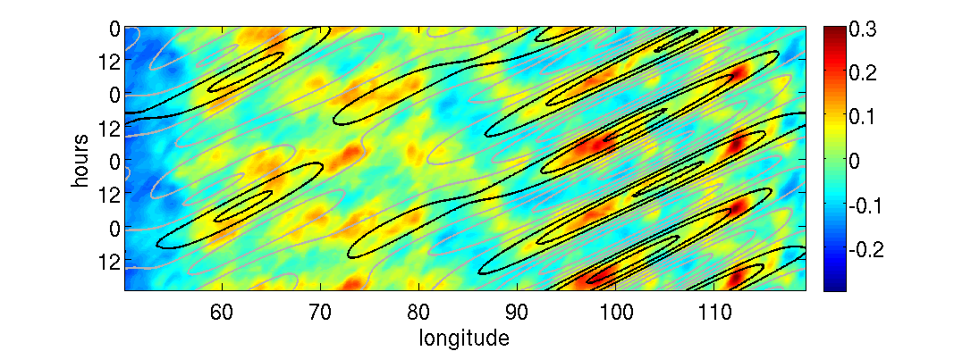
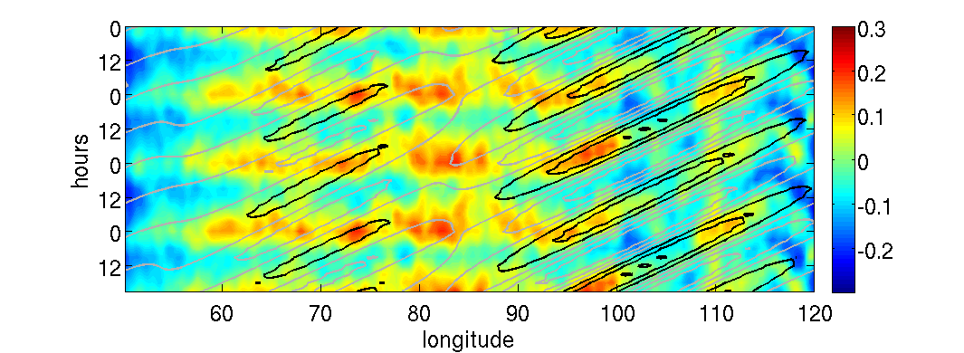
Discussion:
(a) CMORPH
(b) WRF
We hypothesize that the strong precipitation diurnal cycle triggered over the Maritime Continents propagates westward in the form of WIG waves, and transitions into 2-day waves over the eastern Indian Ocean (left), possibly influencing the MJO initiation. However, the model still cannot capture this transition well (right), thus further investigation is needed.

Slide 10
Research plan:
Part 1. Analyze the seasonal variability of WIGs and EIGs and explain the dynamics behind this variability ?
Seasonal variations of WIGs and EIGs: (take year 2006 for a example)
Winter
Summer

Slide 11
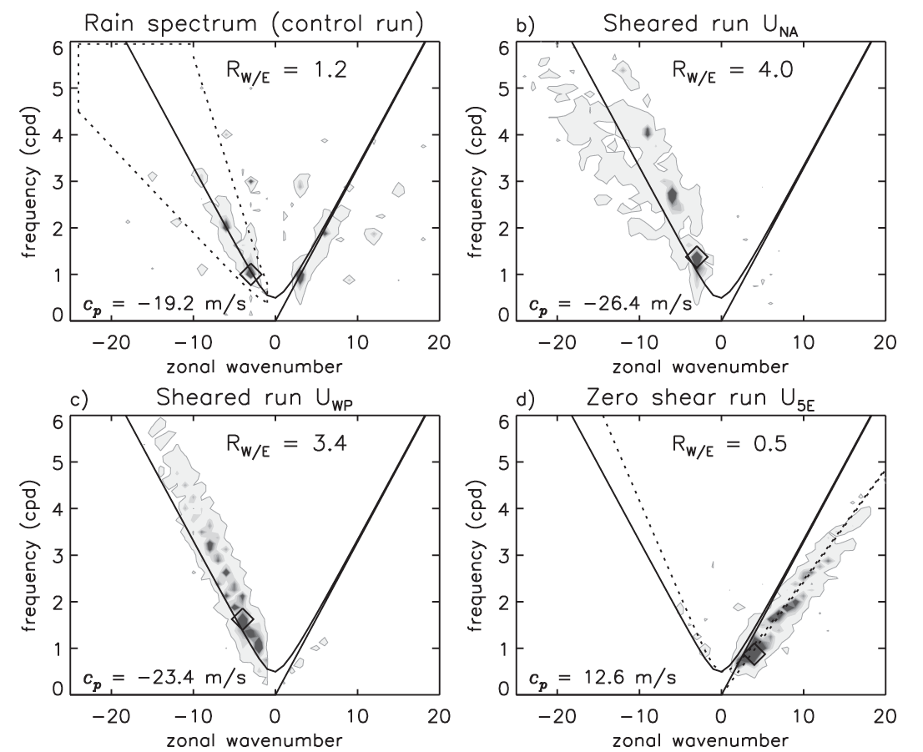
Part 2. Using idealized model to study the Dynamics of WIGs and EIGs, try to understand possible convection organization mechanisms under vertical wind shear ?

Slide 12
Part 3. Try to think a way to demonstrate our hypothesis?
Like high frequency wave can act similar as nudging process?

Slide 13
Thanks!

