Slide 1
Simulations of the May 20 Moore, Oklahoma Tornadic Supercell
Yunji Zhang
07/19/13

Slide 2
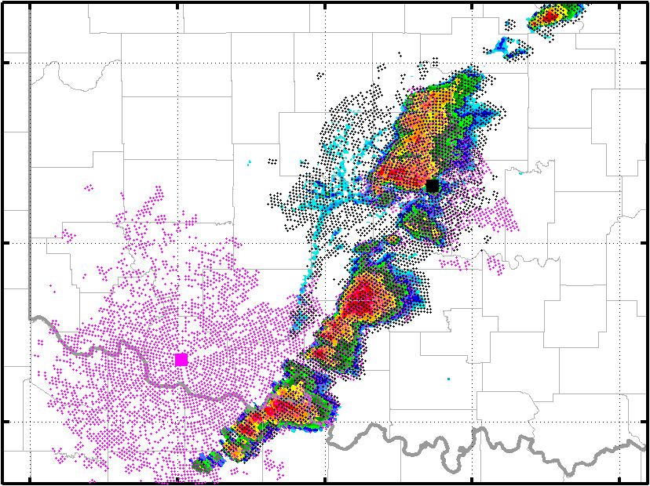
Model and Data
Model: WRF V3.5
Single domain 400x300x43, 1km resolution, 6s time step
Physical parameterization schemes (based on HRRR):
Monin-Obukhov (Janjic) surface layer
RUC land-surface
MYNN 2.5 PBL
Thompson MP, no CU
RRTM LW, Goddard SW
Data:
GDAS Observations
Oklahoma Mesonet
WSR-88D Level-II V_{r}
KTLX and KFDR
2km resolution, 3 m/s error
KTLX
KFDR
KTLX May 20 19:59:00

Slide 3
Experiment Design
Control data assimilation experiment (CNTL):
40-member EnKF initiated from GFS ensemble (questionable)
20 analysis at 1800, 20 6-hour forecasts from 1200
Cycling every 3 minutes from 1800 (questionable) to 2030
Assimilate V_{r} every 3 minutes, GDAS and mesonet every 1 hour
Relaxation 0.8, no inflation, no data thinning
ROI: 10-km Vr, 300-km surface, 900-km upper air
Sensitivity experiments:
5-minutes cycling interval (5min) – longer than one volume scan;
V_{r} error reduced to 2 m/s (Err2).

Slide 4
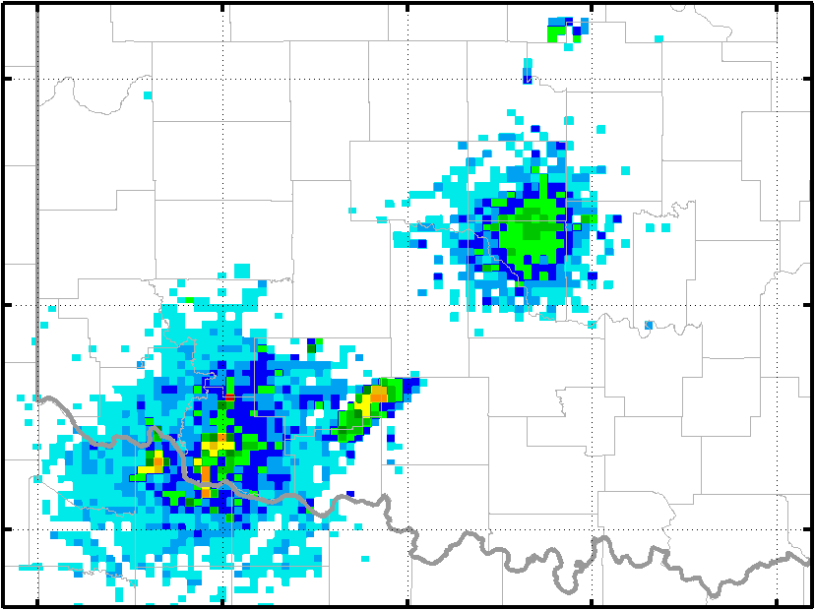
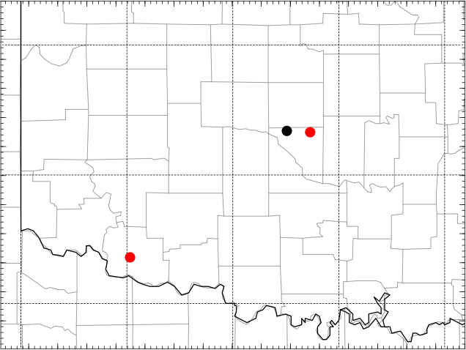
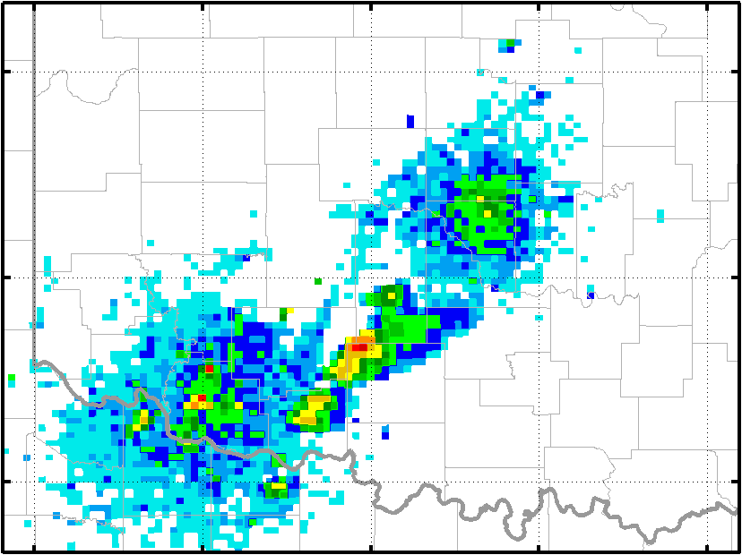
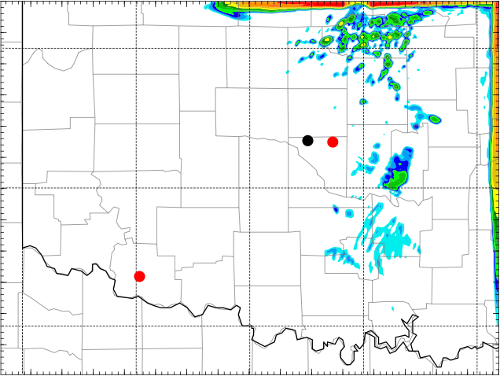
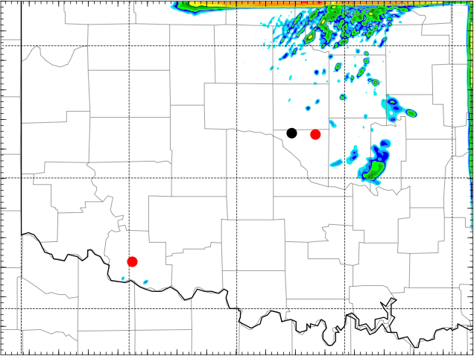
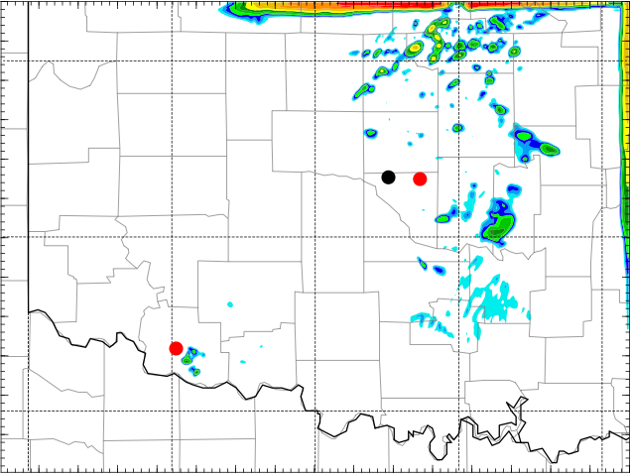
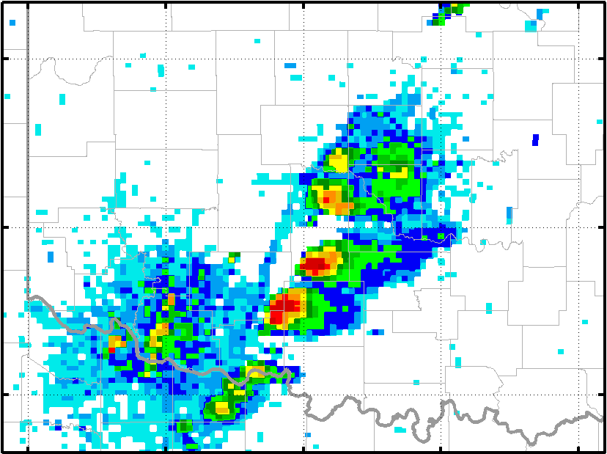
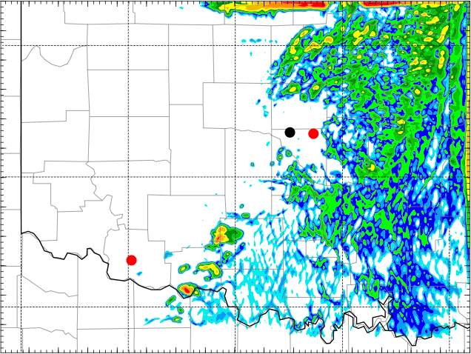
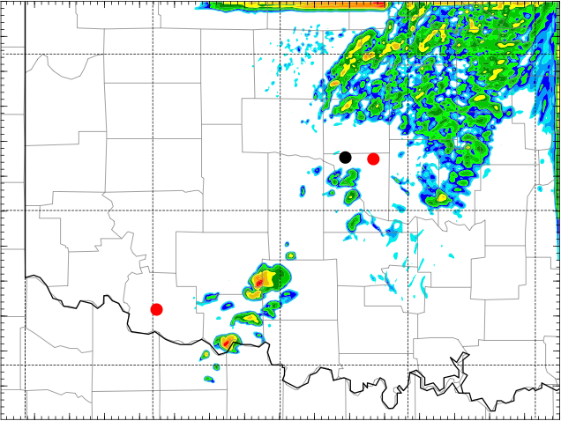
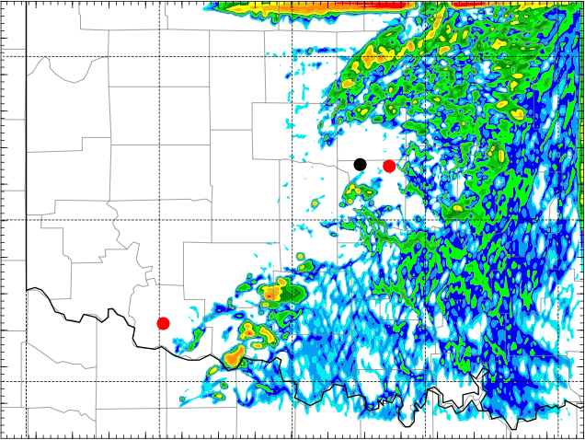
Experiment Results
NexRAD L3
ENKF-CNTL
ENKF-5min
ENKF-Err2
1800 UTC
1830 UTC
1900 UTC

Slide 5
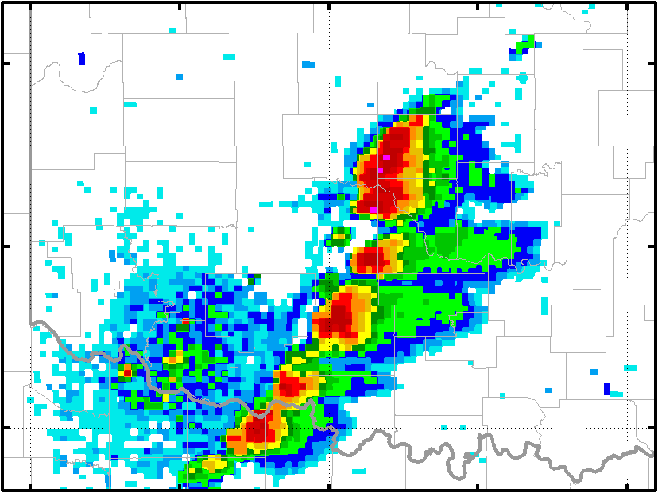
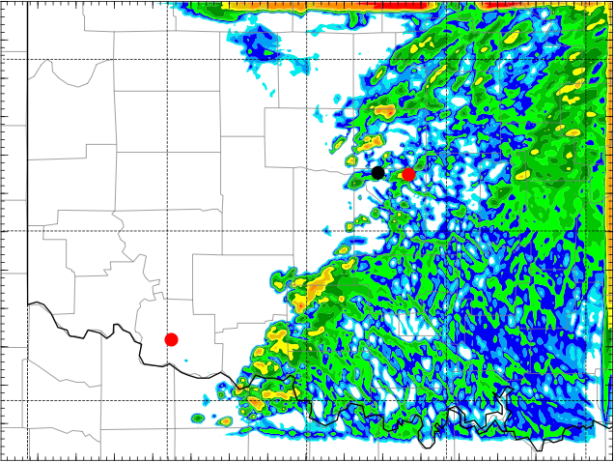
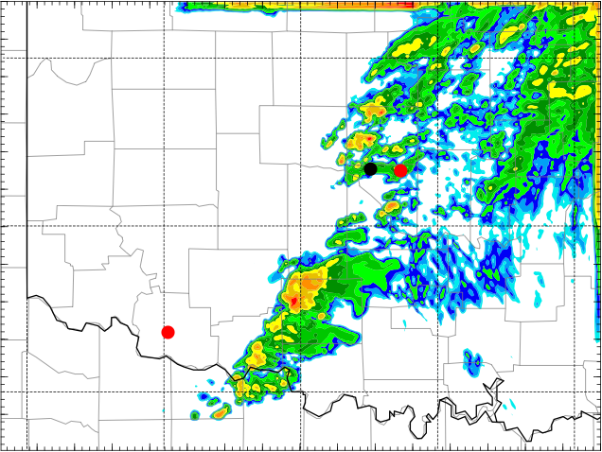
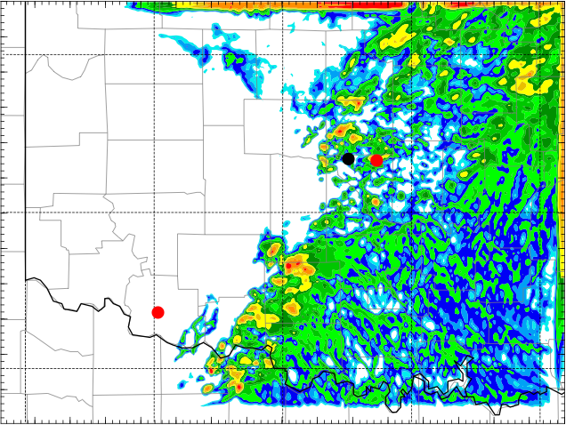
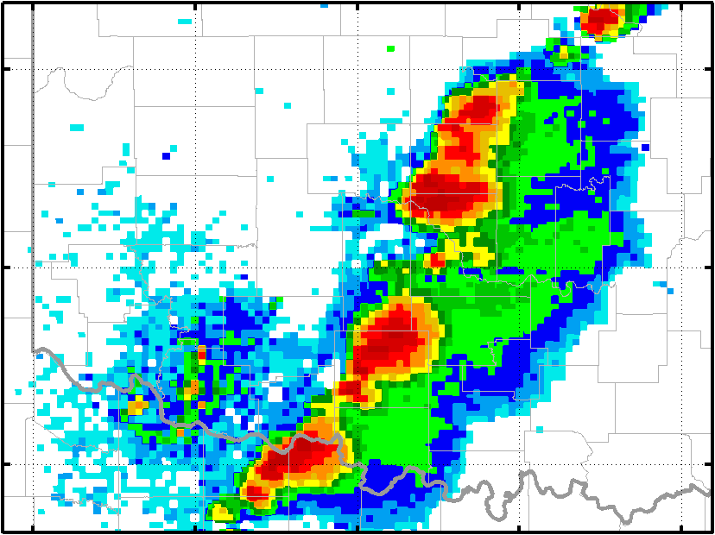
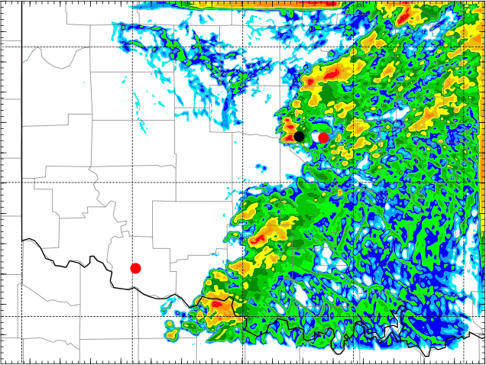
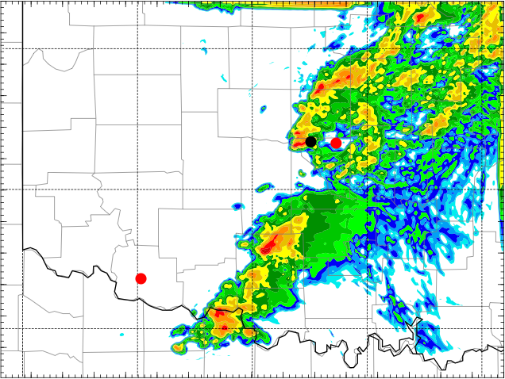
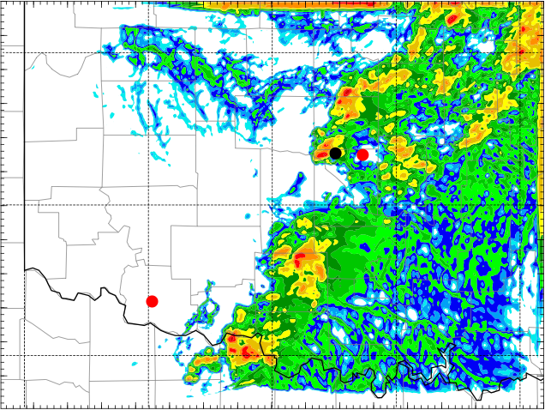
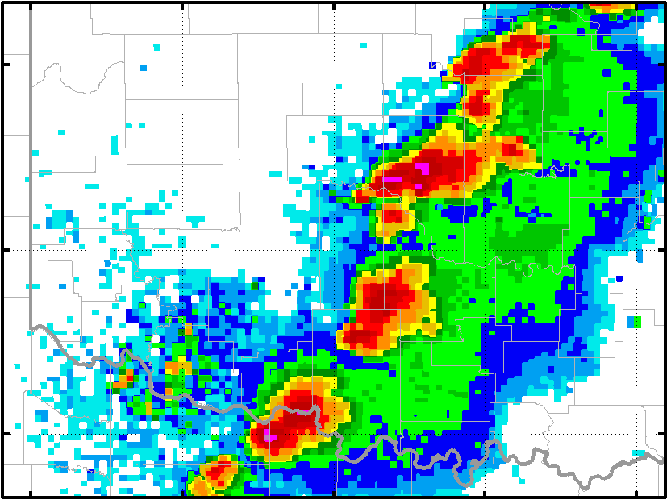
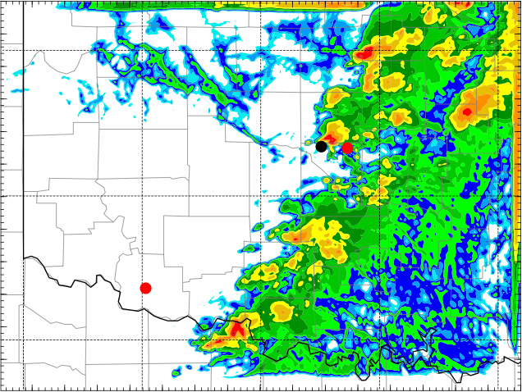
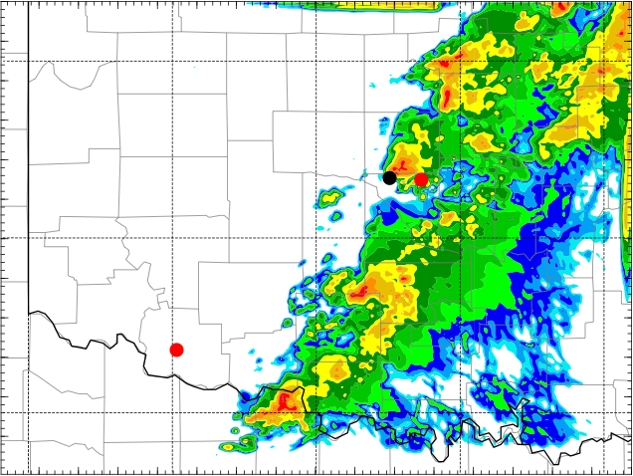
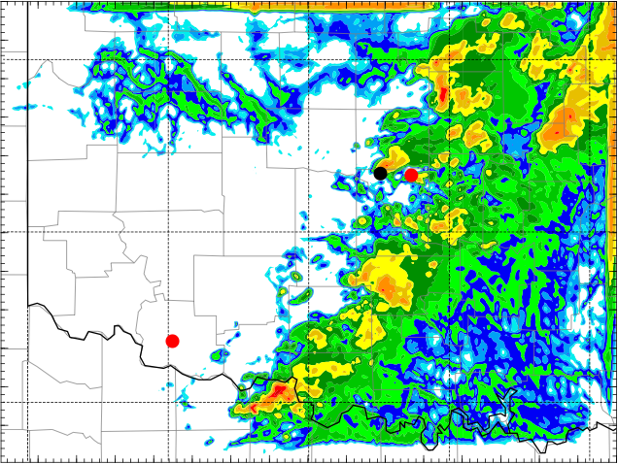
Experiment Results
NexRAD L3
ENKF-CNTL
ENKF-5min
ENKF-Err2
1930 UTC
2000 UTC
2030 UTC

Slide 6
Reflectivity Control
Suppress false convections using composite reflectivity
Additional modifications:
Using 5 dBZ or 10 dBZ as threshold instead of 0
Remove ground clutters in reflectivity fields
maxdBZ 2000 UTC
cref_coef

Slide 7
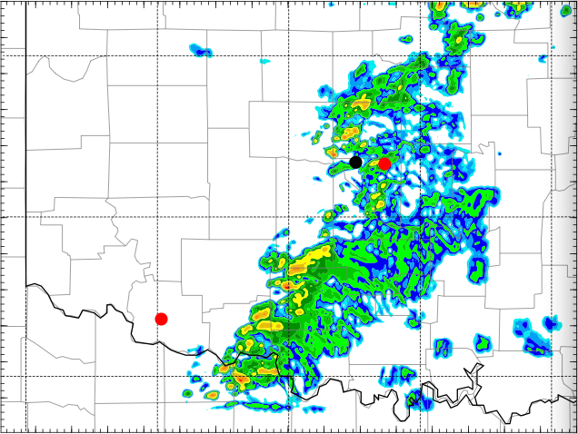
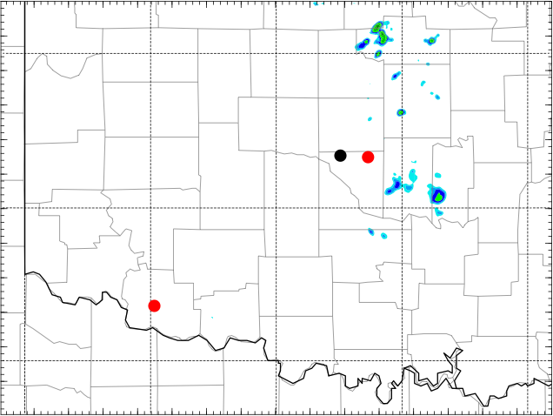
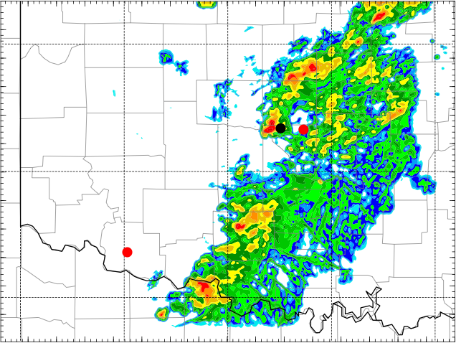
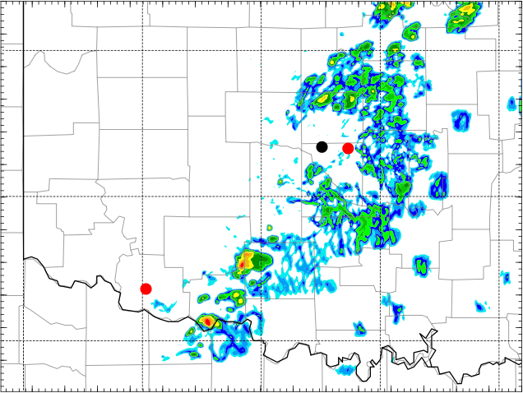
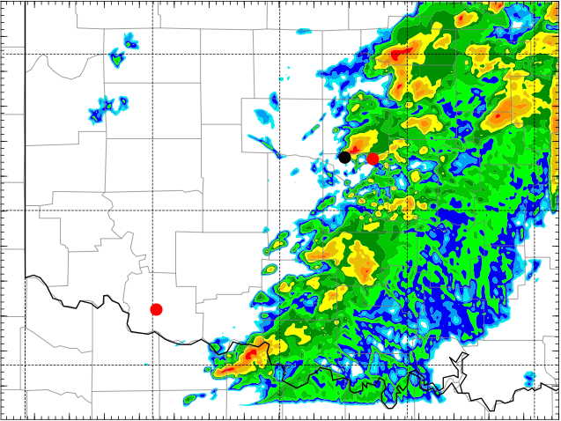
Reflectivity Control Results
NexRAD L3
ENKF-CREF
NexRAD L3
ENKF-CREF
1800 UTC
1930 UTC
1830 UTC
2000 UTC
1900 UTC
2030 UTC

Slide 8
Ongoing Works
Pre-process radar observations
Re-design experiment sets

Slide 9
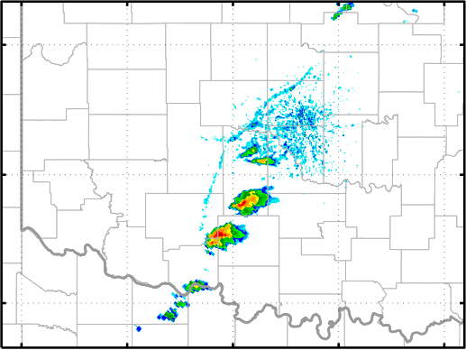
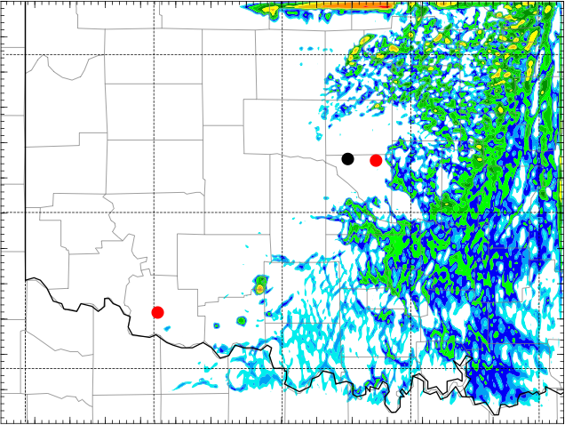
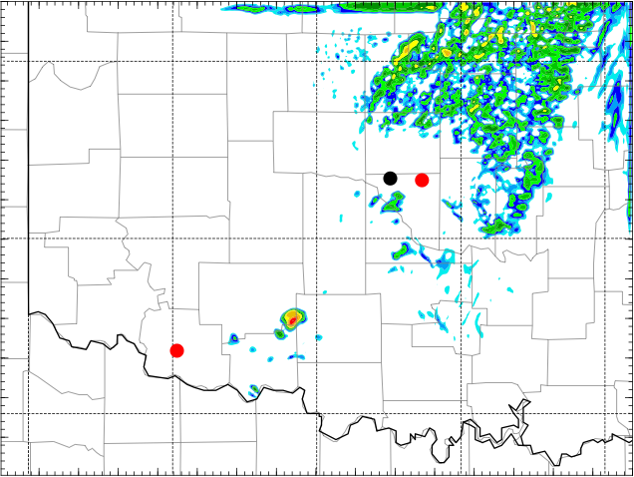
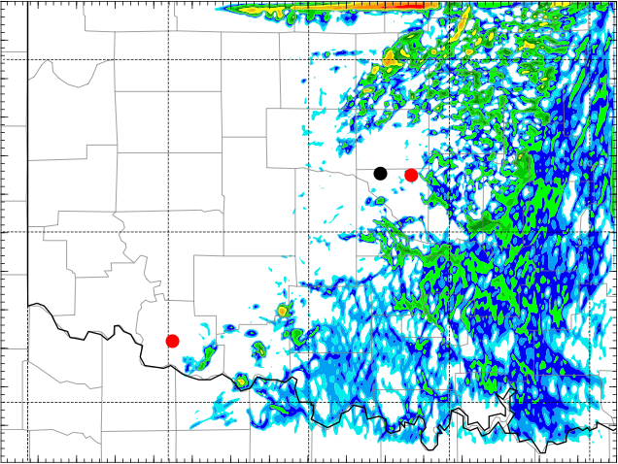
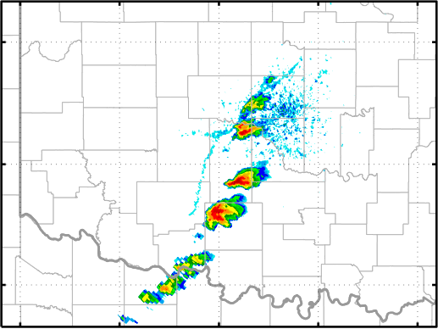
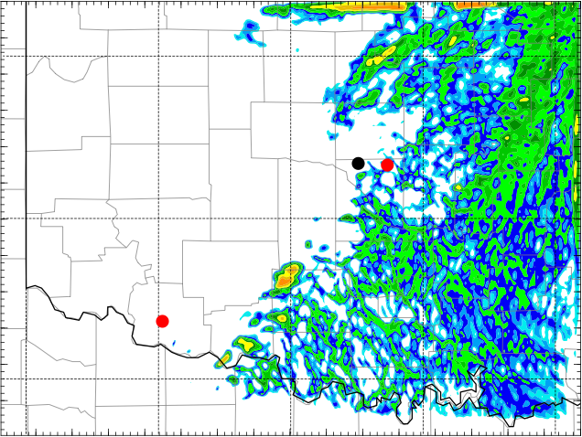
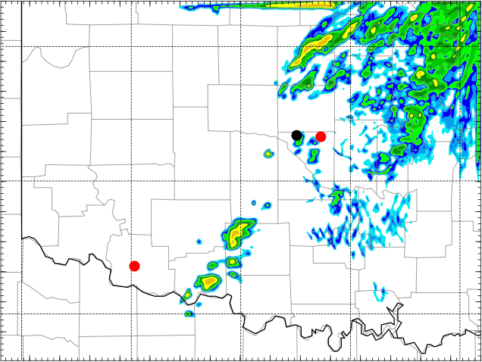
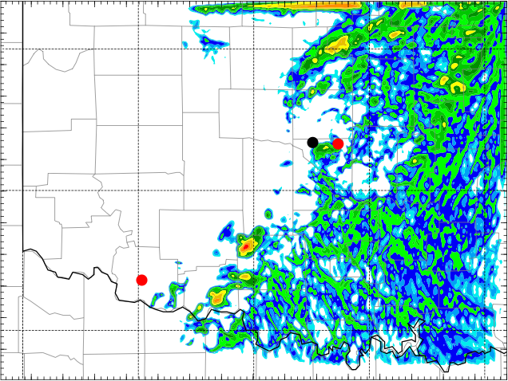
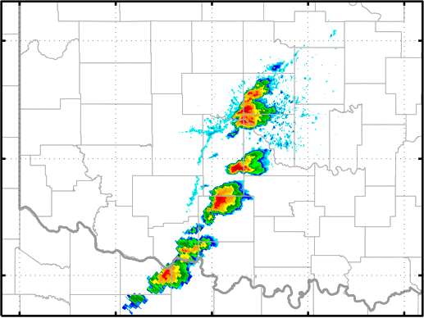
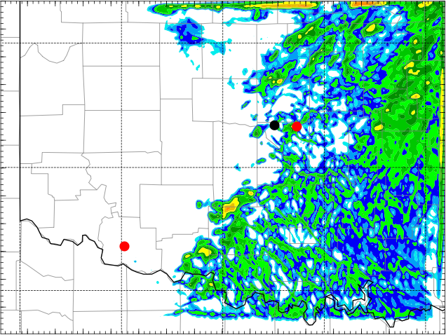
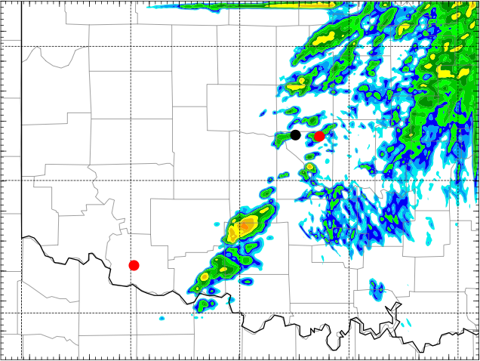
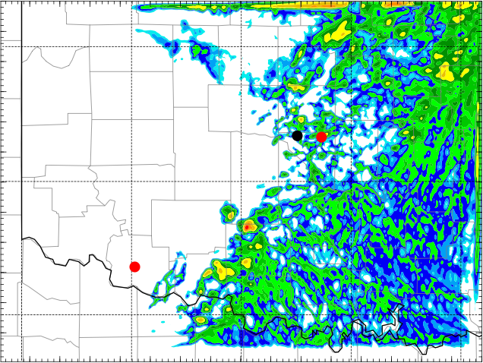
Experiment Results Comparison
KTLX
CNTL
5min
Err2
1900
1915
1930

Slide 10
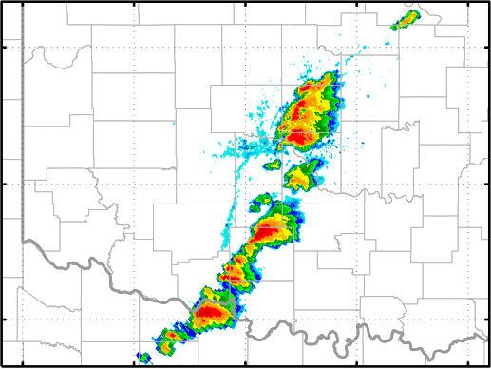
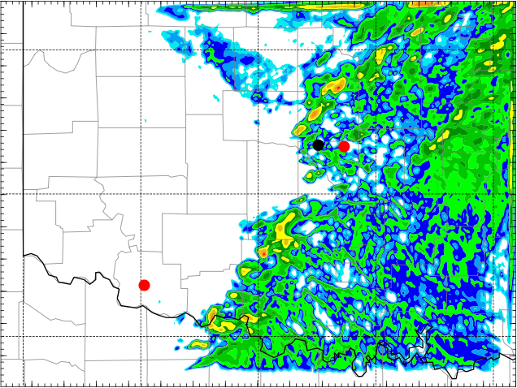
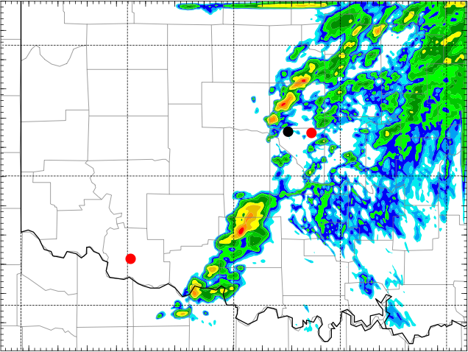
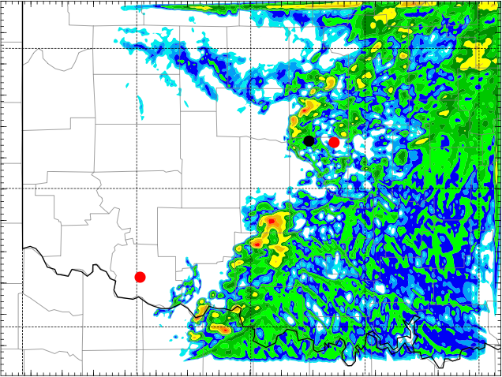
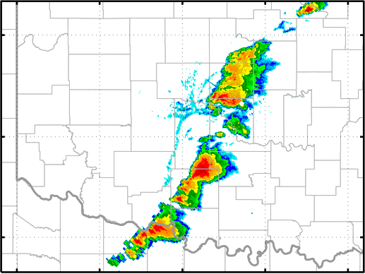
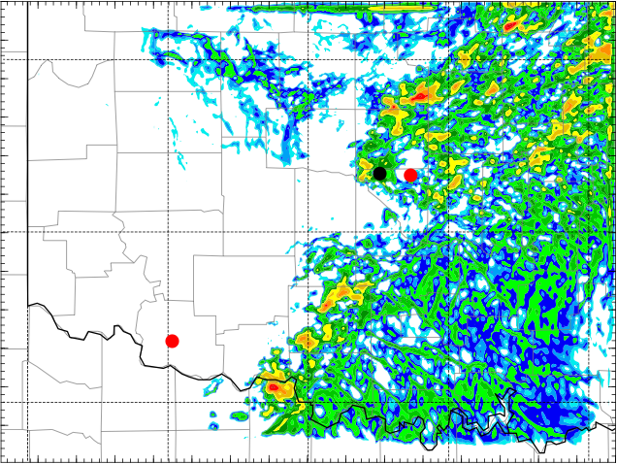
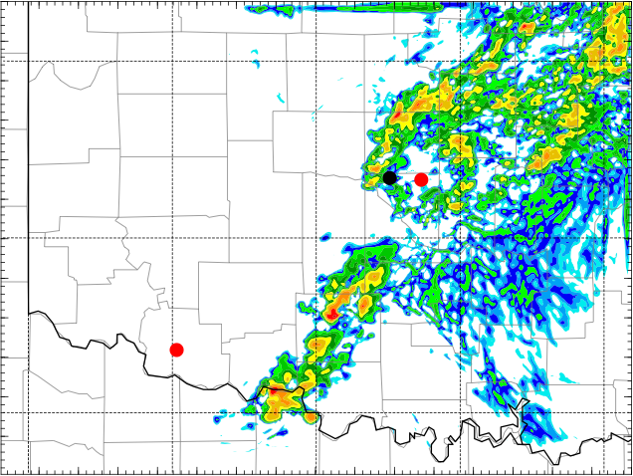
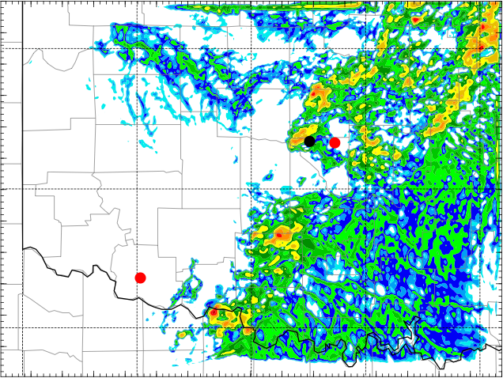
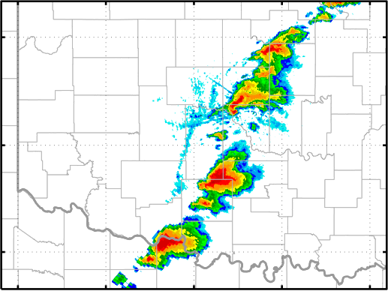
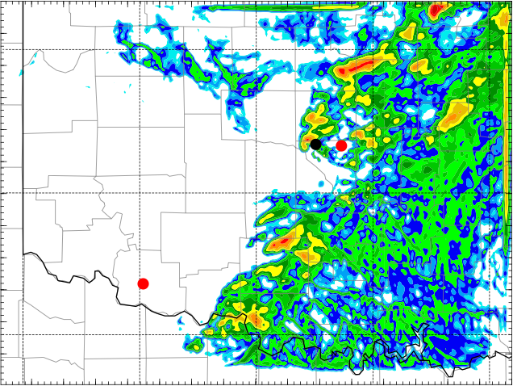
1945
KTLX
CNTL
5min
Err2
2000
2015
2030

