Slide 1
Tornado Cases of Late May 2013
Yunji Zhang
07/19/13

Slide 2
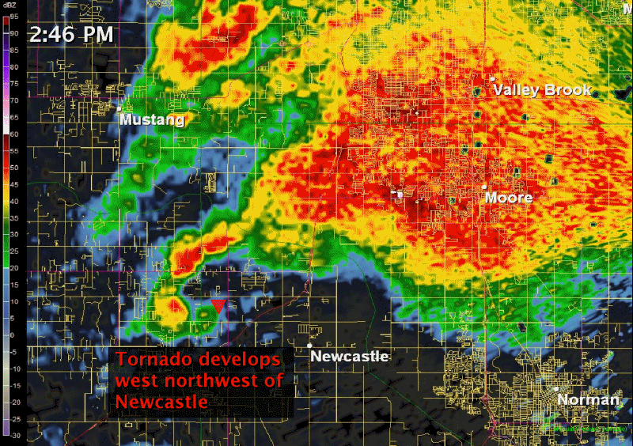
May 20, Moore, OK
(NWS Norman)

Slide 3
May 20, Moore, OK
(NASA)

Slide 4
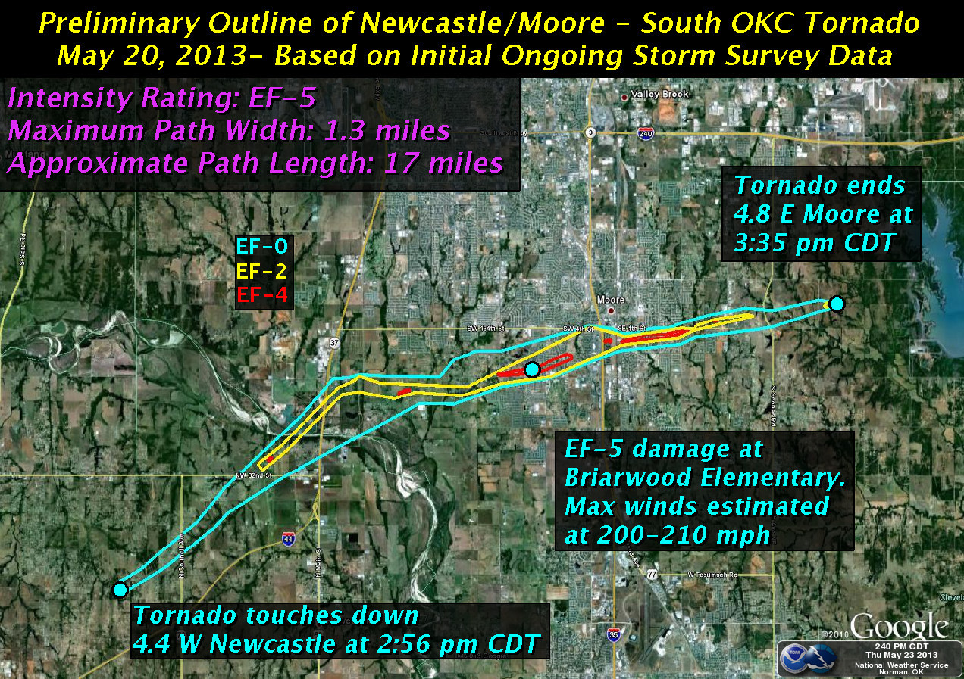
May 20, Moore, OK
(NWS Norman)

Slide 5
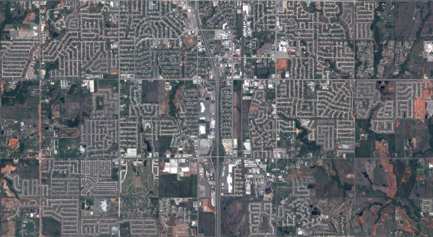
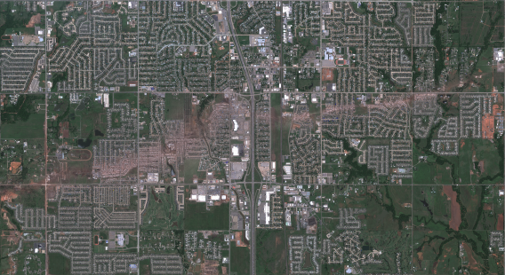
May 20, Moore, OK
23 killed, 377 injured
$2 billion, 3rd costliest
(Google Crisis Map)

Slide 6
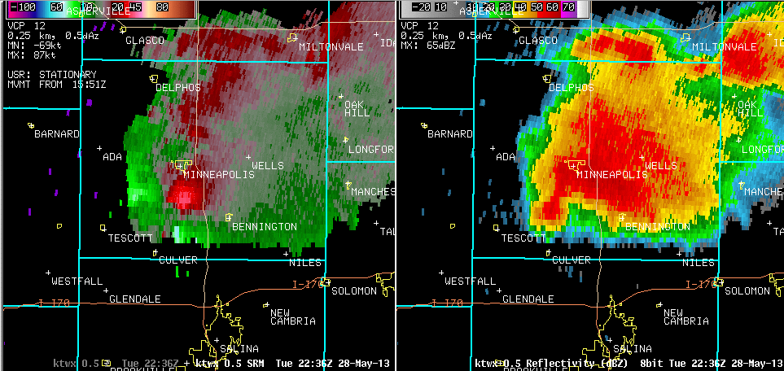
May 28, Bennington, KS
(NWS Topeka)

Slide 7
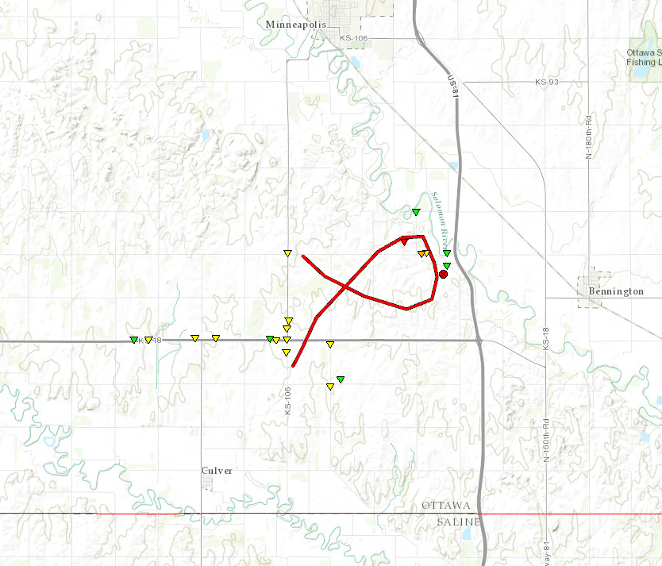
May 28, Bennington, KS
EF4, peak 180mph
Slow-moving (7.7mph)
No fatalities, no severe injuries
Within 200km of 3 radars:
KTXW (Topeka, KS)
KICT(Wichita, KS)
KUEX(Hastings, NE)
Touches down 5:39 pm CDT
Path length: 8.5 miles
Ends 6:45 pm CDT
(NWS Topeka)

Slide 8
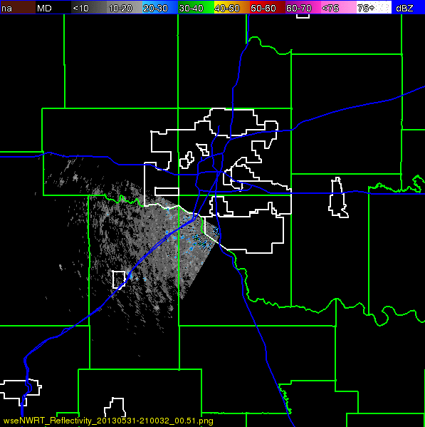
May 31, El Reno, OK
RaxPol, OU

Slide 9
May 31, El Reno, OK
(NWS Norman)

Slide 10
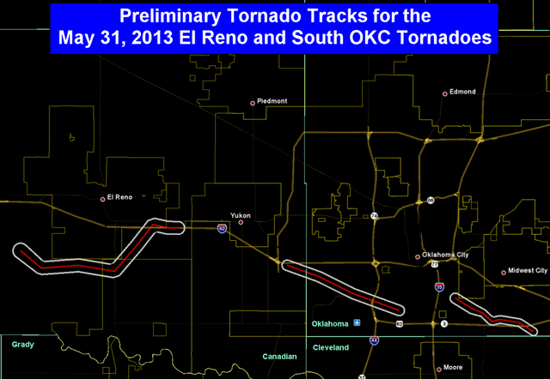
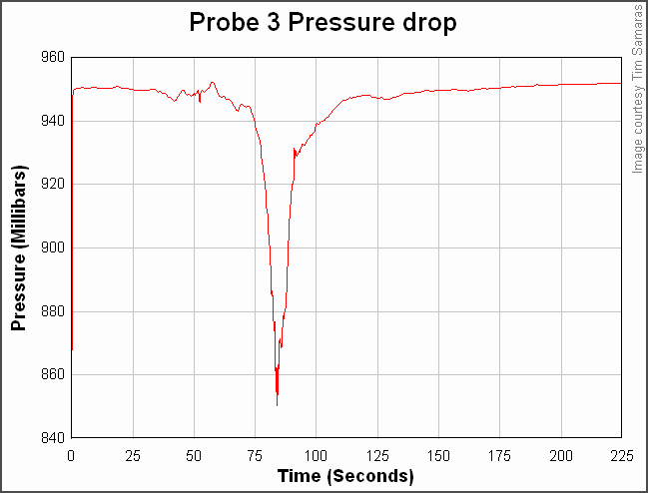
May 31, El Reno, OK
Largest and 2nd strongest ever recorded in US
9 killed, 115 injured
Storm chasers Tim Samaras, Paul Samaras, Carl Young
06/24/03 Manchester SD tornado
Storm chasers escaping
(NWS Norman)
(NWS Sioux Falls)

