Slide 1
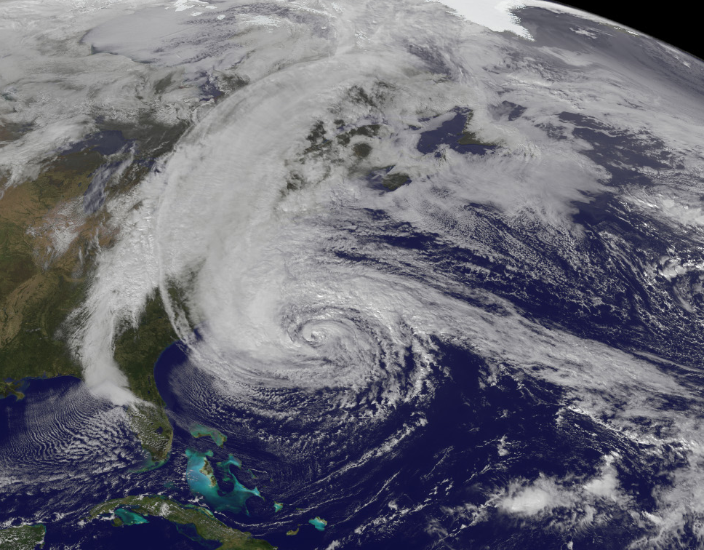
Dynamical Analysis of the PSU WRF/EnKF Real-Time Ensemble Simulation of Hurricane Sandy
Erin Munsell
Group Meeting
July 19th, 2013
http://earthobservatory.nasa.gov/NaturalHazards/view.php?id=79553

Slide 2

Tracks and Intensities of Sandy’s 60 Ensemble Members

Slide 3
Tracks and Intensities of Sandy’s 50 ECMWF Ensemble Members

Slide 4
Tracks and Intensities of Sandy’s 20 NCEP Ensemble Members

Slide 5

Composite Analysis: Mean Tracks
Forecast Hour 24: 10/27/12 at 00Z
Forecast Hour 48:
10/28/12 at 00Z
Good Separates
Black: Best Track
Blue: 10 Best Members (Good)
Red: 10 Worst Members (Bad)
Bad Separates
Magenta: 10 Members that were furthest off the coast but still made landfall (Fair)

Slide 6
Forecast Hour 0: 10/26/12 – 00Z
dBZ, 500 mb Geopotential Height and Surface Winds differences
Top Left: Good – Bad
Bottom Left: Good – Fair
Bottom Right: Fair – Bad

Slide 7
Forecast Hour 24: 10/27/12 – 00Z
dBZ, 500 mb Geopotential Height and Surface Winds differences
Top Left: Good – Bad
Bottom Left: Good – Fair
Bottom Right: Fair – Bad

Slide 8
Differences in Environmental Steering Flow – Zonal
Black – ECMWF, Gray – NCEP, Blue – Good, Magenta – Fair, Red – Bad
Forecast Hour 12
Forecast Hour 18
Forecast Hour 24

Slide 9
Forecast Hour 48: 10/28/12 – 00Z
dBZ, 500 mb Geopotential Height and Surface Winds differences
Top Left: Good – Bad
Bottom Left: Good – Fair
Bottom Right: Fair – Bad

Slide 10
Differences in Environmental Steering Flow – Meridional
Black – ECMWF, Gray – NCEP, Blue – Good, Magenta – Fair, Red – Bad
Forecast Hour 36
Forecast Hour 42
Forecast Hour 48

Slide 11
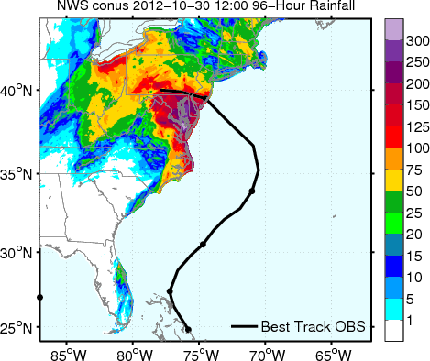
Composite Cumulative Rainfall between 10/26/12 at 00Z – 10/31/12 at 06Z
Domain 2 – Mask over Ocean
Top Left: Good
Bottom Left: Fair
Bottom Right: Bad

Slide 12
Composite Cumulative Rainfall between 10/26/12 at 00Z – 10/31/12 at 06Z
Domain 1 – No Mask
Top Left: Good
Bottom Left: Fair
Bottom Right: Bad

Slide 13
Evolution of Total Rainfall Across Domain 1
} 5% Difference in Total Rainfall

Slide 14
Summary of Results
Deterministic track of Sandy very comparable with the best track; Spread of the members is very dependent on the forward motion of Sandy; Landfall location is sensitive to the timing of the mid-latitude front and tropical cyclone interaction
Operational forecast tracks consistent with PSU ensemble (ECMWF and Good/Fair members, NCEP and Bad members); Divergence also due to steering flow differences
Rainfall forecasts compare vary favorably with observations; Differences that arise can be contributed to differences in track
Total accumulated rainfall is similar for each member; Interaction between Sandy and mid-latitude front may not have further amplified rainfall totals

Slide 15
Sensitivity Run:
Tracks and Intensities of Member 46, 13 and 34

Slide 16
Forecast Hour 0: 10/26/12 at 00Z
500 mb Geoptential Height, dBZ, and Surface Winds
Good Fair Bad

Slide 17
Forecast Hour 24: 10/27/12 at 00Z
500 mb Geoptential Height, dBZ, and Surface Winds
Good Fair Bad

Slide 18
Forecast Hour 48: 10/28/12 at 00Z
500 mb Geoptential Height, dBZ, and Surface Winds
Good Fair Bad

Slide 19
Forecast Hour 96: 10/30/12 at 00Z
500 mb Geoptential Height, dBZ, and Surface Winds
Good Fair Bad

Slide 20
Total Accumulated Rainfall
10/26/12 at 00Z – 10/31/12 at 06Z
Good Fair Bad

Slide 21
Future Work
Further explore the dynamics associated with the tropical cyclone and mid-latitude front interaction; How does the front evolve as Sandy approaches
More sensitivity runs
  Composite initial conditions of three intensity groups
  Swap portions of the domain or certain fields

