Slide 1
Data Assimilation of an MJO Event: My First Step
Michael Ying

Slide 2
Purpose
Study the predictability of MJO
Master the various DA methods
Start with coarse resolution runs as practice

Slide 3
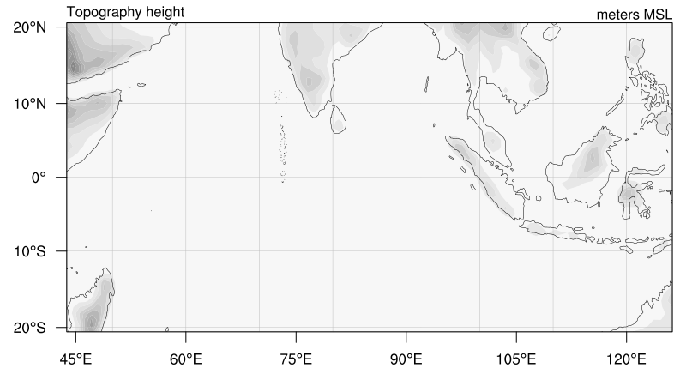
Domain setup (for practice)
81 km grid spacing (100*50), 35 levels
cu_physics: Betts-Miller-Janic
MJO event: 2011 Oct 14 to 27 (initiation)
Assimilate soundings (gts+UPAQF) every 6 hours
Really bad model setup
for MJO simulation!

Slide 4
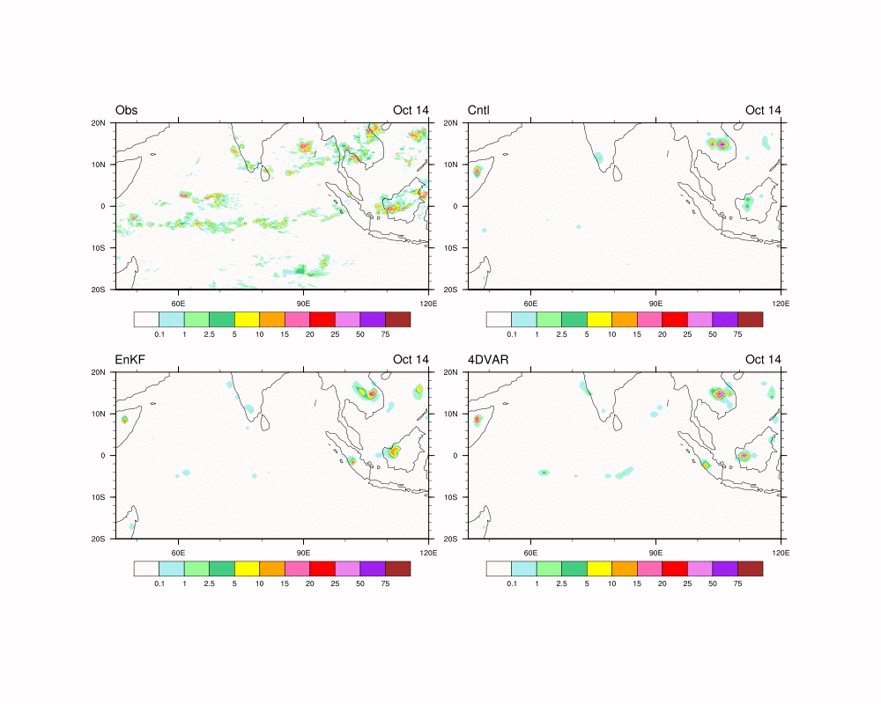
Results from EnKF and 4DVAR

Slide 5
Domain averaged rain rate
obs
4dvar
enkf
cntl
obs: 8 km, simulation: 81 km grid points

Slide 6
What to do next:
Play with E4DVAR and Multi-incremental 4DVAR, read the code
Define “MJO event”
Start higher resolution runs

