Slide 1
Diurnal radiation cycle impact on the genesis of Hurricane Karl (2010)…Revisited
Christopher Melhauser
The Pennsylvania State University
Department of Meteorology
Group Meeting
July 19, 2013
Notes:
Focusing on how radiation impacts tropical cyclogenesis
- Using Hurricane Karl (2010) as case study

Slide 2
Focus
How does the diurnal radiation cycle impact the
development of Hurricane Karl (2010)?

Slide 3
Rehash
Studies focusing on radiation impacts on mesoscale convective system (MCS) evolution in the tropics
  Dudhia (1989) and Miller and Frank (1993)
    Radiation modulates tropical mesoscale convective system development through large-scale cooling and destabilization of the environment
  Tao et al. (1996)
    Examined:
      Cloud-top radiative cooling and cloud-base radiative warming
      Differential clear and cloudy air radiative heating and cooling (Gray and Jacobson, 1977)
      Large-scale radiative cooling of environment
    Large-scale environmental cooling is the most important mechanism → increases relative humidity of environments
Our study corroborates this finding. Large scale environmental cooling dominant mechanism.
Notes:
Dudhia (1989)
Simulate diurnally occurring convection over South China Sea (using MM5; only 2D)
Focused on stratiform cloud deck
Developed and used shortwave/longwave radiation scheme
Radiative forcing was the main forcing that enabled high level ascent in cirrus decks/cloud anvils
Previous studies (found convective activity largely controlled by the cooling rate → stronger radiative cooling permits stronger convection.
Shortwave radiation reduces the longwave cooling, modulating the net cooling and convective activity.
Miller and Frank (1993)
- Peak in precipitation at night; regardless of initialization time
- More rainfall produced when radiation included; peak rainfalls at night larger than rainfalls during the day

Slide 4
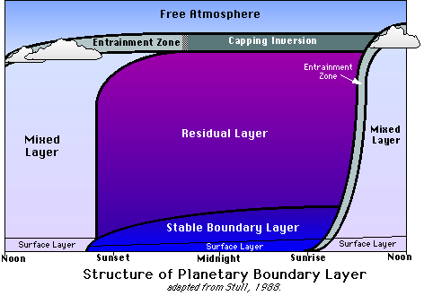
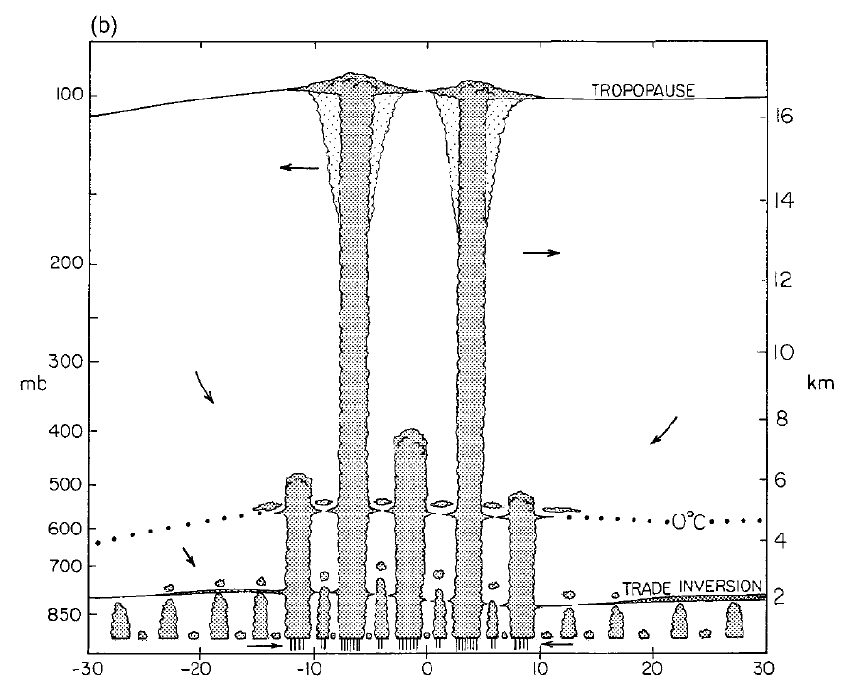
Rehash
Common stable layers and clouds in the tropical atmosphere
Our study, increased stability is top of PBL
Pressure [mb]
Height [km]
Top of PBL
Latitude
Johnson et al. (1999); Figure 13b
Notes:
Johnson et al. (1999):
Tropical Ocean Global Atmosphere Coupled Ocean–Atmosphere Response Experiment
Before → belief bimodal distribution; After → trimodal distribution
Shallower clouds precondition the atmosphere for deep moist convection
Mid and deep clouds produce mid-level cloud layers modifying the radiation budget

Slide 5
Rehash
Relative humidity gradients and differential longwave radiative heating and cooling
  Mapes and Zuidema (1996)
    Relative humidity gradient at base of dry layer causes differential radiative heating and cooling at interface → stabilization of the associated dry layer base
  Pakula and Stephens (2008)
    Relative humidity gradients at the trade inversion and melting layer cause additional stabilization
This mechanism may be contributing, but not first order effect.
  Boundary layer cloud shortwave warming and cloud top cooling dominant mechanism for modifying PBL stable layer.
LW
Up
Dry Layer
Stabilization
LW
Moist Layer
Notes:
Mapes and Zuidema (1996)
- Studied dry layers in the tropics (warm pool in the western Pacific; data from TOGA COARE field experiment)
- Focused on dry layers
- Dry layers at 925mb, 850mb, and 550mb and sit atop sharp stable layers (inversions)
Pakula and Stephens (2008)
- Radiative convective equilibrium study of cloud distributions in the tropics
- Corroborated the findings of Mapes and Zuidema (1996); convectively active regions: no RH gradient; convectively suppressed regions: sharp RH gradients at stable layers.

Slide 6
Sensitivity Experiments
Sensitivity experiments:
  CNTL
    No modification
  Day Only
    Shortwave set to local noon
  Night Only
    No shortwave
  No Radiation
  Offset
    Shortwave offset 12 hours
0-96h average center track
0-108 h 10-m max wind speed
D03
Notes:
Initial ensemble:
17 developed
13 non-developed (not shown)
What develops?
Developed Members 16 & 39:
i. Night Only: stronger
ii. Day Only: no development
iii. No Radiation: no development
iv. Offset: similar to Control
Non-developed Members 11 & 37 (not shown):
i. None develop
Storm intensity → maximum 10-m wind speed within 225 km of the vortex center
Tropical storm: Saffir-Simpson scale: (34 knots → 18 m/s)

Slide 7
Member 16 Development
Focus on first 24 hours
  → Day Only:
    Dry air aloft
    Lack of deep moist convection
    Lack of mid-level to upper-level relative vorticity
Notes:
Focusing on Member 16

Slide 8
700 hPa Relative Humidity
0-25 h average center track
CNTL – 1800UTC 09/12
Night Only – 1800UTC 09/12
Day Only – 1800UTC 09/12
Moving
Day Only more southern track

Slide 9
0-16 km Vertical Profiles
Higher average tropospheric relative humidity
  → More conducive for convective development (Tao et al. 1996)
Clear Sky Environment
Clear Sky Radiation
16
14
12
10
8
Height [km]
6
4
2
0
300
330
360
60
80
0
10
20
-5
0
5
1
2
3
4
-5
0
5
Potential Temperature [K]
Relative Humidity
[%]
Water
Vapor
[g kg⁻¹]
Net Radiative Heating
[K day⁻¹]
SW Radiative Heating
[K day⁻¹]
LW Radiative Heating
[K day⁻¹]

Slide 10
0-2 km Vertical Profiles
Theta-E gradient above top of PBL
  Day Only → much more moisture in BL
  Entrainment layer
  Increased cap for first 24 hours
Clear Sky Environment
Clear Sky Vertical Gradients
2000
1800
1600
1400
1200
Height [m]
1000
800
600
400
200
0
290
320
340
350
80
0
5
10
-10
0
5
10
-50
0
50
305
360
90
-5
-20
0
70
10
15
20
Potential Temperature [K]
Equivalent Potential Temperature [K]
Relative Humidity
[%]
Water
Vapor
[g kg⁻¹]
dTheta/dZ
[K km⁻¹]
dThetaE/dZ
[K km⁻¹]
dT/dZ
[K km⁻¹]
dRH/dZ
[K km⁻¹]

Slide 11
Instability
Maximum Convective
Available Potential Energy
(first 24 h of simulation)
Maximum Convective Inhibition
(first 24 h of simulation)
MCAPE [J kg⁻¹]
MCIN [J kg⁻¹]
Forecast Time [h]
Forecast Time [h]
Night Only:
  Increased large scale clear-air radiative cooling
  → increased convective activity
  → depletes instability
Day Only:
  Additional shortwave heating
  → Increased environmental potential temperature
  → Increases convective inhibition

Slide 12
KEY:
LONGWAVE
SHORTWAVE
* length of arrow indicates magnitude
DayOnly
Net environmental warming
Net decrease in relative humidity throughout the troposphere
Net environmental stabilization
Enhanced initial convective inhibition
NightOnly
Net environmental cooling
Net increase in relative humidity throughout the troposphere
Net environmental destabilization
Notes:
FULL DIURNAL CYCLE
- Net increase in relative humidity
- Net low-level destabilization
- Neutral mid-level stability
- Melting layer stabilization

Slide 13
Conclusions
  Radiation modifies the development environment impacting development potential
  The night phase of the diurnal radiation cycle is critical in development
    Allows large scale destabilization → enhanced convection
How does the diurnal radiation cycle impact the development of Hurricane Karl (2010)?

Slide 14
Acknowledgements
Dr. Yonghui Weng
  Performing the real-time ensemble data assimilation and forecasts
Dr. Xiaqiong Zhou:
  Initiating preliminary analysis of the diurnal cycle and sensitivity
Research Partially Supported by:
  ONR (Grant N000140910526)
  NOAA (HFIP)
  NASA (NNX12AJ79G)
  NSF (Grant 0840651)
Texas Advanced Computing Center (TACC):
  Computing resources for sensitivity experiments

Slide 15
References
Hack, J. J., 1980: The role of convective-scale processes in tropical cyclone development. PhD thesis, Colorado State University.
Davis, C. A. and D. A. Ahijevych, 2012: Mesoscale structural evolution of three tropical weather systems observed during PREDICT. J. Atmos. Sci., 69, 1284-1305.
Dudhia, J., 1989: Numerical Study of Convection Observed during the Winter Monsoon Experiment Using a Mesoscale Two-Dimensional Model. J. Atmos. Sci., 46, 3077–3107.
Hack, J. J., 1980: The role of convective-scale processes in tropical cyclone development. PhD thesis, Colorado State University.
Johnson, R., T. Rickenbach, S. Rudledge, P. Ciesielske, and W. Schubert, 1999: Trimodal characteristics of tropical convection. J. Climate, 12, 2397-2418.
Mapes, B., and P. Zuidema, 1996: Radiative-dynamical consequences of dry tongues in the tropical atmosphere. J. Atmos. Sci., 53, 620-638.
Miller, R. A., and W. M. Frank, 1993: Radiative Forcing of Simulated Tropical Cloud Clusters. Mon. Wea. Rev., 121, 482–498.
Pakula, L., and G. L. Stephens, 2009: The Role of Radiation in Influencing Tropical Cloud Distributions in a Radiative-Convective Equilibrium Cloud-Resolving Model. J. Atmos. Sci., 66, 62-76.
Sundqvist, H. 1970: Numerical simulation of the development of tropical cyclones with a ten-level model. Part II., Tellus, 22, 504-510.
Tao W.-K, S. Lang, J. Simpson, C.-H. Sui, B. Ferrier and M.-D. Chou, 1996: Mechanisms of Cloud-Radiation Interaction in the Tropics and Midlatitudes. J. Atmos. Sci., 53, 2624-2651.

Slide 16
Extra slides
Diurnal radiation cycle impact on the genesis of
Hurricane Karl (2010)

Slide 17
Background
Radiation impacts on idealized tropical cyclone development:
  Sundqvist (1970)
    Rate of intensification increased with inclusion of longwave radiative cooling outside core (> 200 km from center); final intensity unaffected
  Hack (1980)
    Earlier intensification and increased intensity with inclusion of shortwave and longwave radiation
  Craig (1996)
    Increased intensification rate and intensity with the inclusion of radiative heating and cooling
Notes:
Sundqvist (1970): (Hilding Sundqvist; Sweden)
Studied various physical processes impact on TC (shifting vortex center further north, sea surface temperature)
Convection parameterized
Axisymmetric 10-level primitive equation model
Haik (1980): PhD Dissertation 1980
- Note: shortwave diurnal cycle not included; only daily shortwave average. Convective and non-convective profiles of LW/SW used in lookup table.
- Focus on interaction of cumulus clouds and large scale characteristics elading to TC
- First to apply convective parameterization of Arakawa and Shubert (1974) to TC development
Craig et al. (1996):
- Axi-symmetric model with explicit convection and detailed microphysics/radiation
- Differential cooling between warm core and cooler environment outside the core.
- Need simulations with heterogeneous environment
All idealized started without cloud; need a long spin-up until a cloud-field becomes well established.
Adjustment process important. Water vapor concentration key to role of radiative cooling.

Slide 18
Background
Strong diurnal oscillations found in Karl’s deep moist convection (Davis and Ahijevych 2012)
Adapted from: Davis and Ahijevych (2012) Figure 3b
Notes:
Steranka et al. (1984):
- Observational study of GEOS satellite imagery
- Found significant diurnal and semidiurnal cloud cycles analyzing observations of satellite derived cloud top temperatures.
Kossin et al. (2002):
- Confirmed the diurnal oscillations
- Hypothesized that radiative cooling induced subsidence at night in the region of the hurricane canopy reduces the spatial coverage of high cirrus clouds producing the observed reduction in cloud top temperatures

Slide 19
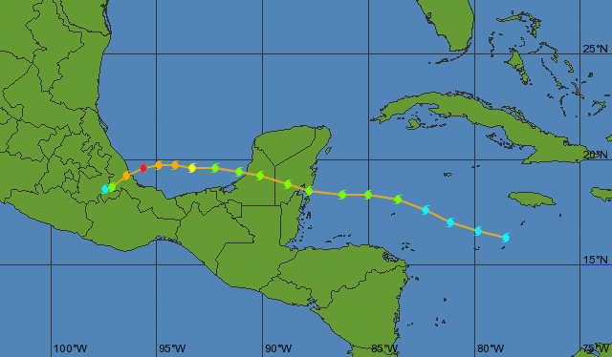
Background
Hurricane Karl (2010)
  September 14-18, 2010
  Observed during PREDICT
Formed 09/14 1800 UTC
Source: Weather Underground
Notes:
Hurricane Karl (2010)
Predecessor was a broad cyclonic circulation north of South America (Sept 8th) and moved westward into the Caribbean by 12 September.
System had periodic convection.
Convection became steadier by September 13th;
TD declared on 1800 UTC 14 September.
PREDICT: Pre-Depression Investigation of Cloud-systems in the Tropics field experiment
Obtain extensive pre-genesis environmental measurements of forming tropical cyclones

Slide 20
Model Setup
WRF-ARW v3.1.1
  Domains
    D01: 40.5 km, D02: 13.5 km, D03: 4.5 km
  Radiation
    Shortwave: Dudhia shortwave radiation scheme (Dudhia (1989))
    Longwave: Rapid radiation transfer model (RRTM)
Model initialization
  September 12th, 2010 at 0000 UTC
Member 16
Member 39
NHC Best Track
Dev. Members
Notes:
D01 not shown. Covers the Atlantic Basin (~110ºW to 10ºW and 5ºS to 50ºN). More information: Zhang et al. 2009; Montgomery et al. 2012
Vortex Center → Average of 850- and 500-hPa vorticity centers (filtered < 300 km wavelengths w/ FFT)

Slide 21
Model Setup
Initial Conditions
  PSU-WRF-EnKF cycling Ensemble Kalman Filter (EnKF) data assimilation system
  30 member ensemble
Boundary Conditions
  GFS deterministic forecast
Member 16
Member 39
NHC Best Track
Dev. Members
Notes:
All observations used by NCEP, excluding satellite radiances

Slide 22
Sensitivity Experiments
Performed for 4 members of ensemble (2 developing, 2 non-developing)
  Control (C)
    No modification
  Day Only (D)
    SW set @ local noon
  Night Only (N)
    No SW
  No Radiation (NR)
    No SW or LW
  Offset (O)
    SW offset 12 hours
Day Only
Initial SI
Offset
Initial SI
Night Only
Initial SI
Control
Initial SI
Solar Insolation (SI)
0500
UTC
(Local
Midnight)
1700
UTC
(Local
Noon)
0000
UTC
(Local
1900)
Time
(Local
Time)
1200
UTC
(Local
0700)

Slide 23
Clouds and Stable Layers
Common stable layers in tropical atmosphere (Johnson et al. (1999))
  Trade inversion
  Melting layer
  Tropopause
Pressure [mb]
Stable layers can prevent deep moist convection
Focus on first day of simulation
  September 12 0000 UTC → September 13 0000 UTC
Height [km]
Latitude
Johnson et al. (1999); Figure 13b
Notes:
How does radiation/deep moist convection effect these layers?

Slide 24
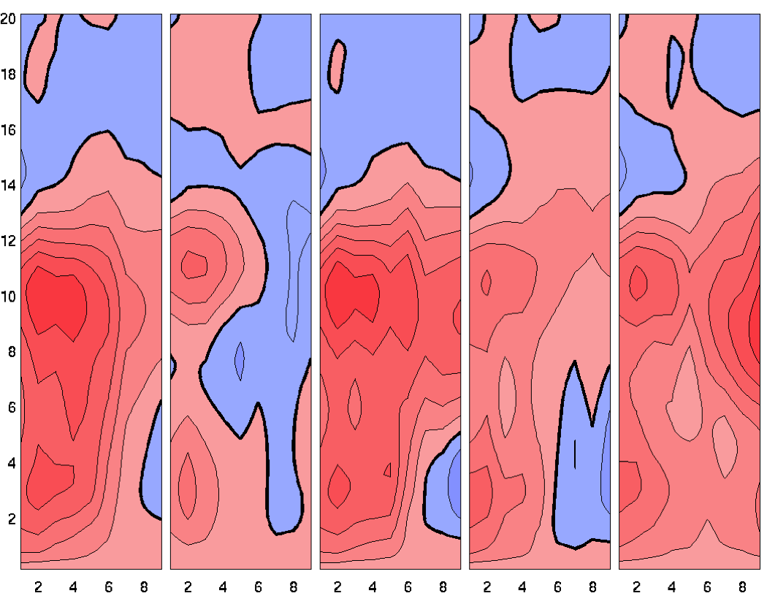
Mass Flux

Slide 25
CNTL
NightOnly
DayOnly
Offset
NoRad
Higher tropospheric relative humidity → more conducive for convective development (Tao et al. 1996)
Day Only and Offset
  →Enhanced RH gradient
  Increased stability at trade inversion
Control and Night Only
  Detrainment at melting layer
  Enhanced RH gradient and stability
12/1500 to 12/2100
Height [km]
12/0000 to 13/0000
Height [km]
Relative Humidity [%]
Environmental Lapse Rate [ºC km⁻¹]
Notes:
Focus: first day of integration
Relative humidity (RH) gradients can stabilize layers (Mapes and Zuidem (1996); Pakula and Stephens (2009))

Slide 26
Trade inversion
  Day Only: shortwave warming
  Day Only/Offset: enhanced longwave warming
Melting Layer:
  Control: minimal shortwave warming
  Control/Night Only: enhanced longwave warming
Overall:
  Night Only: environmental cooling
  Day Only: net environmental warming
(a)
(b)
(c)
12/1500 to 12/2100
Height [km]
(e)
(f)
(g)
CNTL
NightOnly
DayOnly
Offset
NoRad
12/0000 to 13/0000
Height [km]
Net Radiative Heating [K day⁻¹]
LW Radiative Heating [K day⁻¹]
SW Radiative Heating [K day⁻¹]

Slide 27
DayOnly
NightOnly
CNTL
NightOnly
DayOnly
CNTL
Tropopause
Melting
Layer
NET RADIATION TENDENCY
PBL
Stable
Layer
-
+

