Slide 1
Tracking Mesoscale Gravity Waves in Moist Baroclinic Waves
Reported By JW
Group Meeting 07/19/2013

Slide 2
Outline
Overview of the identified mesoscale gravity waves
Overview of the preliminary result of gravity wave tracking
The tracking of WP3

Slide 3
Outline
Overview of the identified mesoscale gravity waves

Slide 4
Overview of Identified Mesoscale Gravity Waves
(a) EXP00132h
Figure. Simulated 1-km temperature (yellow lines), 8-km horizontal wind (black lines), and 12-km horizontal divergence (blue lines, positive; red lines, negative) in (a) EXP00 at 132 h, (b) EXP20 at 132 h. The turquoise lines denote the 7-km dynamic tropopause where potential vorticity equals 1.5 PVU.

Slide 5
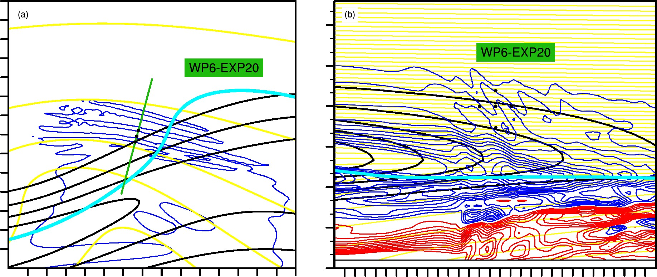
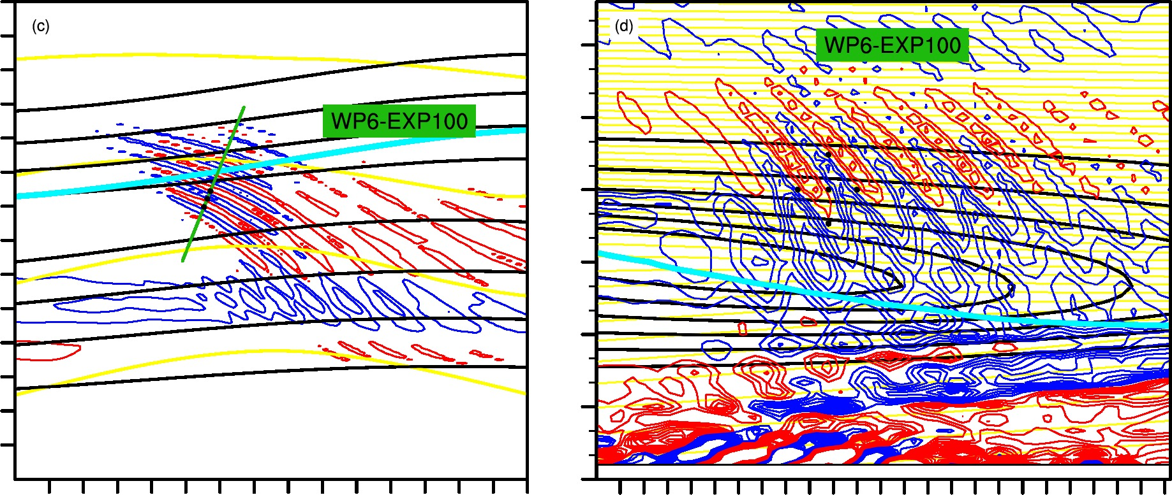
Overview of Identified Mesoscale Gravity Waves
Figure. The Horizontal View and Vertical Cross Section of WP6 in EXP20 and EXP100.

Slide 6
Overview of Identified Mesoscale Gravity Waves
Summary for This Part
1) List of Wave Packet (WP) in EXP00:
WP1-EXP00, WP2-EXP00, WP3-EXP00, WP4-EXP00, WP5s-EXP00, WP5n-EXP00
2) List of WP in EXP20:
WP1-EXP20, WP2-EXP20, WP3a-EXP20, WP3b-EXP20, WP4-EXP20, WP5s-EXP20, WP5n-EXP20, WP6-EXP20
3) List of WP in EXP100:
WP6-EXP100, and more
4) All the above-mentioned WP are tested in a gravity wave tracing model

Slide 7
Outline
Overview of the identified mesoscale gravity waves
Overview of the preliminary result of gravity wave tracking

Slide 8
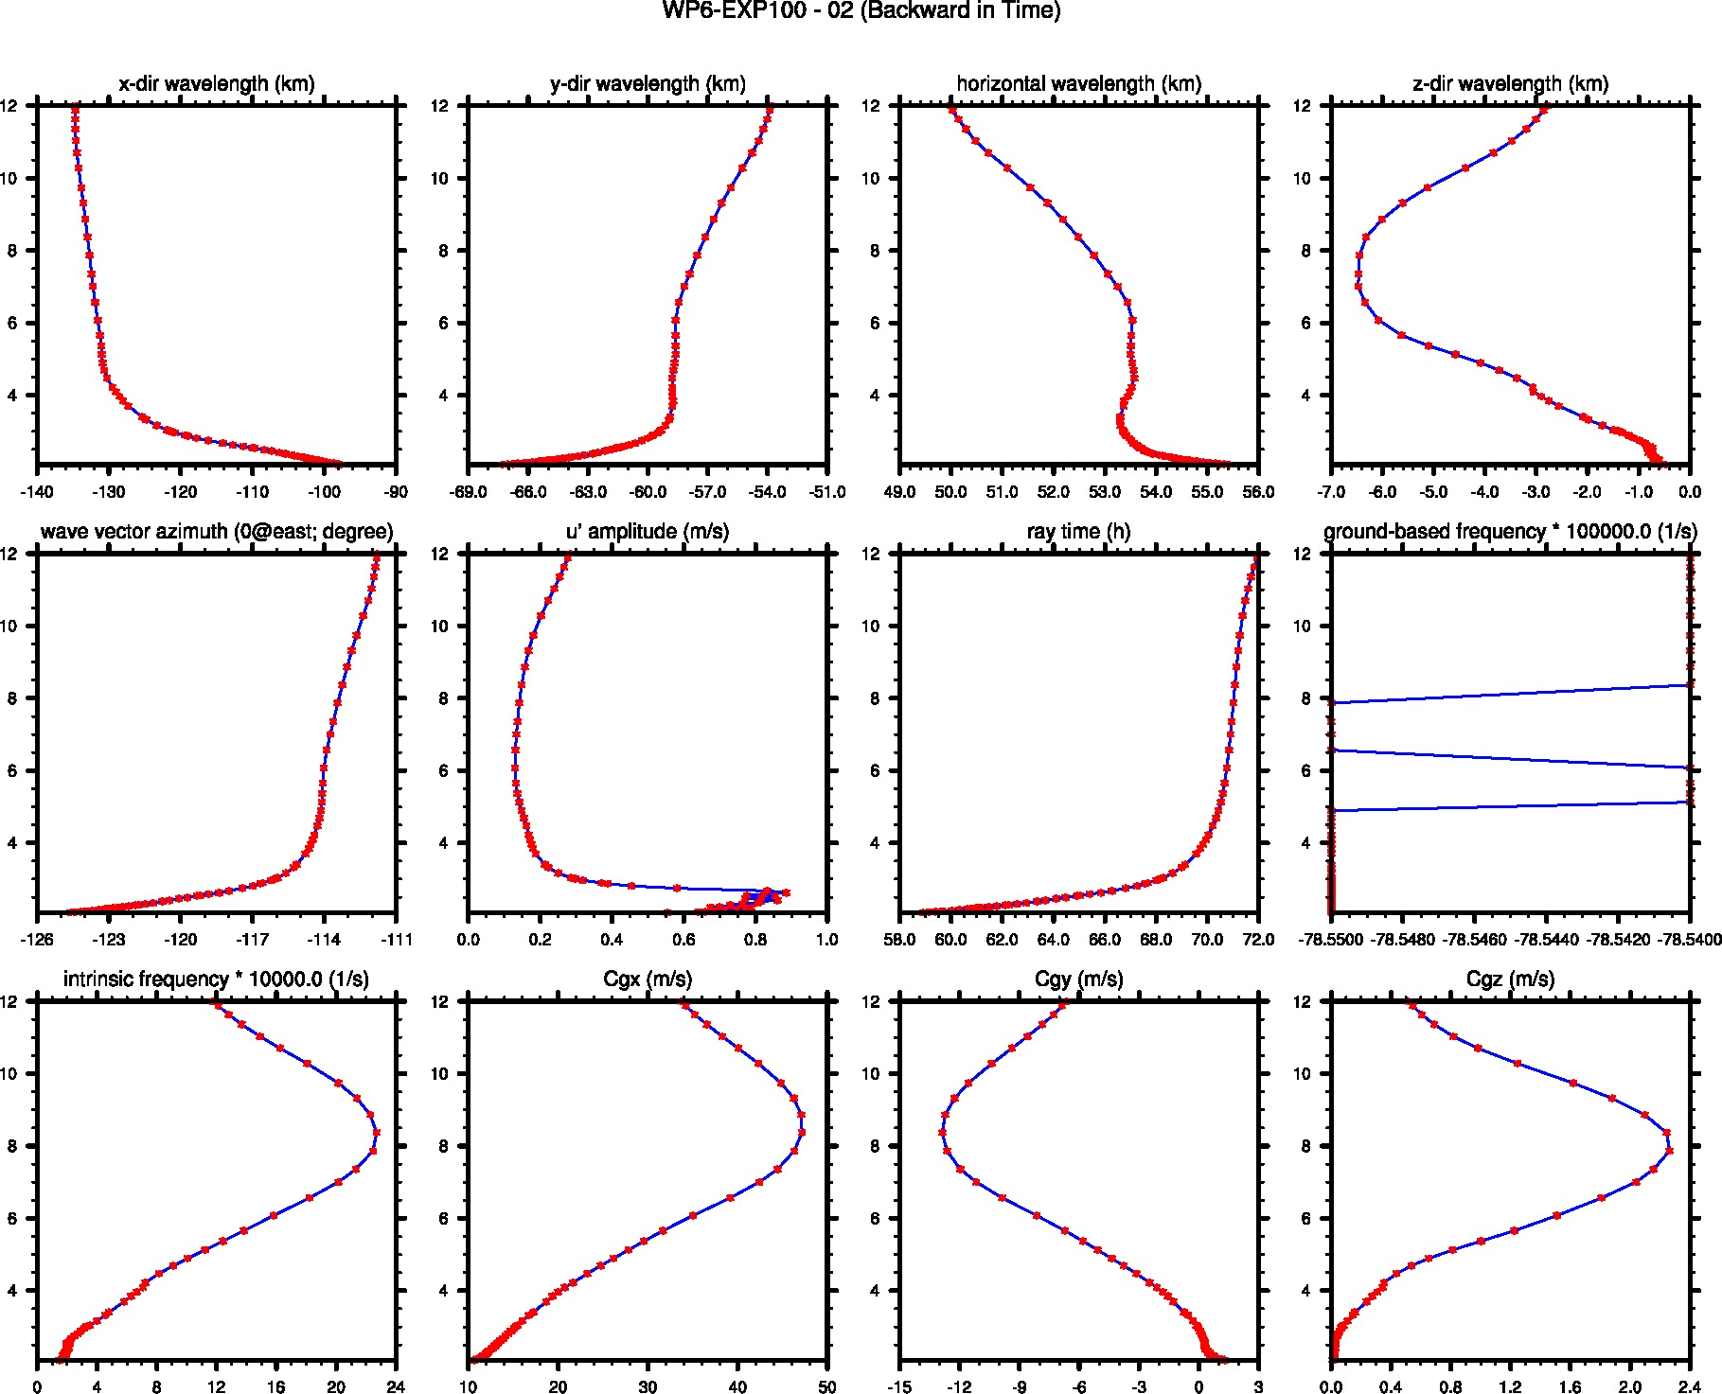
Overview of Gravity Wave Tracking

Slide 9
Overview of Gravity Wave Tracking – Initial Condition of Wave Parameters
Location (x,y,z); dt, t_0

Slide 10
Overview of Gravity Wave Tracking – Parameters that will be compared with WRF

Slide 11
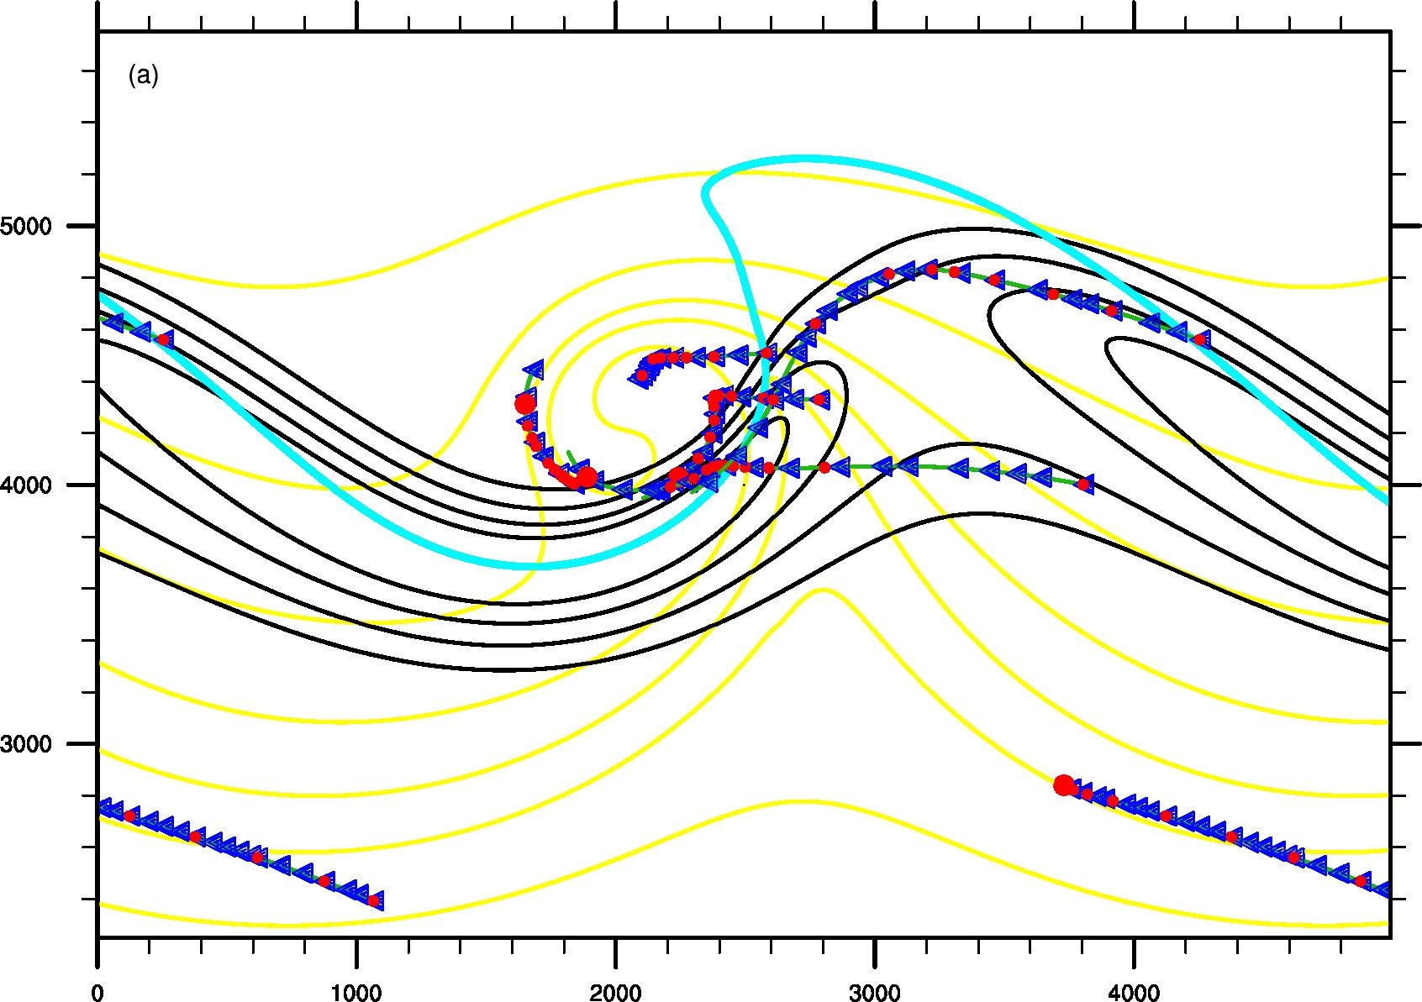
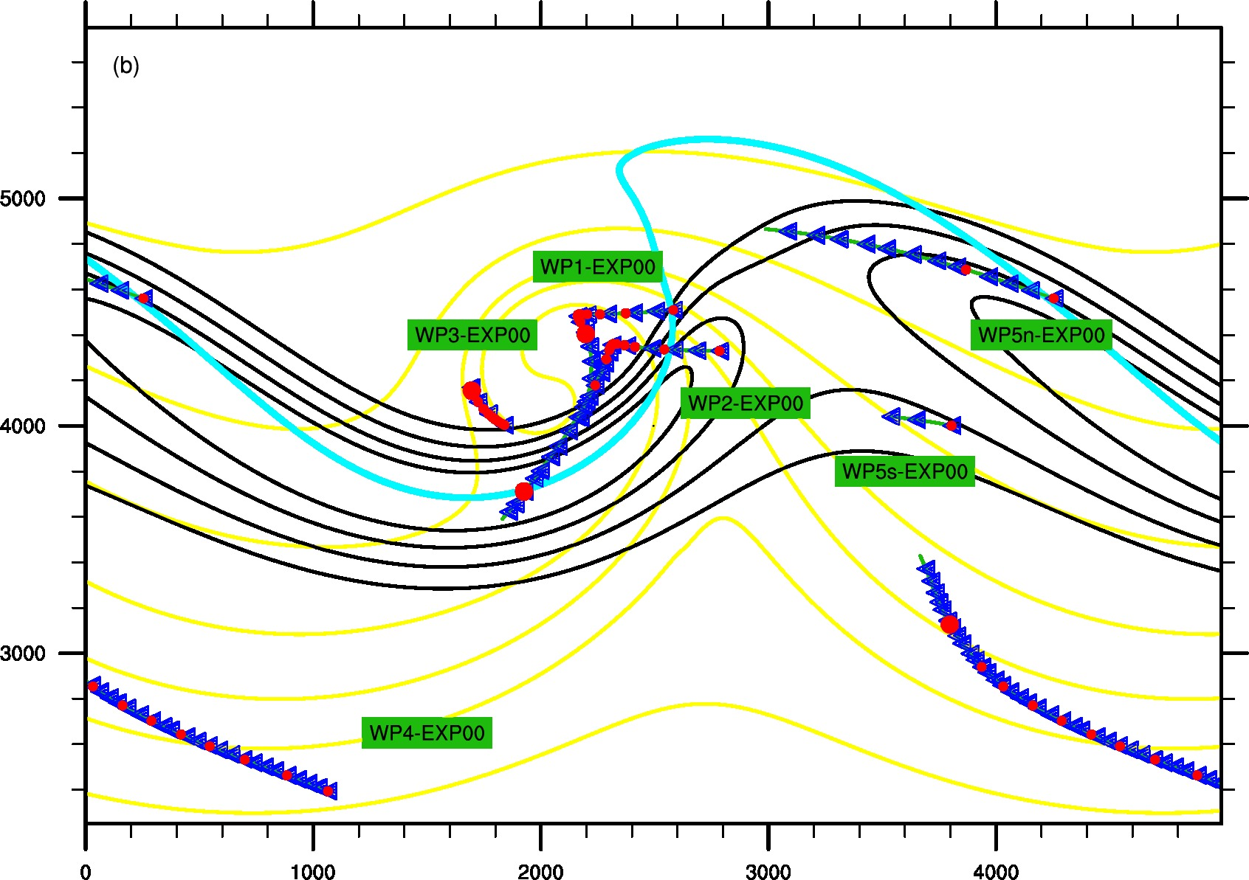
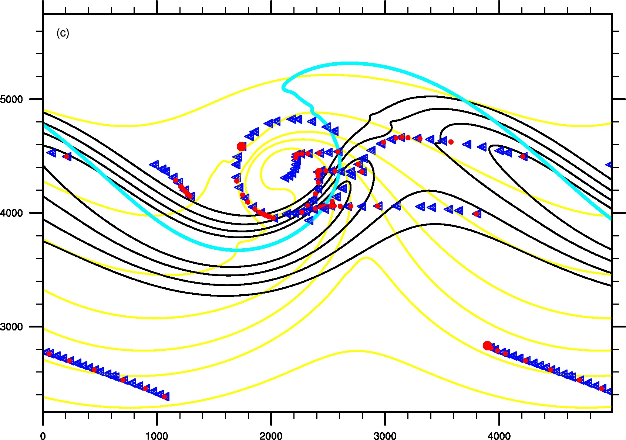
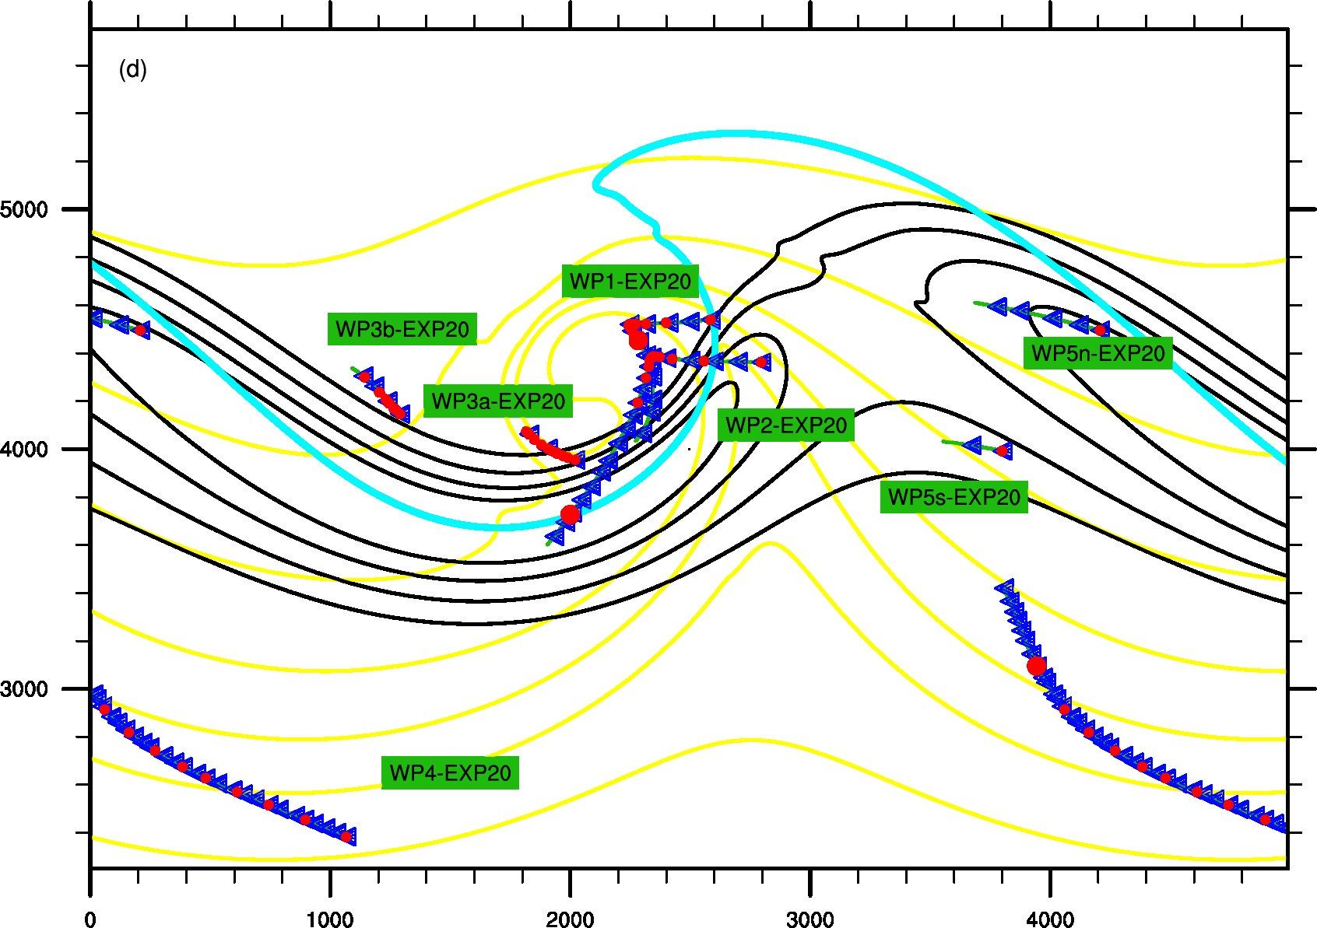
Overview of Gravity Wave Tracking
3D data at 132 h in EXP00
4D data in EXP00
3D data at 132 h in EXP20
4D data in EXP20

Slide 12
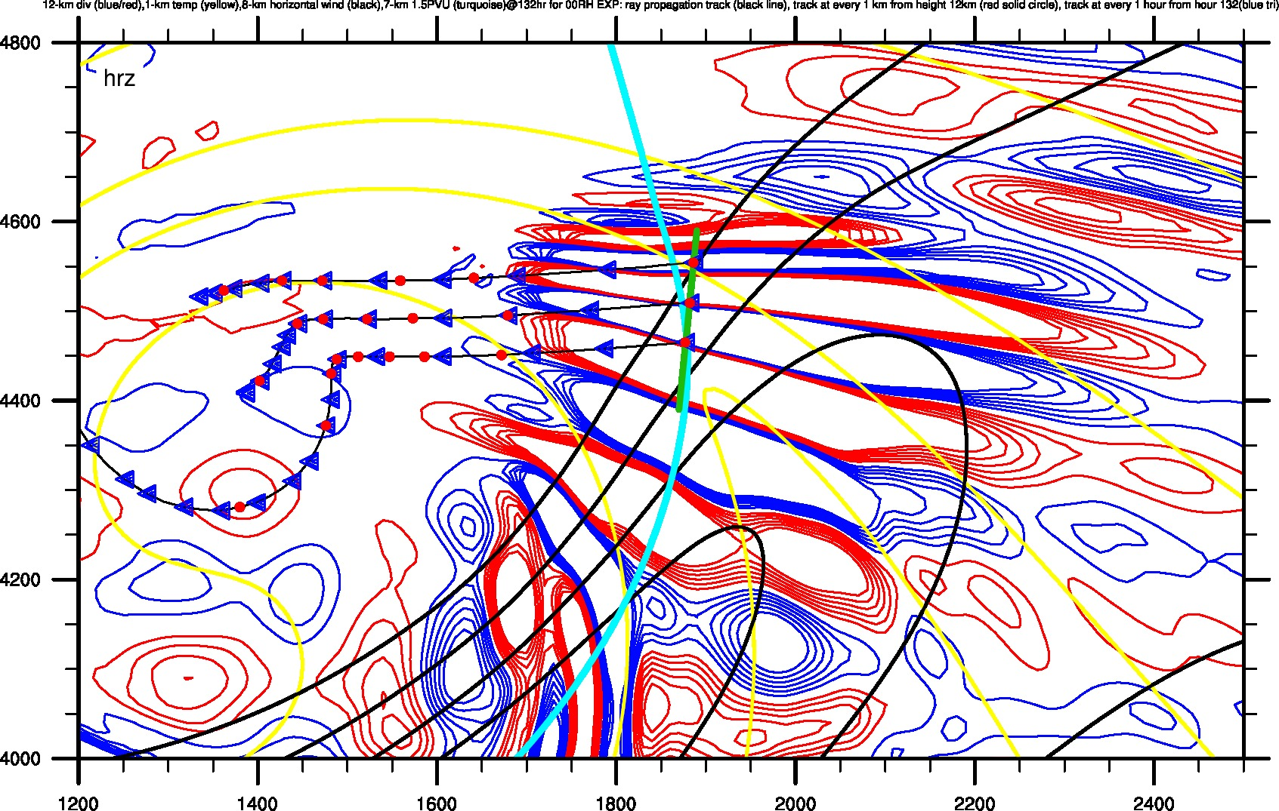
WP1-EXP00 --- 3D DATA
Red Circles represent every 1 km; Blue Triangles represent every 1 hr

Slide 13
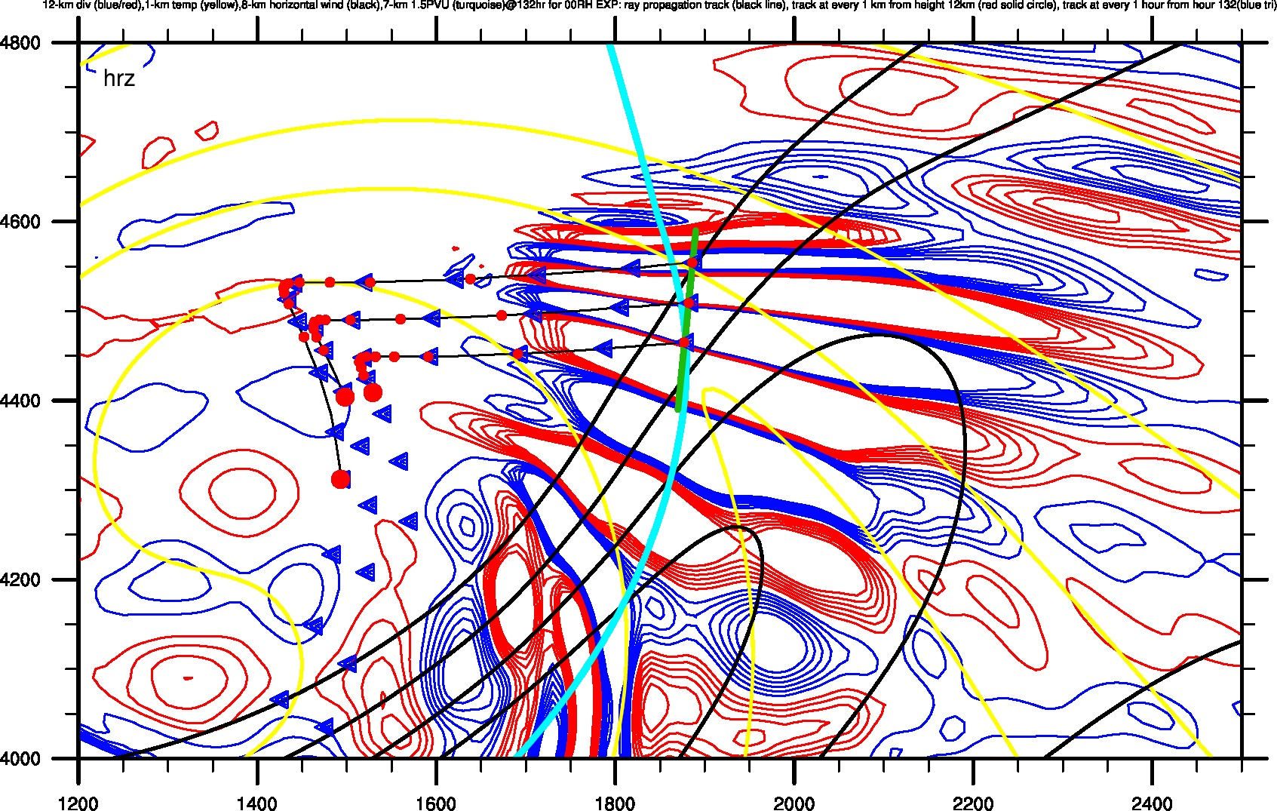
WP1-EXP00 --- 4D DATA
Red Circles represent every 1 km; Blue Triangles represent every 1 hr

Slide 14
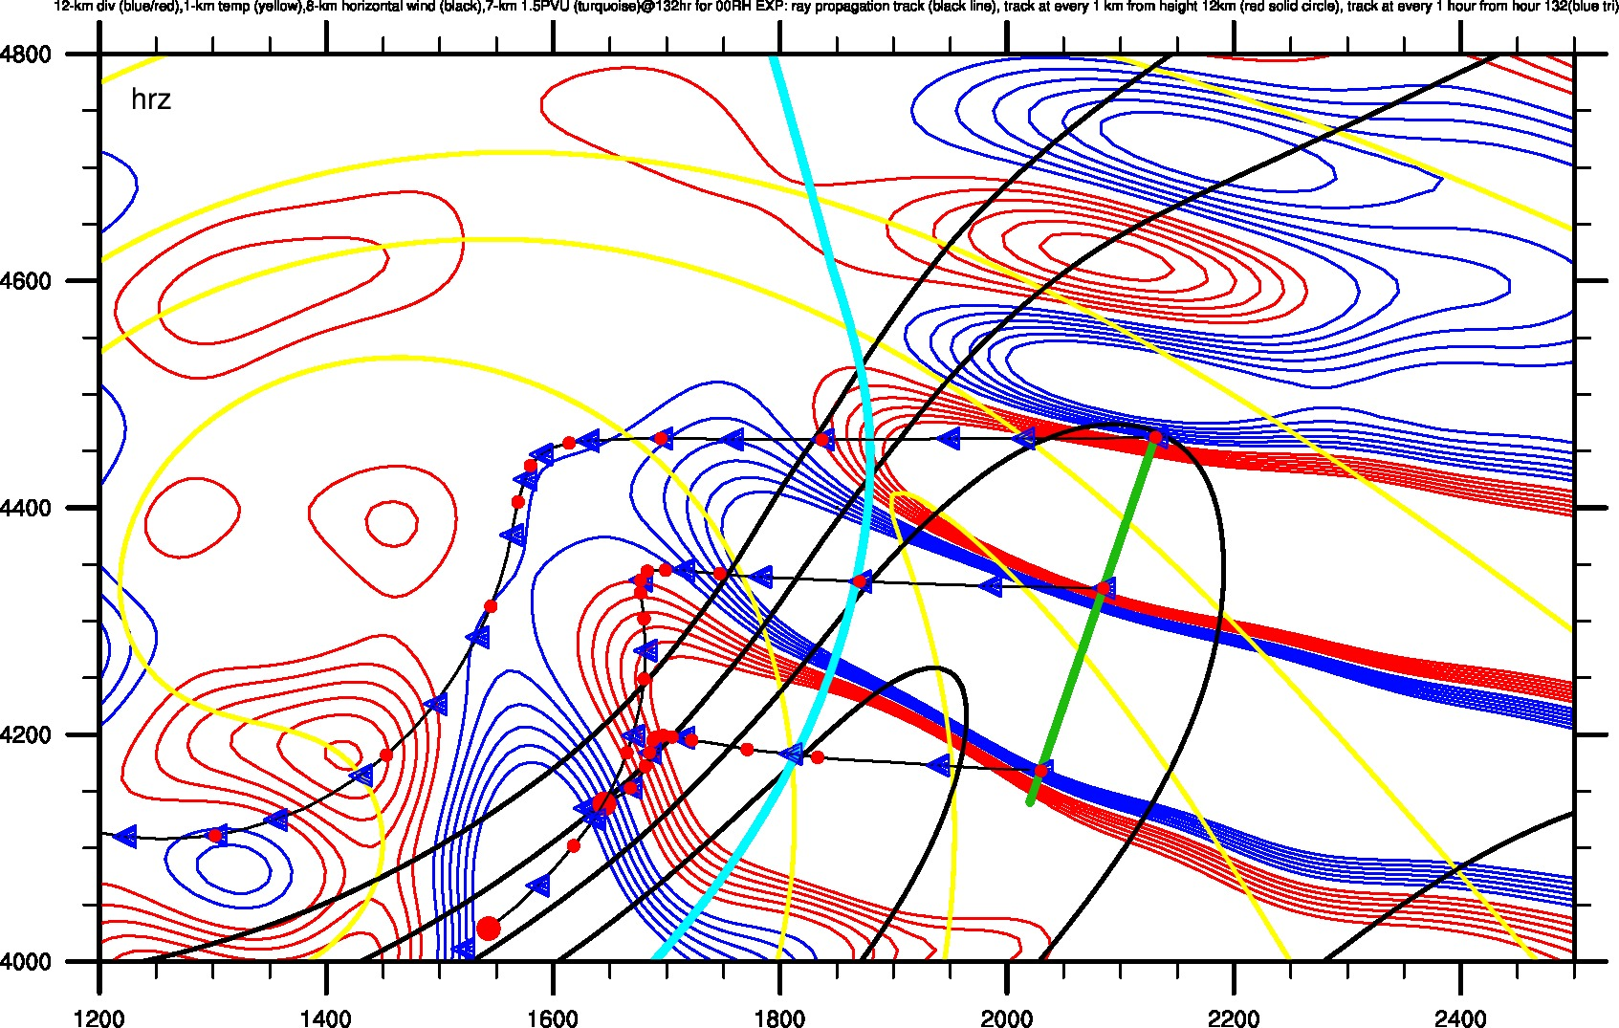
WP2-EXP00 --- 3D DATA
Red Circles represent every 1 km; Blue Triangles represent every 1 hr

Slide 15
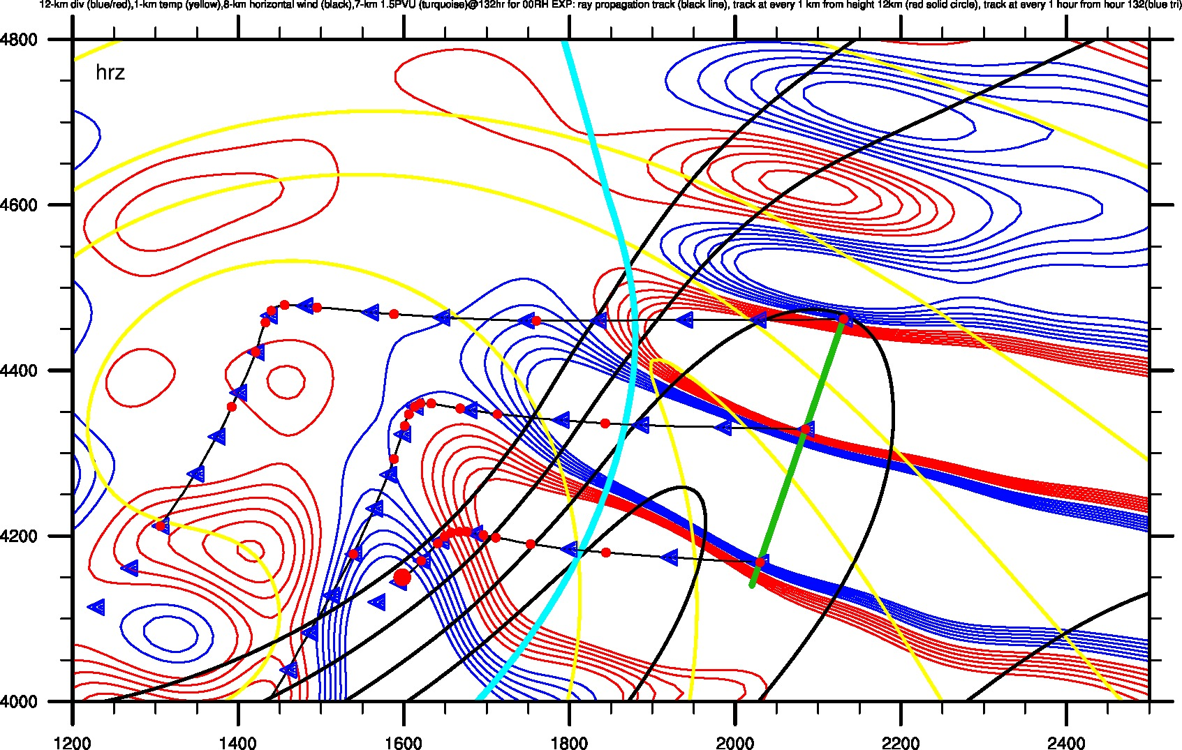
WP2-EXP00 --- 4D DATA
Red Circles represent every 1 km; Blue Triangles represent every 1 hr

Slide 16
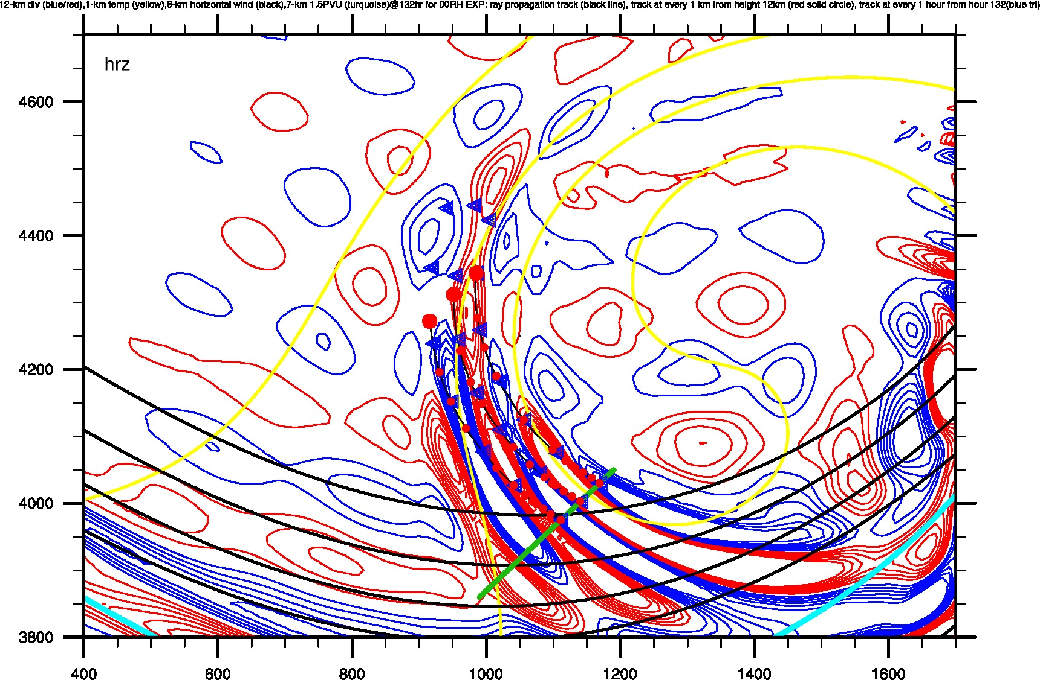
WP3-EXP00 --- 3D DATA
Red Circles represent every 1 km; Blue Triangles represent every 1 hr

Slide 17
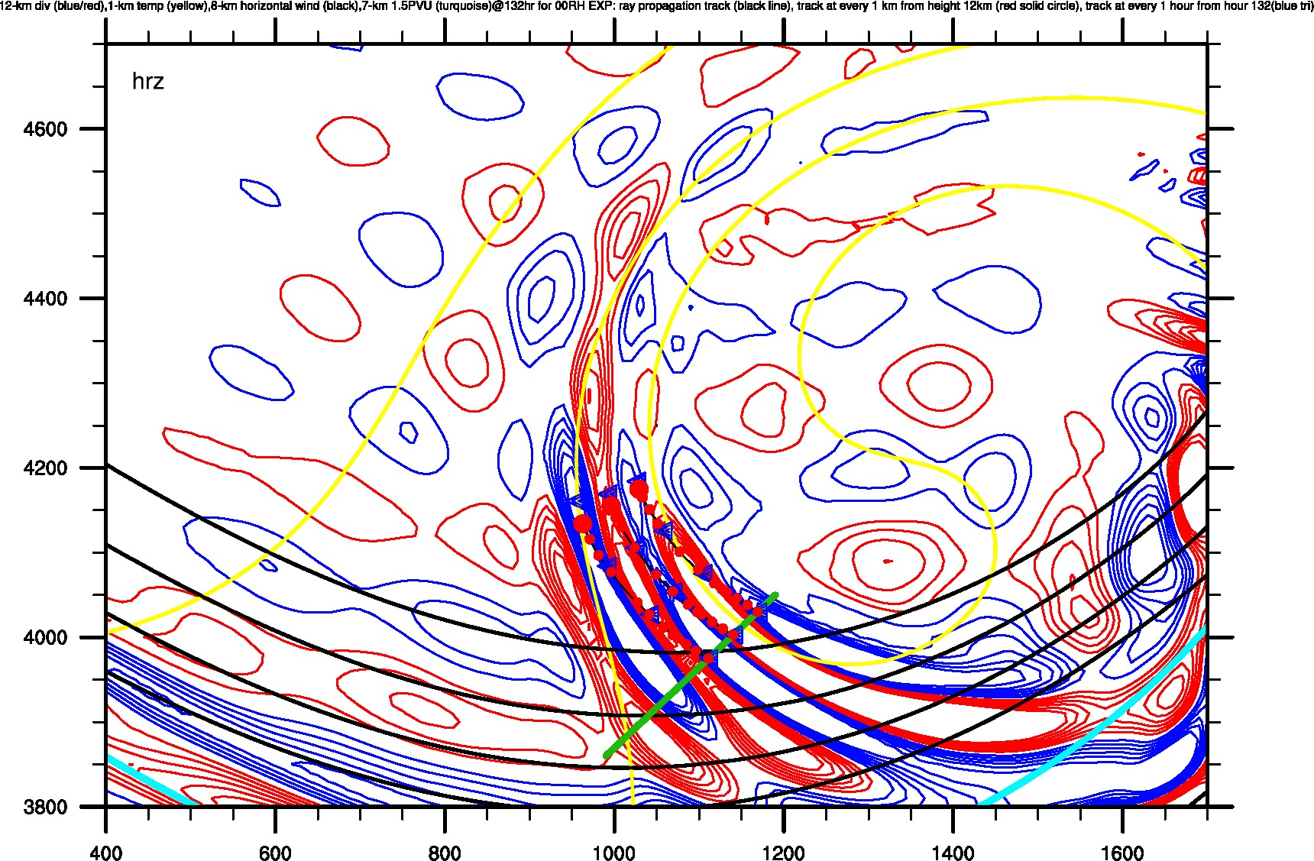
WP3-EXP00 --- 4D DATA
Red Circles represent every 1 km; Blue Triangles represent every 1 hr

Slide 18
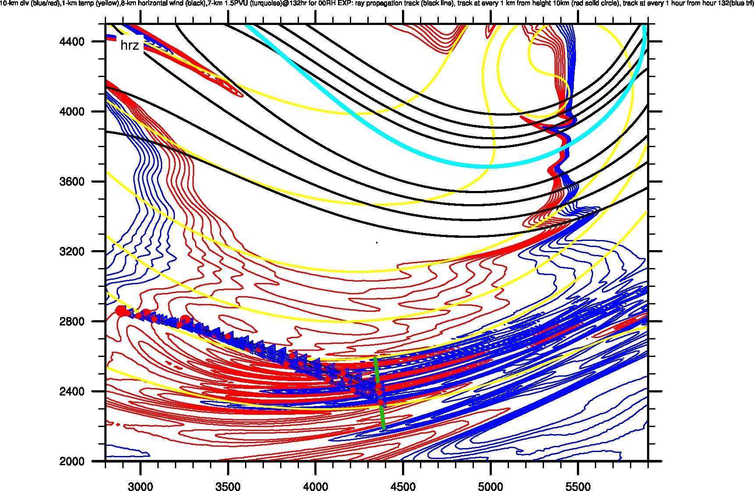
WP4-EXP00 --- 3D DATA
Red Circles represent every 1 km; Blue Triangles represent every 1 hr

Slide 19
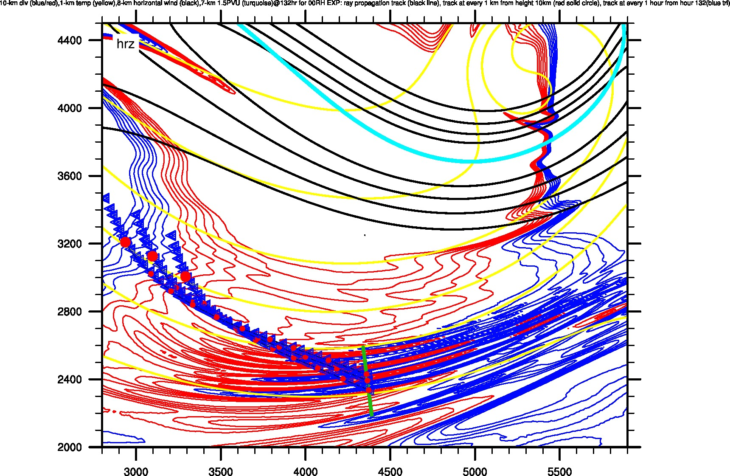
WP4-EXP00 --- 4D DATA
Red Circles represent every 1 km; Blue Triangles represent every 1 hr

Slide 20
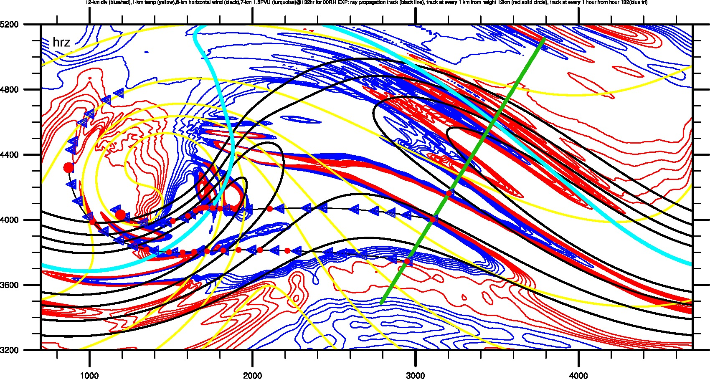
WP5s-EXP00 --- 3D DATA
Red Circles represent every 1 km; Blue Triangles represent every 1 hr

Slide 21
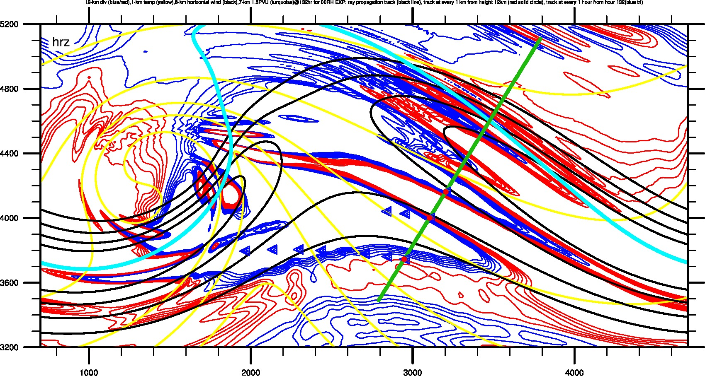
WP5s-EXP00 --- 4D DATA
Red Circles represent every 1 km; Blue Triangles represent every 1 hr

Slide 22
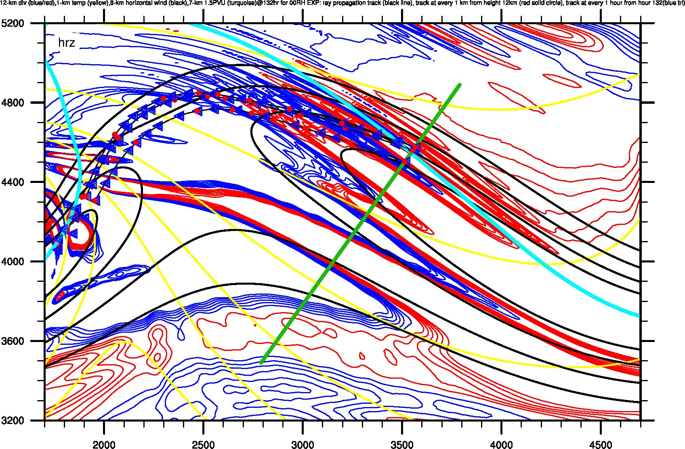
WP5n-EXP00 --- 3D DATA
Red Circles represent every 1 km; Blue Triangles represent every 1 hr

Slide 23
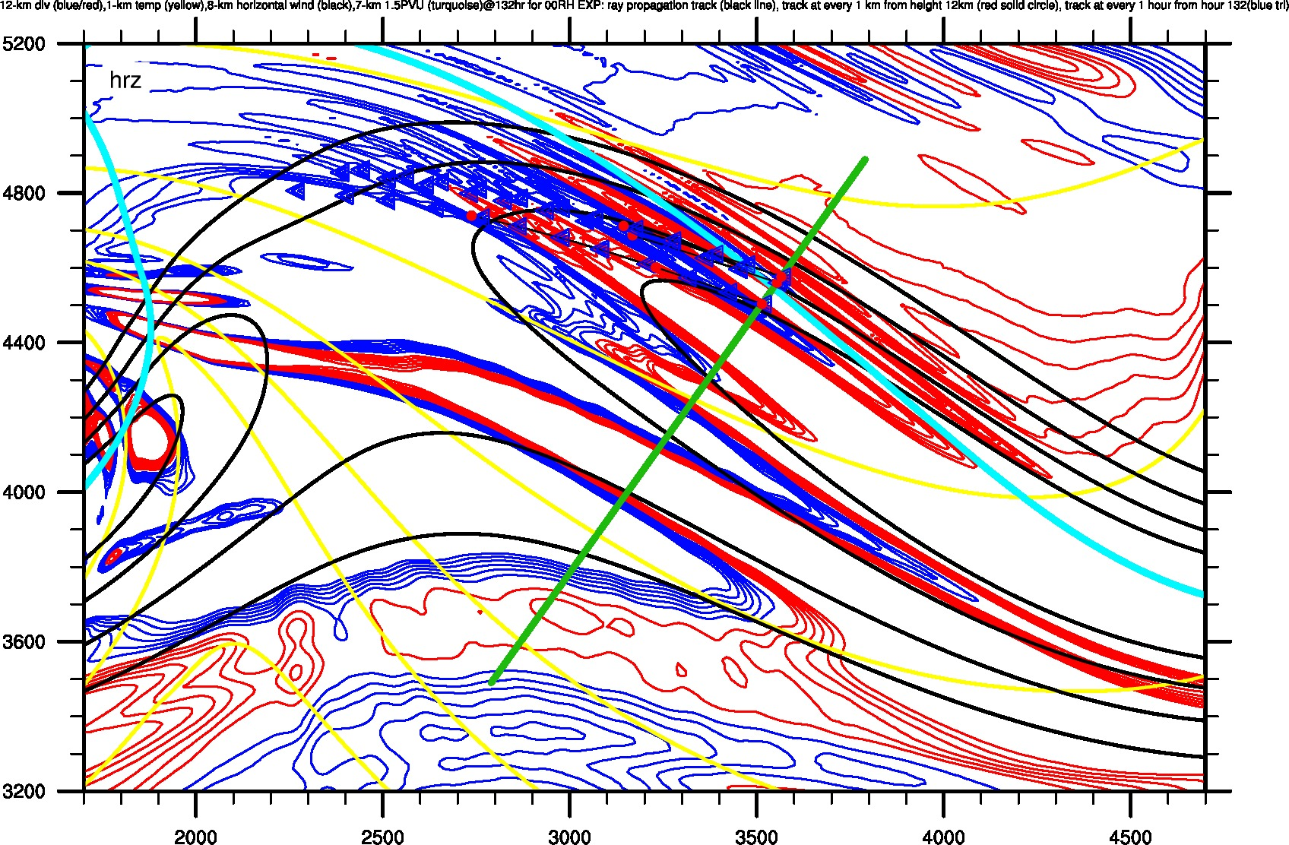
WP5n-EXP00 --- 4D DATA
Red Circles represent every 1 km; Blue Triangles represent every 1 hr

Slide 24
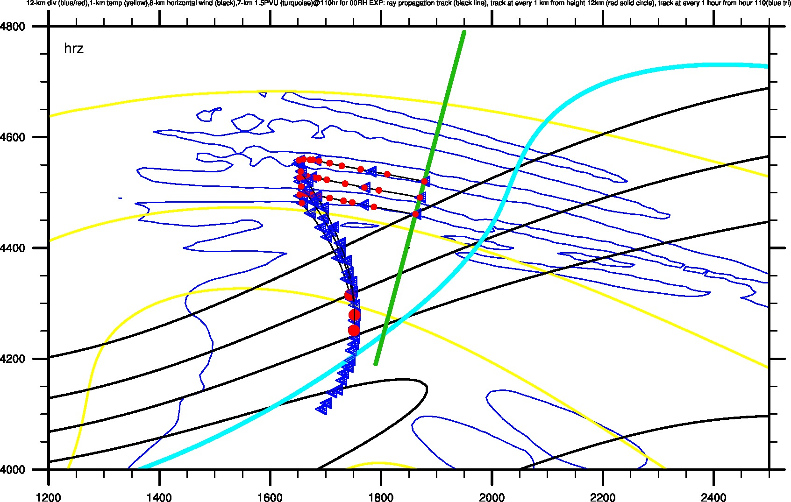
WP6-EXP20 --- 3D DATA
Red Circles represent every 1 km; Blue Triangles represent every 1 hr

Slide 25
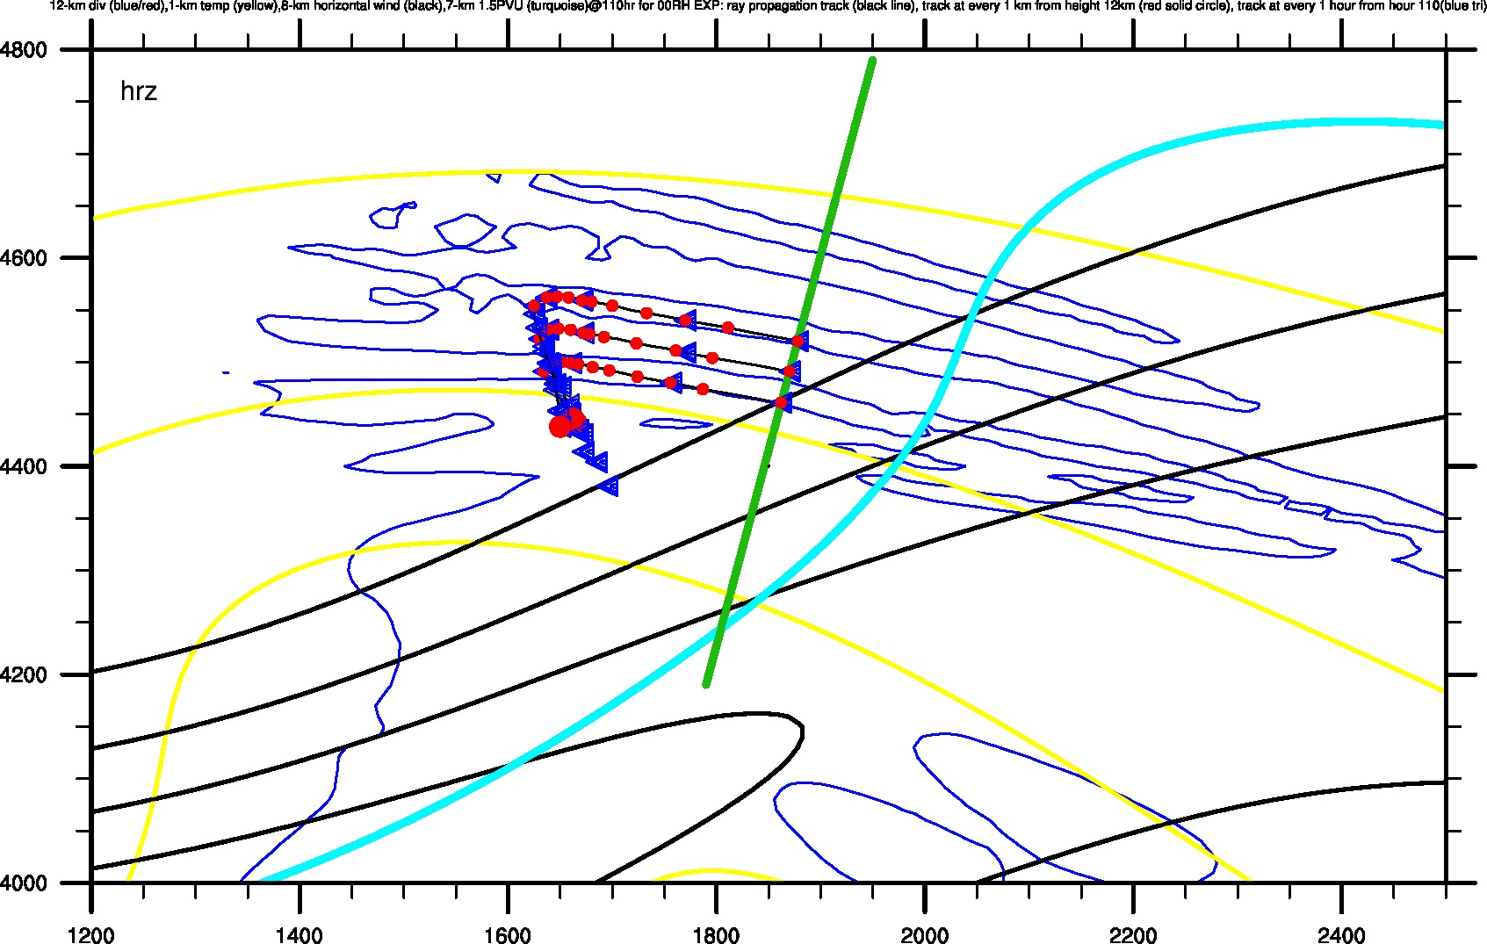
WP6-EXP20 --- 4D DATA
Red Circles represent every 1 km; Blue Triangles represent every 1 hr

Slide 26
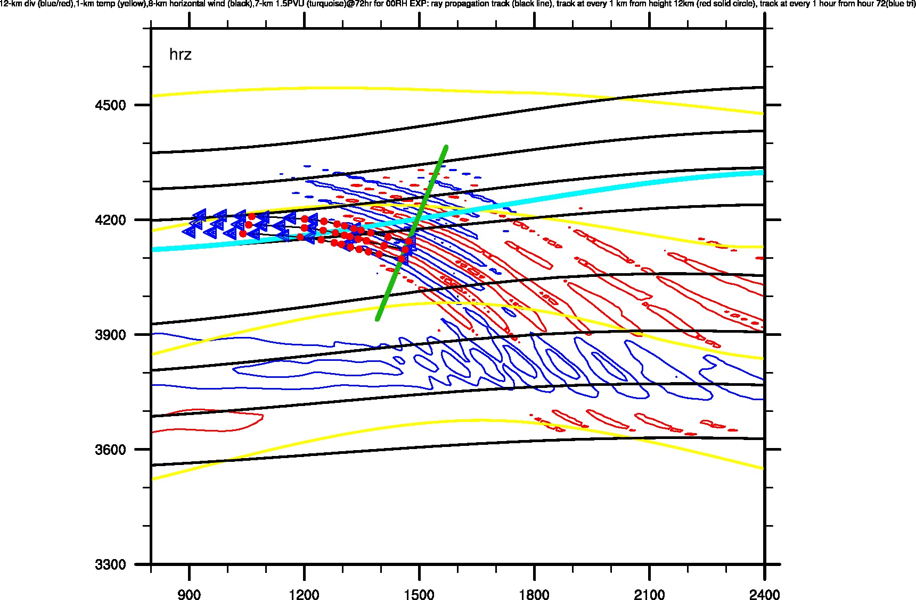
WP6-EXP100 --- 3D DATA
Red Circles represent every 1 km; Blue Triangles represent every 1 hr

Slide 27
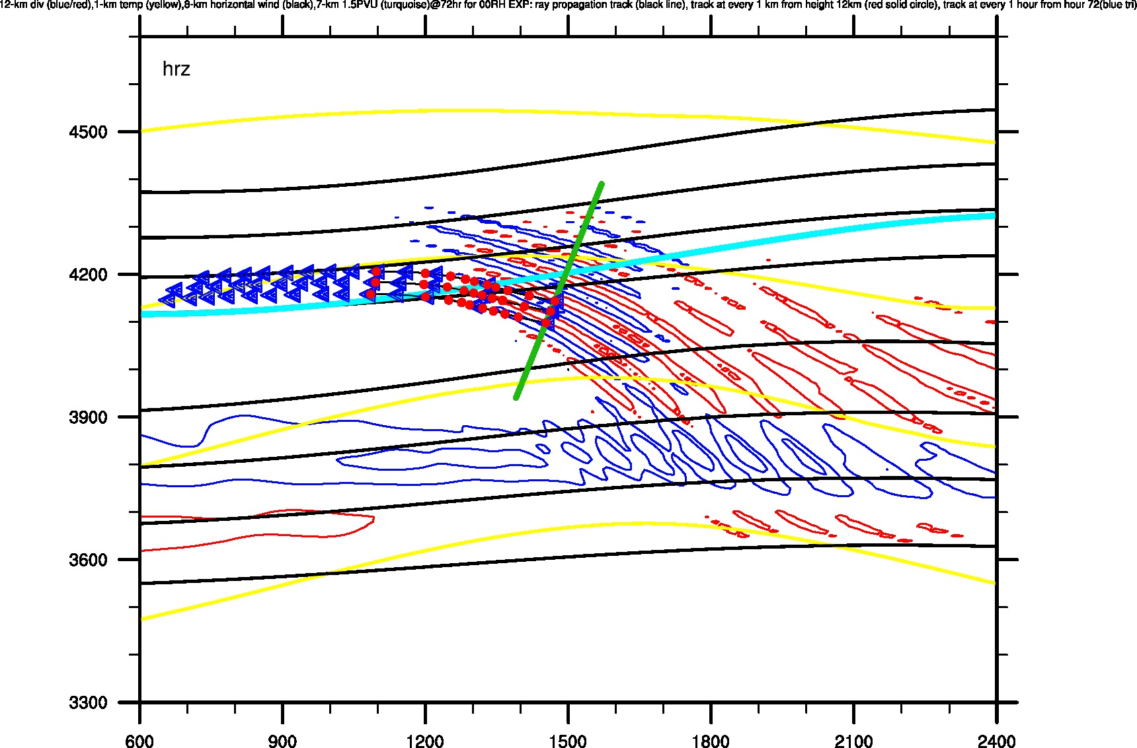
WP6-EXP100 --- 4D DATA
Red Circles represent every 1 km; Blue Triangles represent every 1 hr

Slide 28
Overview of Identified Mesoscale Gravity Waves
Summary for This Part
A 600-km low-pass filter is used for the background flow (u,v,w,p,t).
Initial conditions of WP include its location (x,y,z), k, l, u’, ground-based frequency, dt, initial time
Parameters along the trajectory include location (x,y,z), k, l, u’, ground-based frequency, intrinsic frequency, group velocity
For the trajectory, EXP00 and EXP20 generally share similar paths.
Based on the comparison of trajectory between EXP00 and EXP20, the trajectory is sensitive to transient background flow.

Slide 29
Outline
Overview of the identified mesoscale gravity waves
Overview of the preliminary result of gravity wave tracking
The tracking of WP3

Slide 30
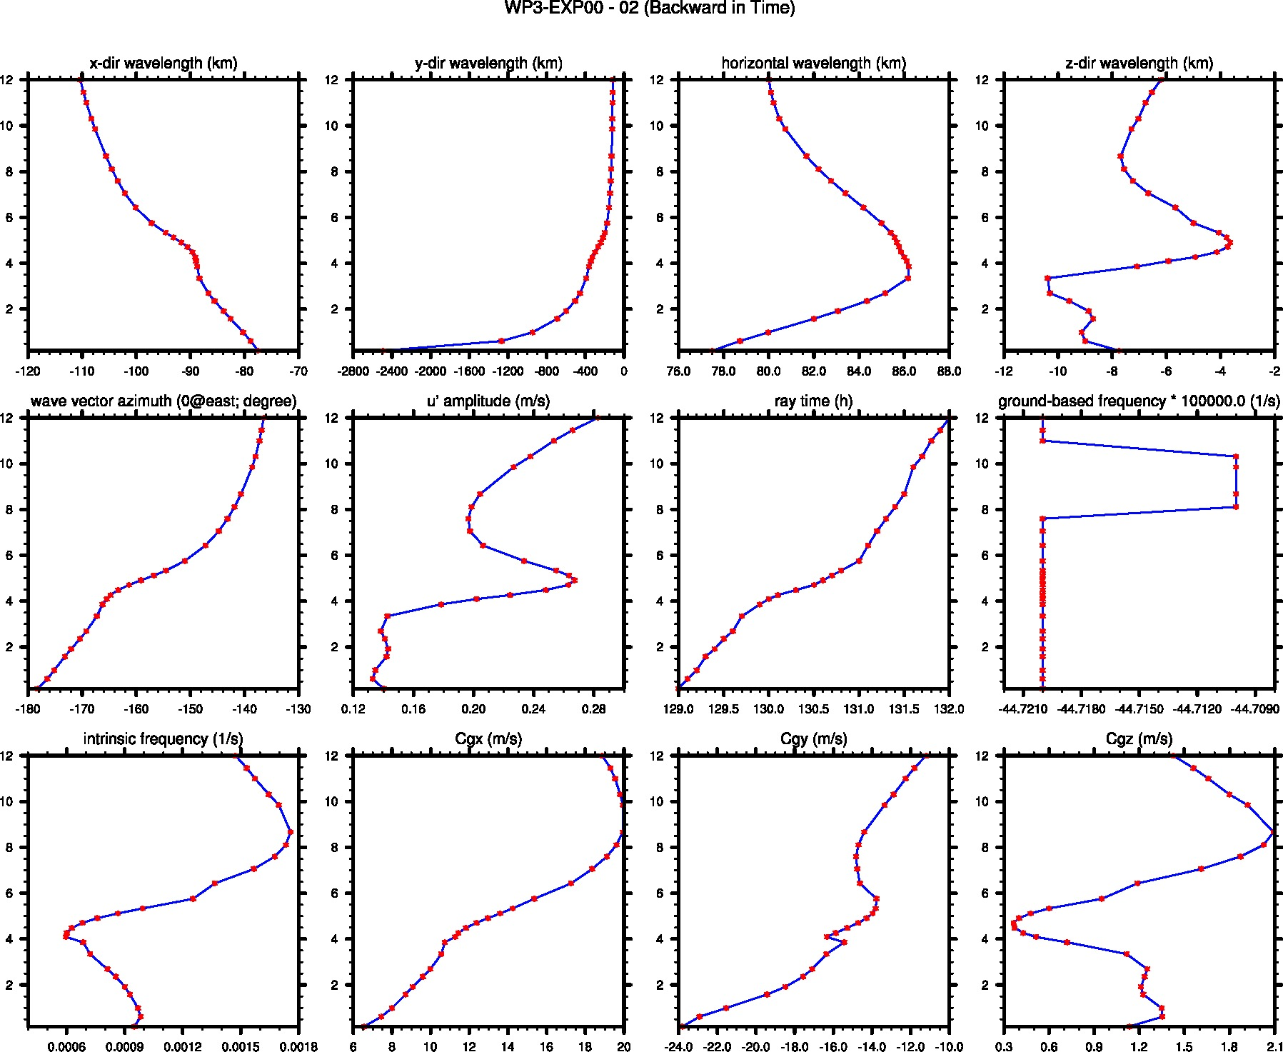
The Tracking of WP3

Slide 31
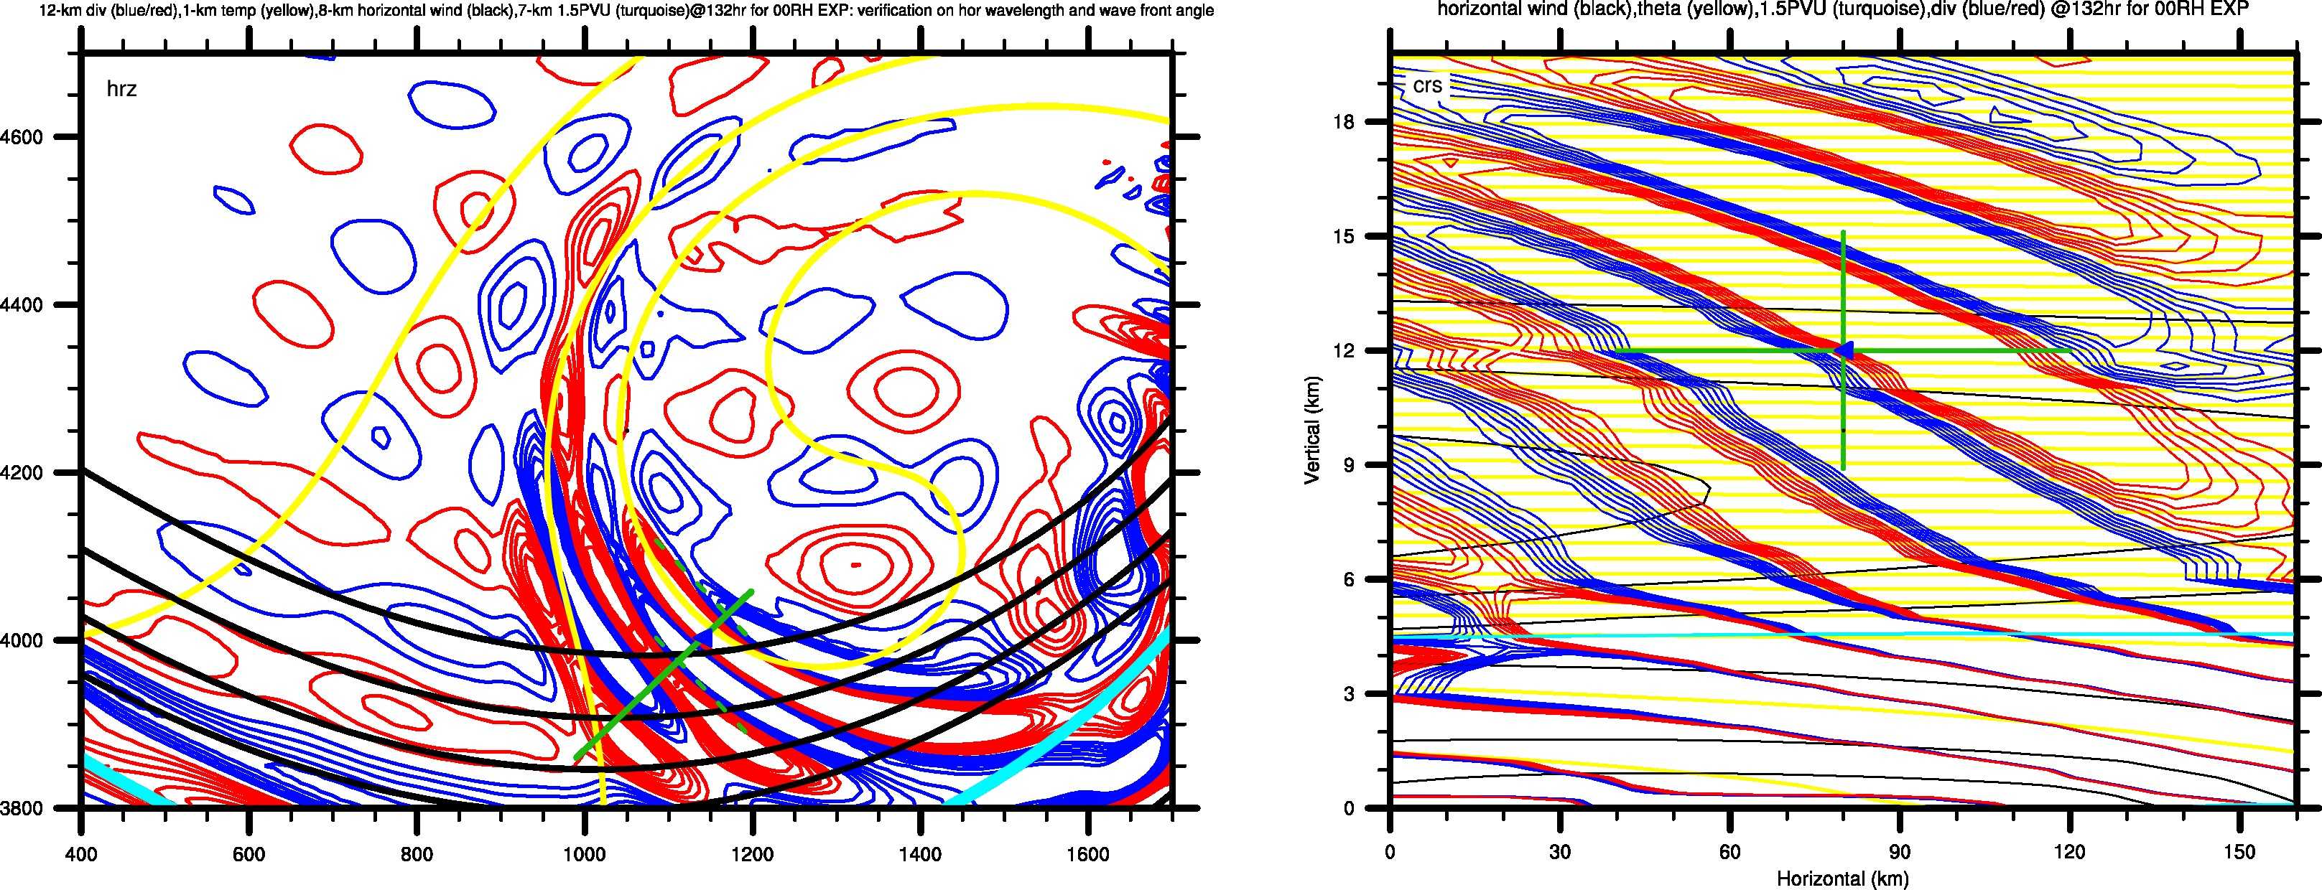
The Tracking of WP3
WP3-EXP00 at 132 h in EXP00
Comparison Between WRF and GRAGROT:
Horizontal Wavelength; Wave Vector Azimuth; Vertical Wavelength

Slide 32
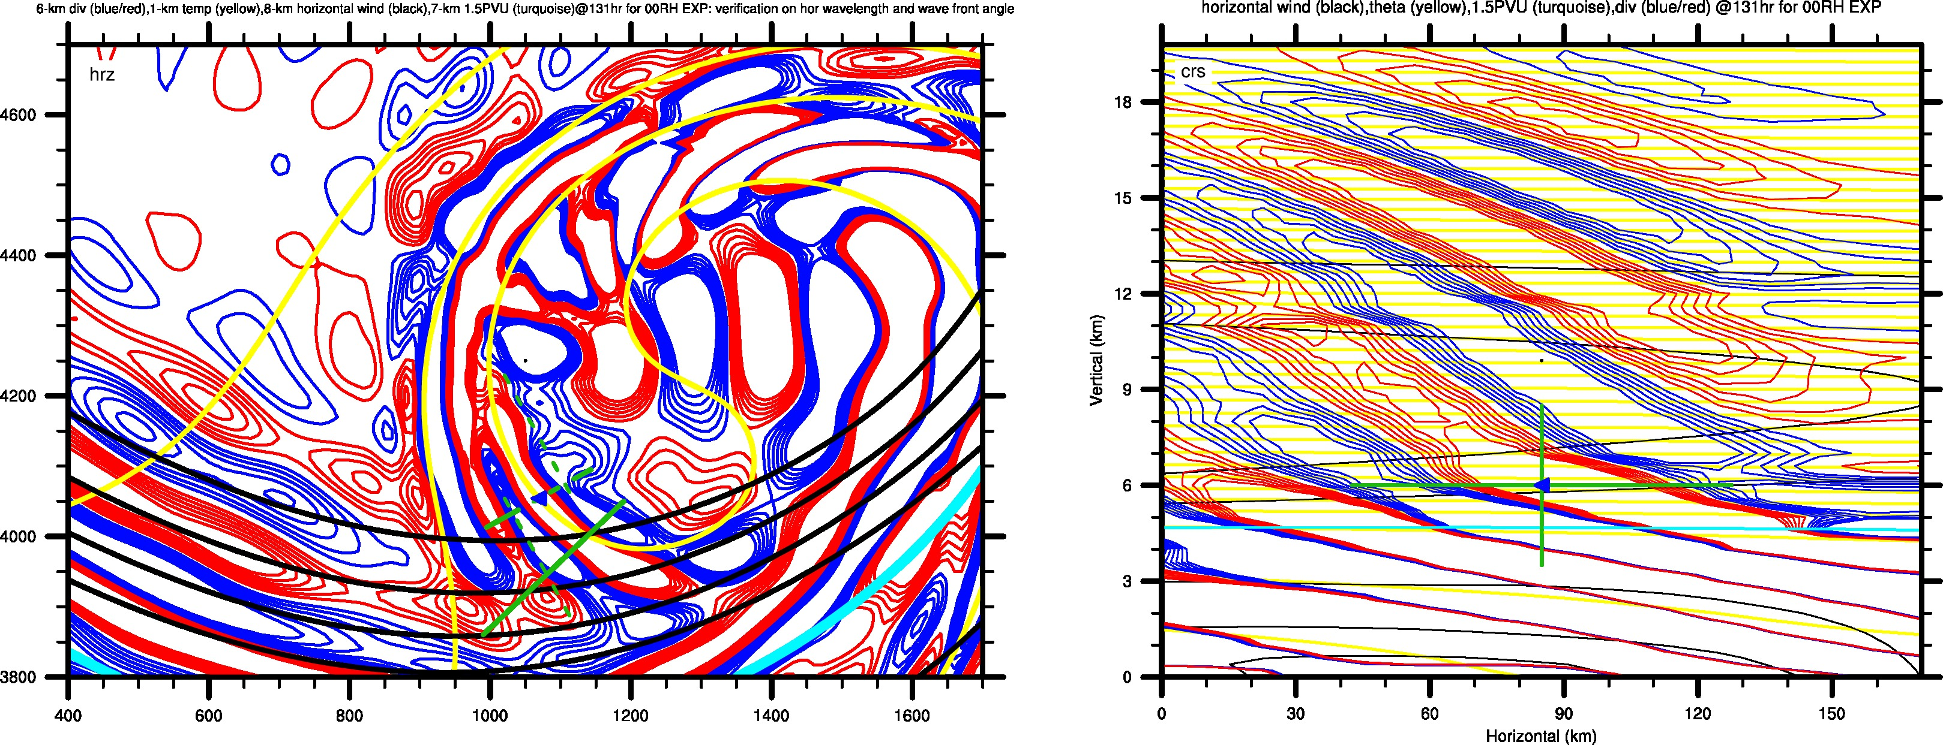
The Tracking of WP3
WP3-EXP00 at 131 h in EXP00
Comparison Between WRF and GRAGROT:
Horizontal Wavelength; Wave Vector Azimuth; Vertical Wavelength

Slide 33
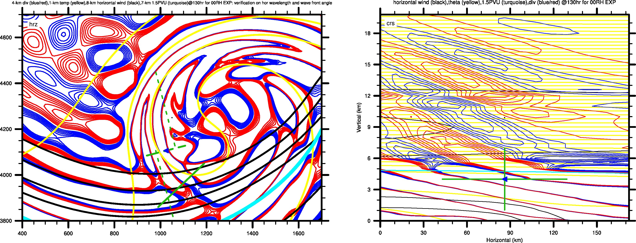
The Tracking of WP3
WP3-EXP00 at 130 h in EXP00
Comparison Between WRF and GRAGROT:
Horizontal Wavelength; Wave Vector Azimuth; Vertical Wavelength

Slide 34
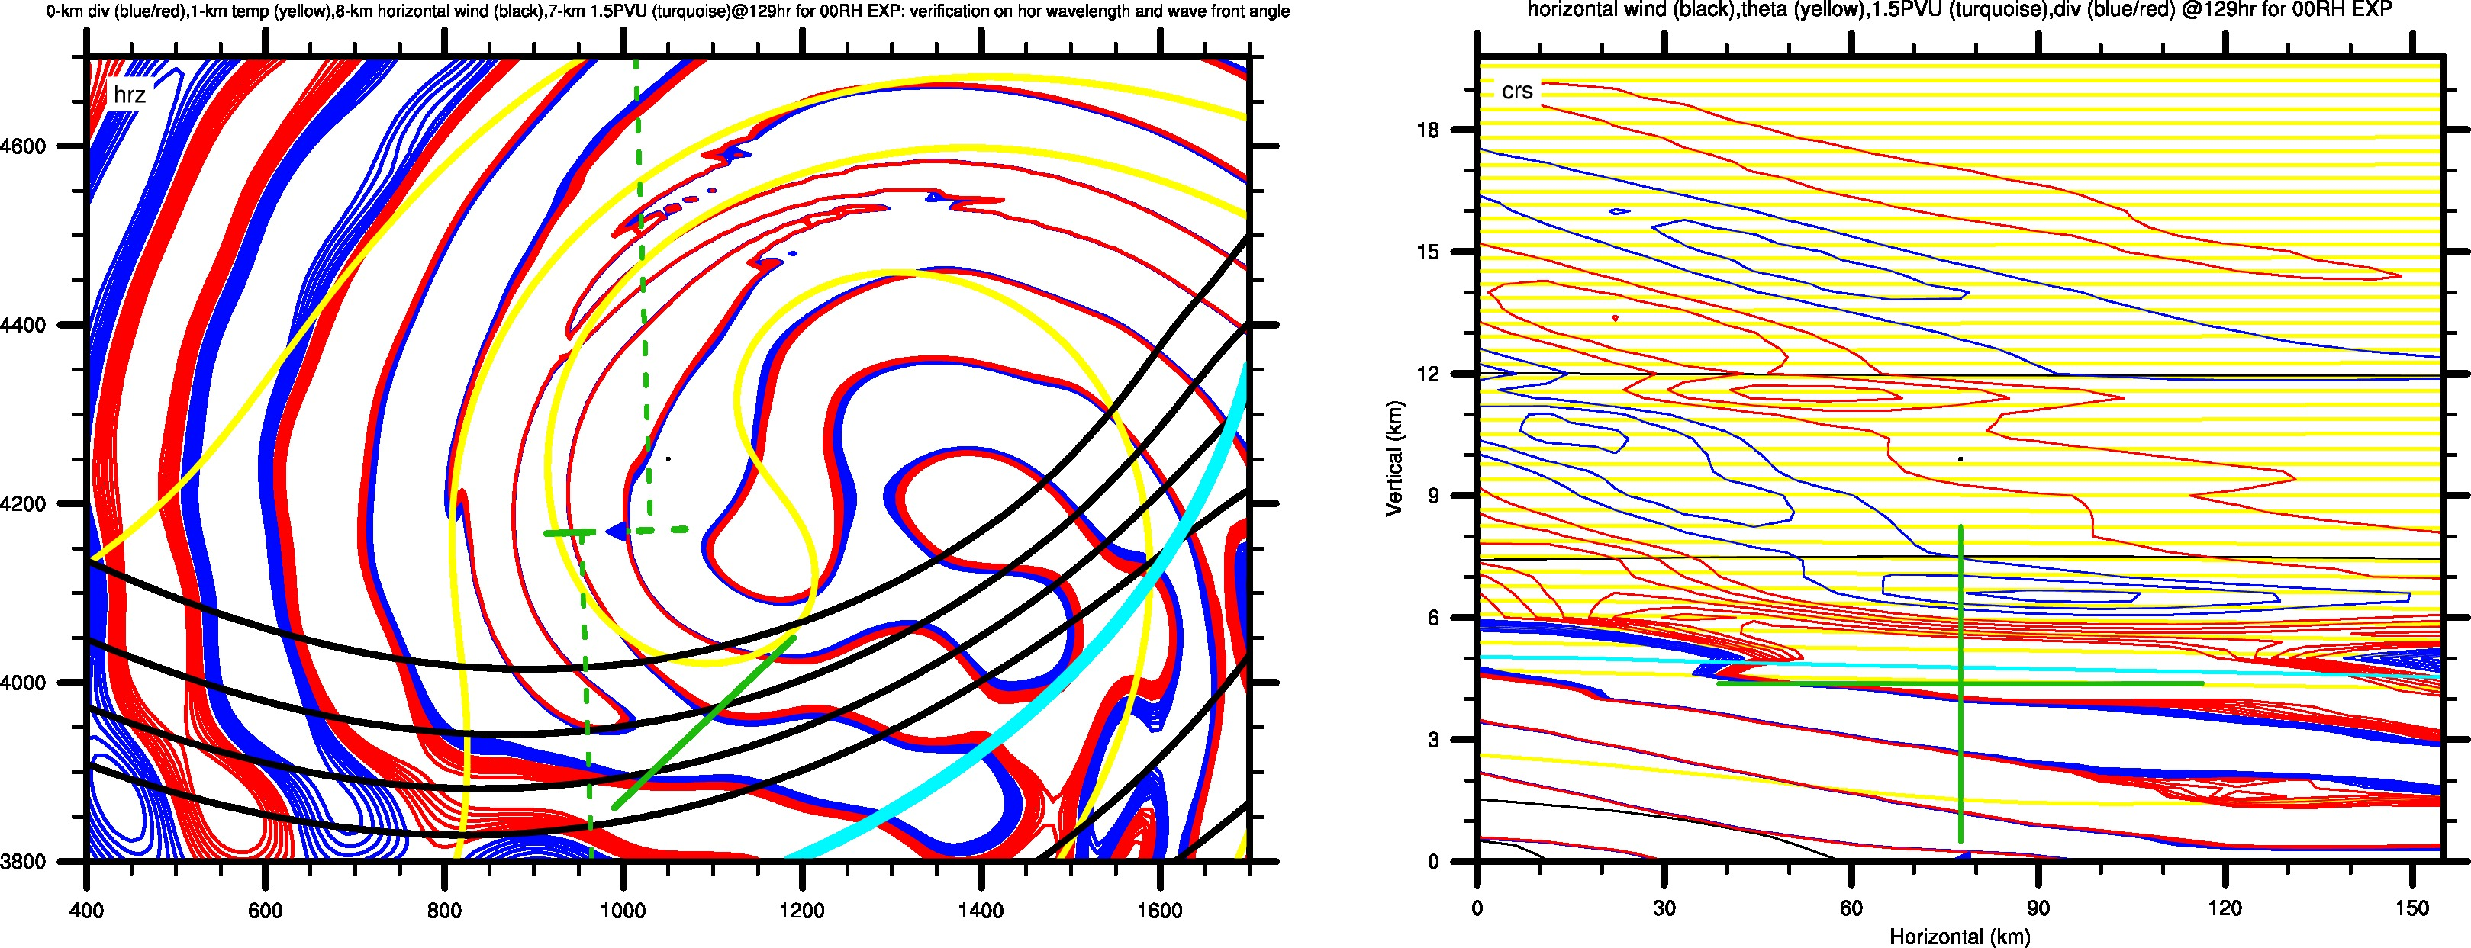
The Tracking of WP3
WP3-EXP00 at 129 h in EXP00
Comparison Between WRF and GRAGROT:
Horizontal Wavelength; Wave Vector Azimuth; Vertical Wavelength

Slide 35
The Tracking of WP3
Summary for This Part
Generally good agreement in horizontal wavelength and wave vector azimuth from 12 km to surface
It appears that the trajectory is along the phase line (also seen in WP6).
Generally good agreement in vertical wavelength over lower stratosphere
Disagreement in vertical wavelength over tropophere
Decrease of wind perturbation approximately below the tropopause

Slide 36
Outline
Overview of the identified mesoscale gravity waves
Overview of the preliminary result of gravity wave tracking
The tracking of WP3

