Slide 1
The genesis of Hurricane Karl (2010) examined through cycling EnKF, 4DVar and hybrid data assimilation experiments
Jonathan Poterjoy
July 19, 2013

Slide 2
Case study: Hurricane Karl (2010)
MADIS observations
This study uses the WRF model with a 13.5-km domain to perform EnKF, 4DVar and E4DVar data assimilation experiments over a 10-day period.
The experiments are initialized from GDAS analyses on 18 UTC 07 Sept. and the first assimilation cycle occurs on 06 UTC 08 Sept.
Analyses are performed every six hours until 00 UTC 18 Sept. using data from MADIS and the PREDICT field campaign.
PREDICT dropsondes

Slide 3
Data assimilation systems
EnKF
60 members
900 km horizontal localization ROI
80% relaxation to prior
4DVar
40.5-km inner loop, 13.5-km outer loop
CV5 control variable option with default amplitude and length scale parameters
E4DVar
Two-way coupling between EnKF and 4DVar:
  4DVar uses ensemble mean first guess and ensemble perturbations
  EnKF updates members
  Hybrid 4DVar analysis replaces EnKF mean analysis
Same ensemble options as EnKF case
80% of increment comes from ensemble perturbations during hybrid minimization

Slide 4
Deterministic forecast results
RMSD (observations)
Forecast root mean squared deviations (RMSD) are averaged over grid points within 2500 km of the storm center.
Values are averaged from 28 deterministic forecasts during the cycling period.
Forecasts are verified using radiosonde and dropsonde observations (PREDICT and GRIP) in the top figure.
RMSD are calculated from GDAS in the bottom figure.
RMSD (GDAS)

Slide 5
Deterministic forecast results
RMSD (observations)
RMSD (GDAS)
Vertical profiles of 24- and 72-h forecast RMSD are compared.
Both upper-air and GDAS data are used to perform the verification.

Slide 6
Deterministic forecast results for track and intensity
Forecasts are run from each analysis using a 4.5-km nested domain that follows the vortex using preset moves.
Each simulation starts from the respective analysis time and ends on 00 UTC 18 Sept.

Slide 7
Analyses from cycling DA experiments
The 950 – 500 mb vertical shear and vortex tilt are estimated using winds within 3° of the wave or vortex center.
The relatively low shear prior to genesis is partially caused by the alignment of the upper- and lower-level circulation centers prior to genesis.
A broad low-level vortex persists during early assimilation cycles for each experiment, but decreases during 11 – 12 Sept. The 500-mb circulation, however, steadily increases with time.
All cases show a diurnal cycle in RH, which decreases in amplitude leading up the 18 UTC 14 Sept. genesis time.
The E4DVar case has much higher column relative humidity within 3° of the circulation center.

Slide 8
Analysis θ_{v}’ averaged within 3° of center
Perturbation θ_{v} is estimated by taking θ_{v} between 3° and 6° from the center as the environmental value and subtracting it from the mean θ_{v} within 3° of the center. Values are averaged horizontally and plotted at each analysis time from 12 UTC 10 Sept.
All cases produce a warm temperature anomaly above 600 mb during cycling, which increases by a factor of two - three after genesis.
The warm temperature perturbations are larger for E4DVar case.

Slide 9
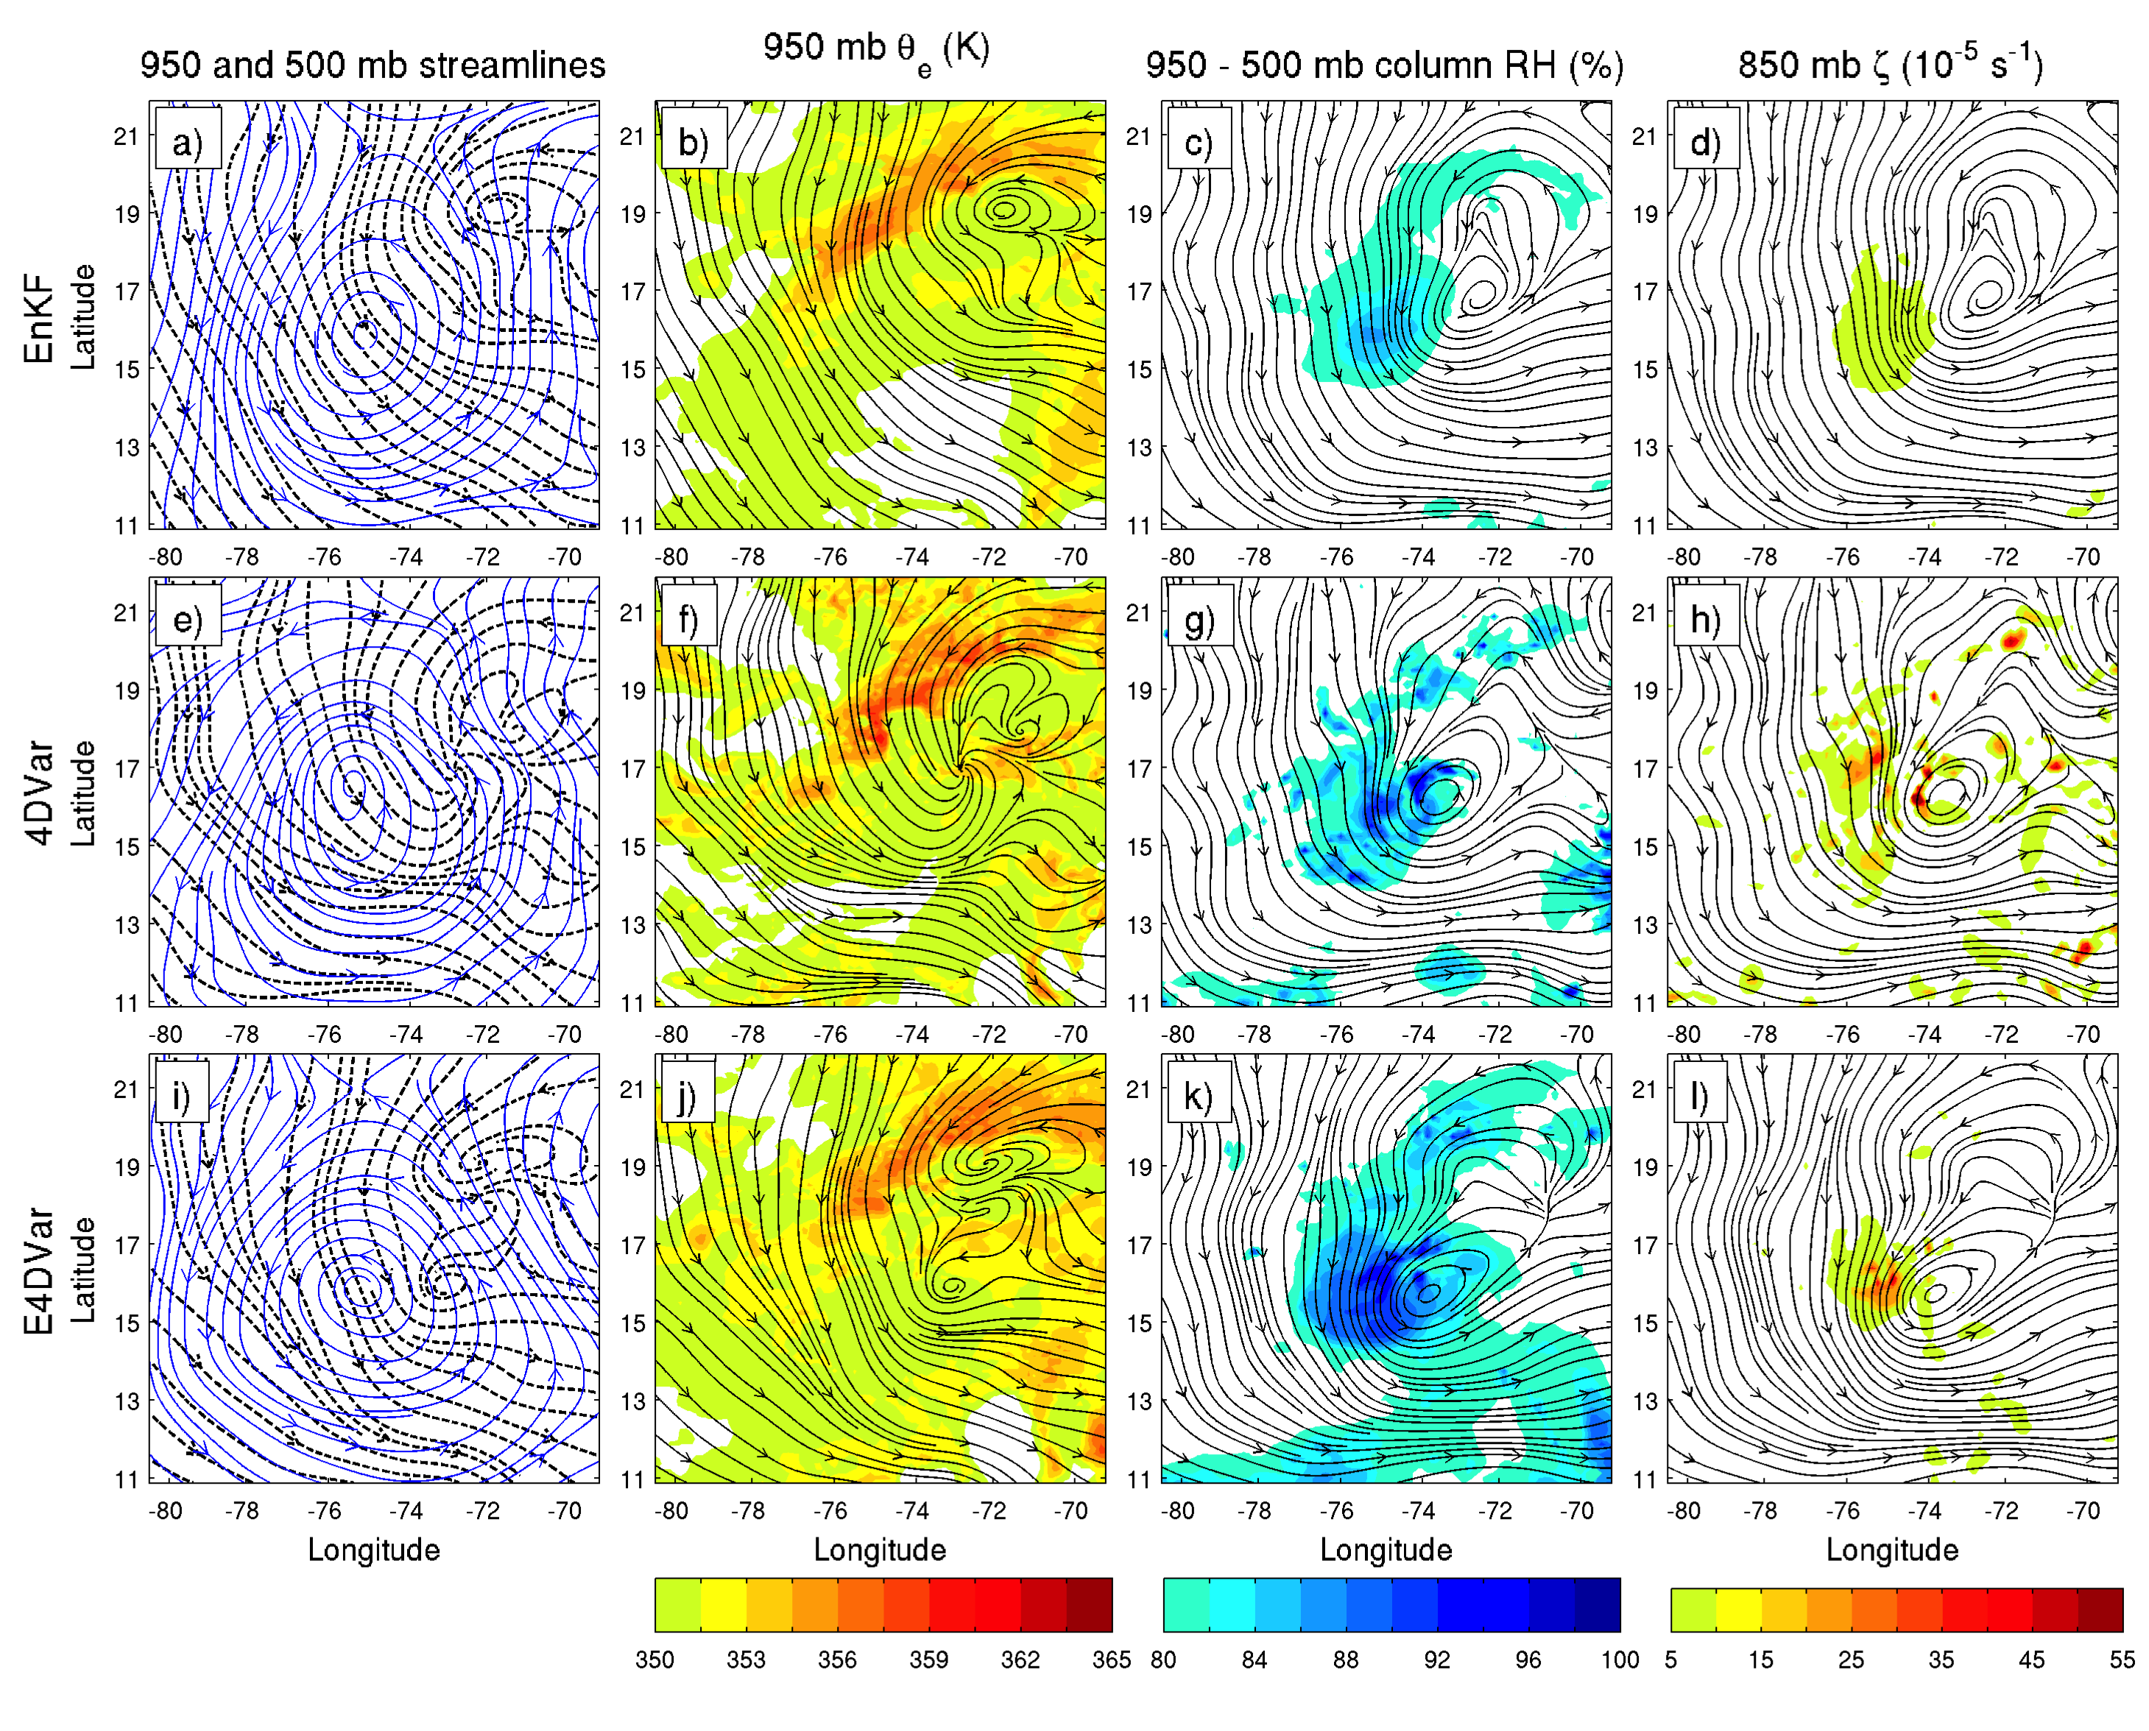
06 UTC 13 analyses
Filtered (black) 950 and (blue) 500 mb streamlines, 950-mb θ_{e}, column RH, and vorticity are plotted for the 06 UTC 13 analyses.

Slide 10
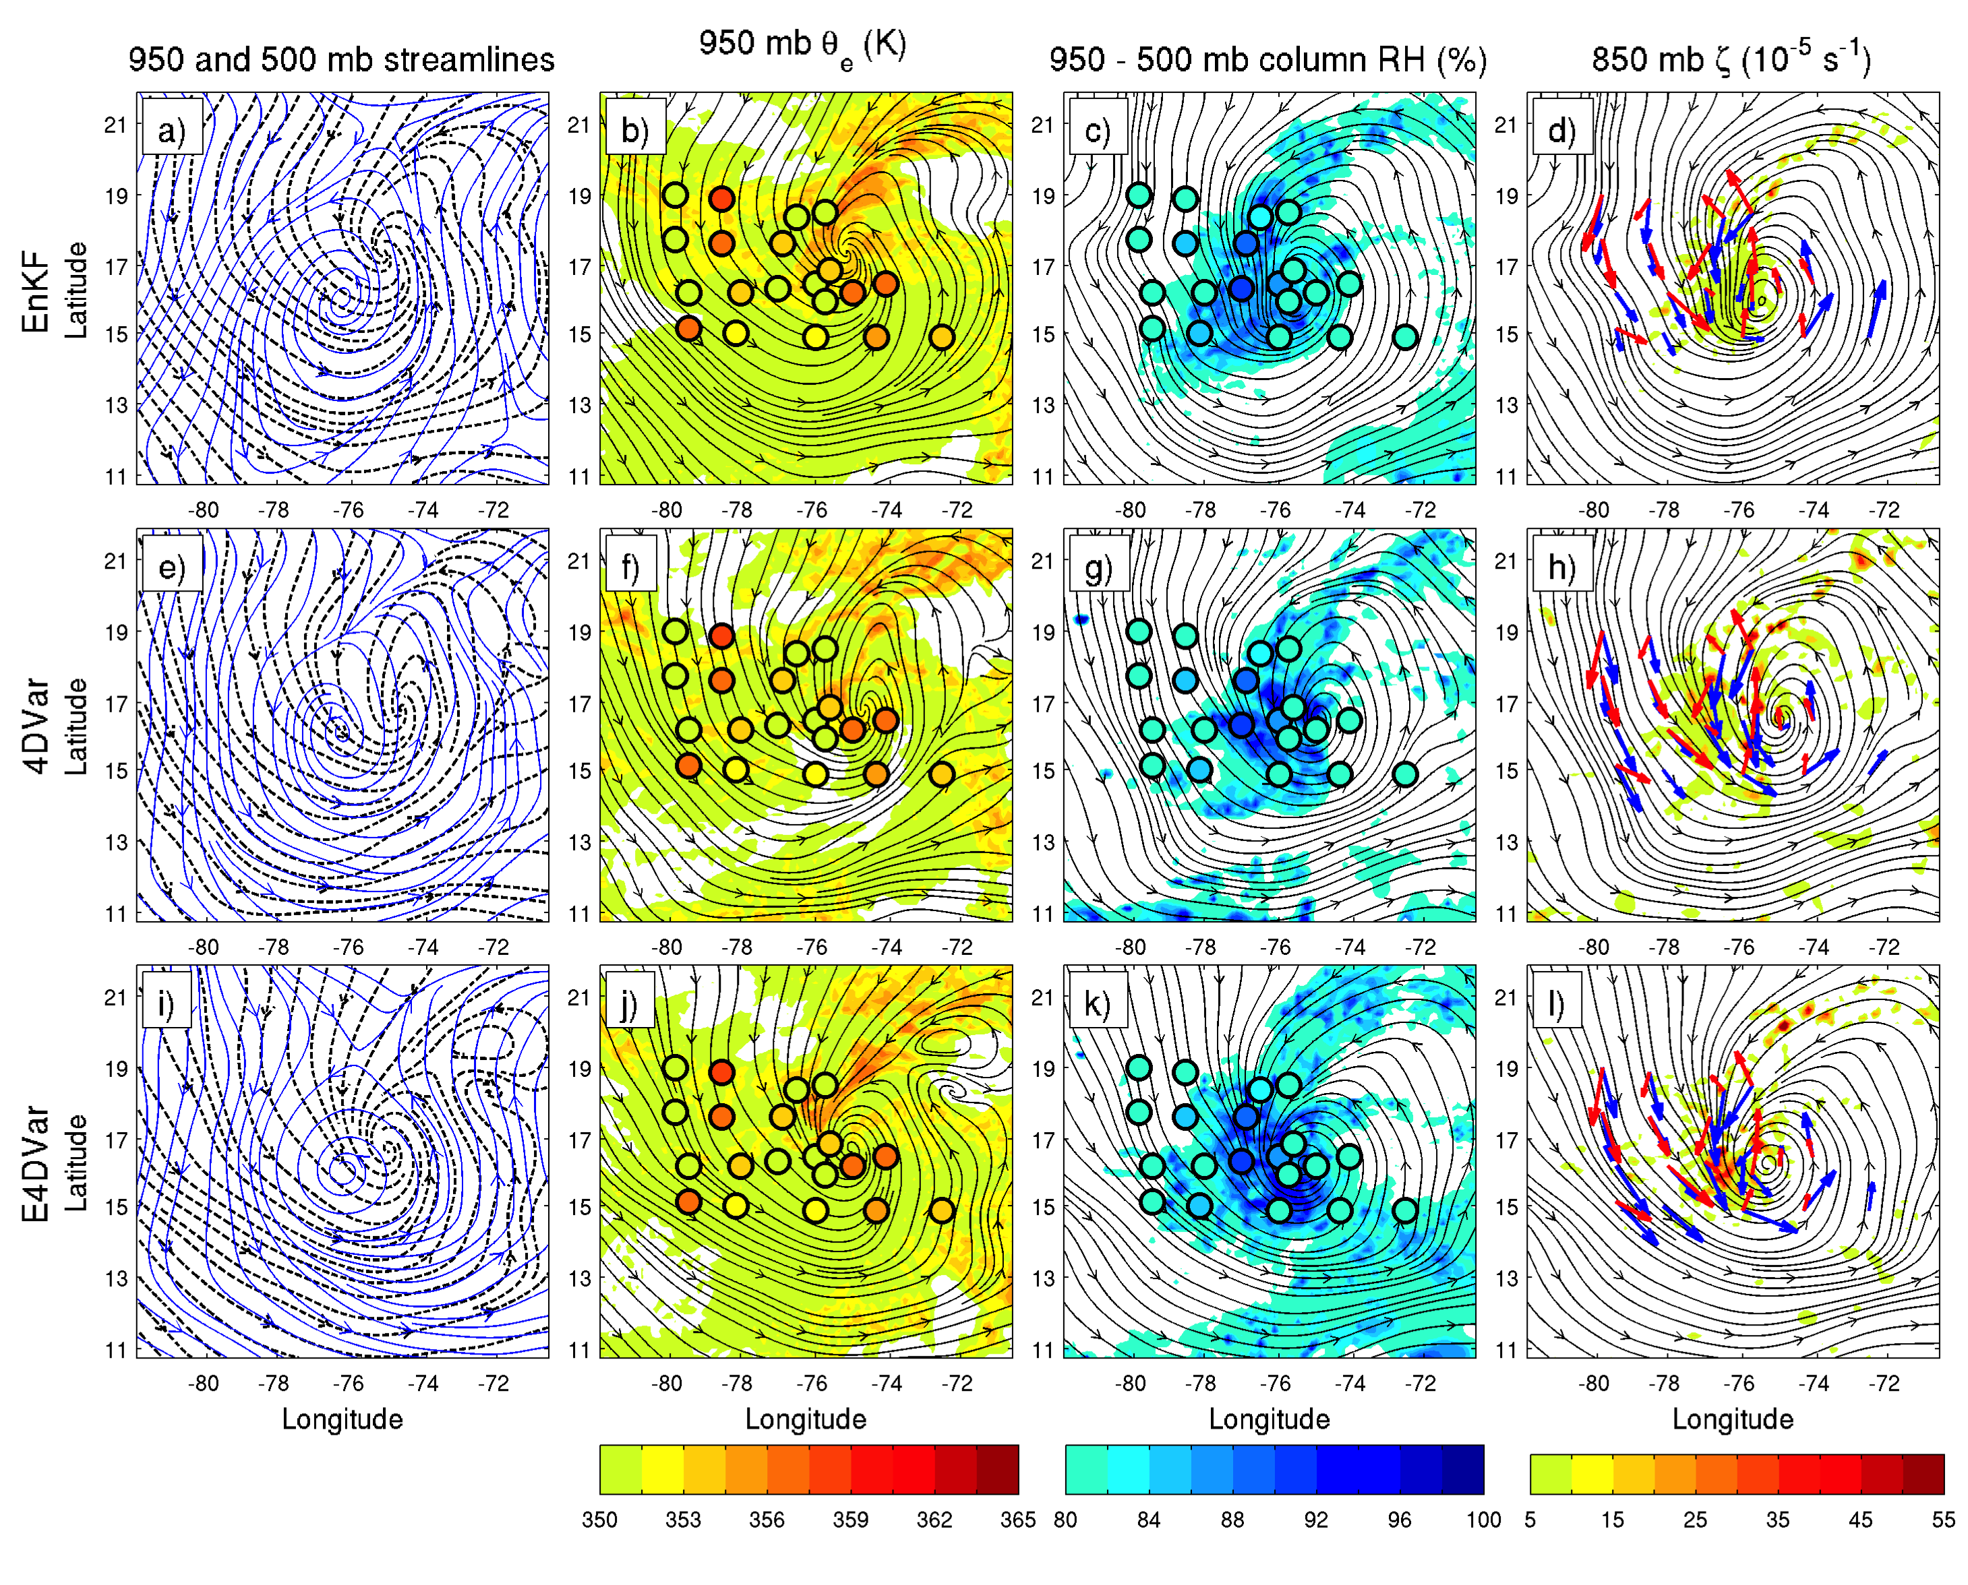
12 UTC 13 forecasts from 06 UTC 13 (6-h lead time)
Filtered (black) 950 and (blue) 500 mb streamlines, 950-mb θ_{e}, column RH, and vorticity are plotted for the 12 UTC 13 forecast.
PREDICT observations are indicated by the shaded circles and red wind vectors.

Slide 11
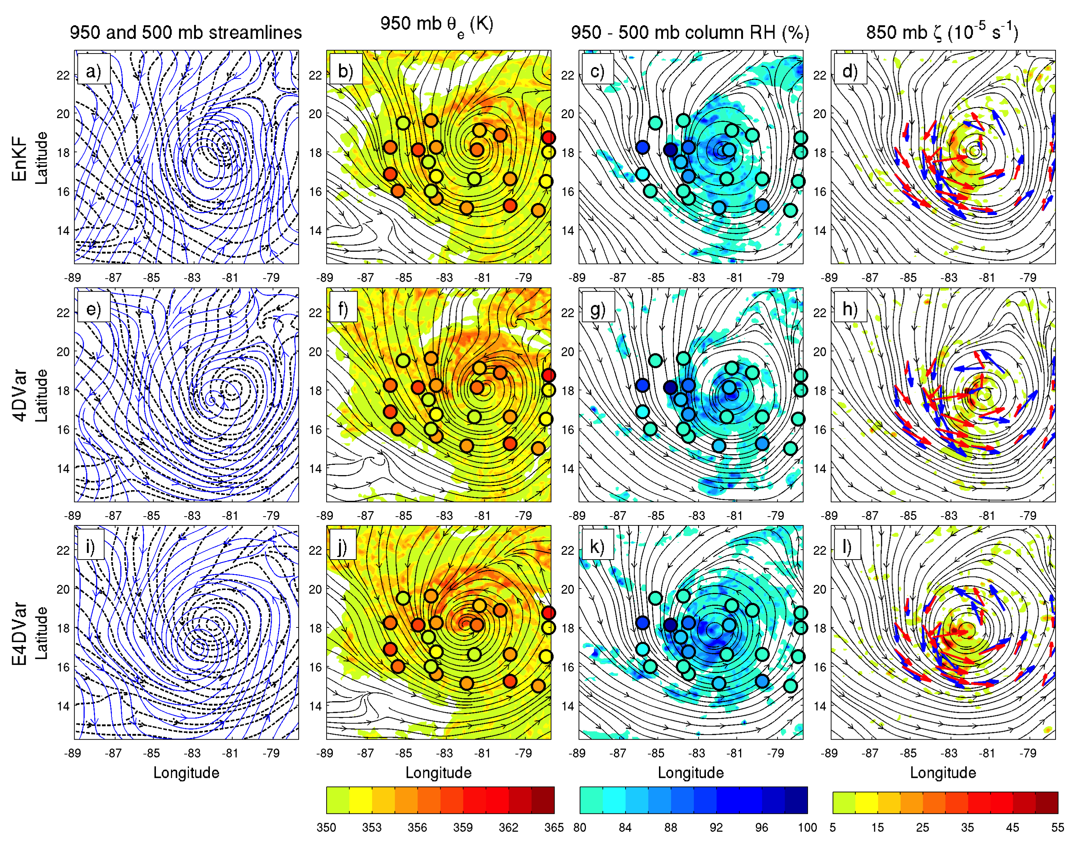
18 UTC 14 forecasts from 06 UTC 13 (36-h lead time)
Filtered (black) 950 and (blue) 500 mb streamlines, 950-mb θ_{e}, column RH, and vorticity are plotted for the 18 UTC 14 forecast.
PREDICT observations are indicated by the shaded circles and red wind vectors.

Slide 12
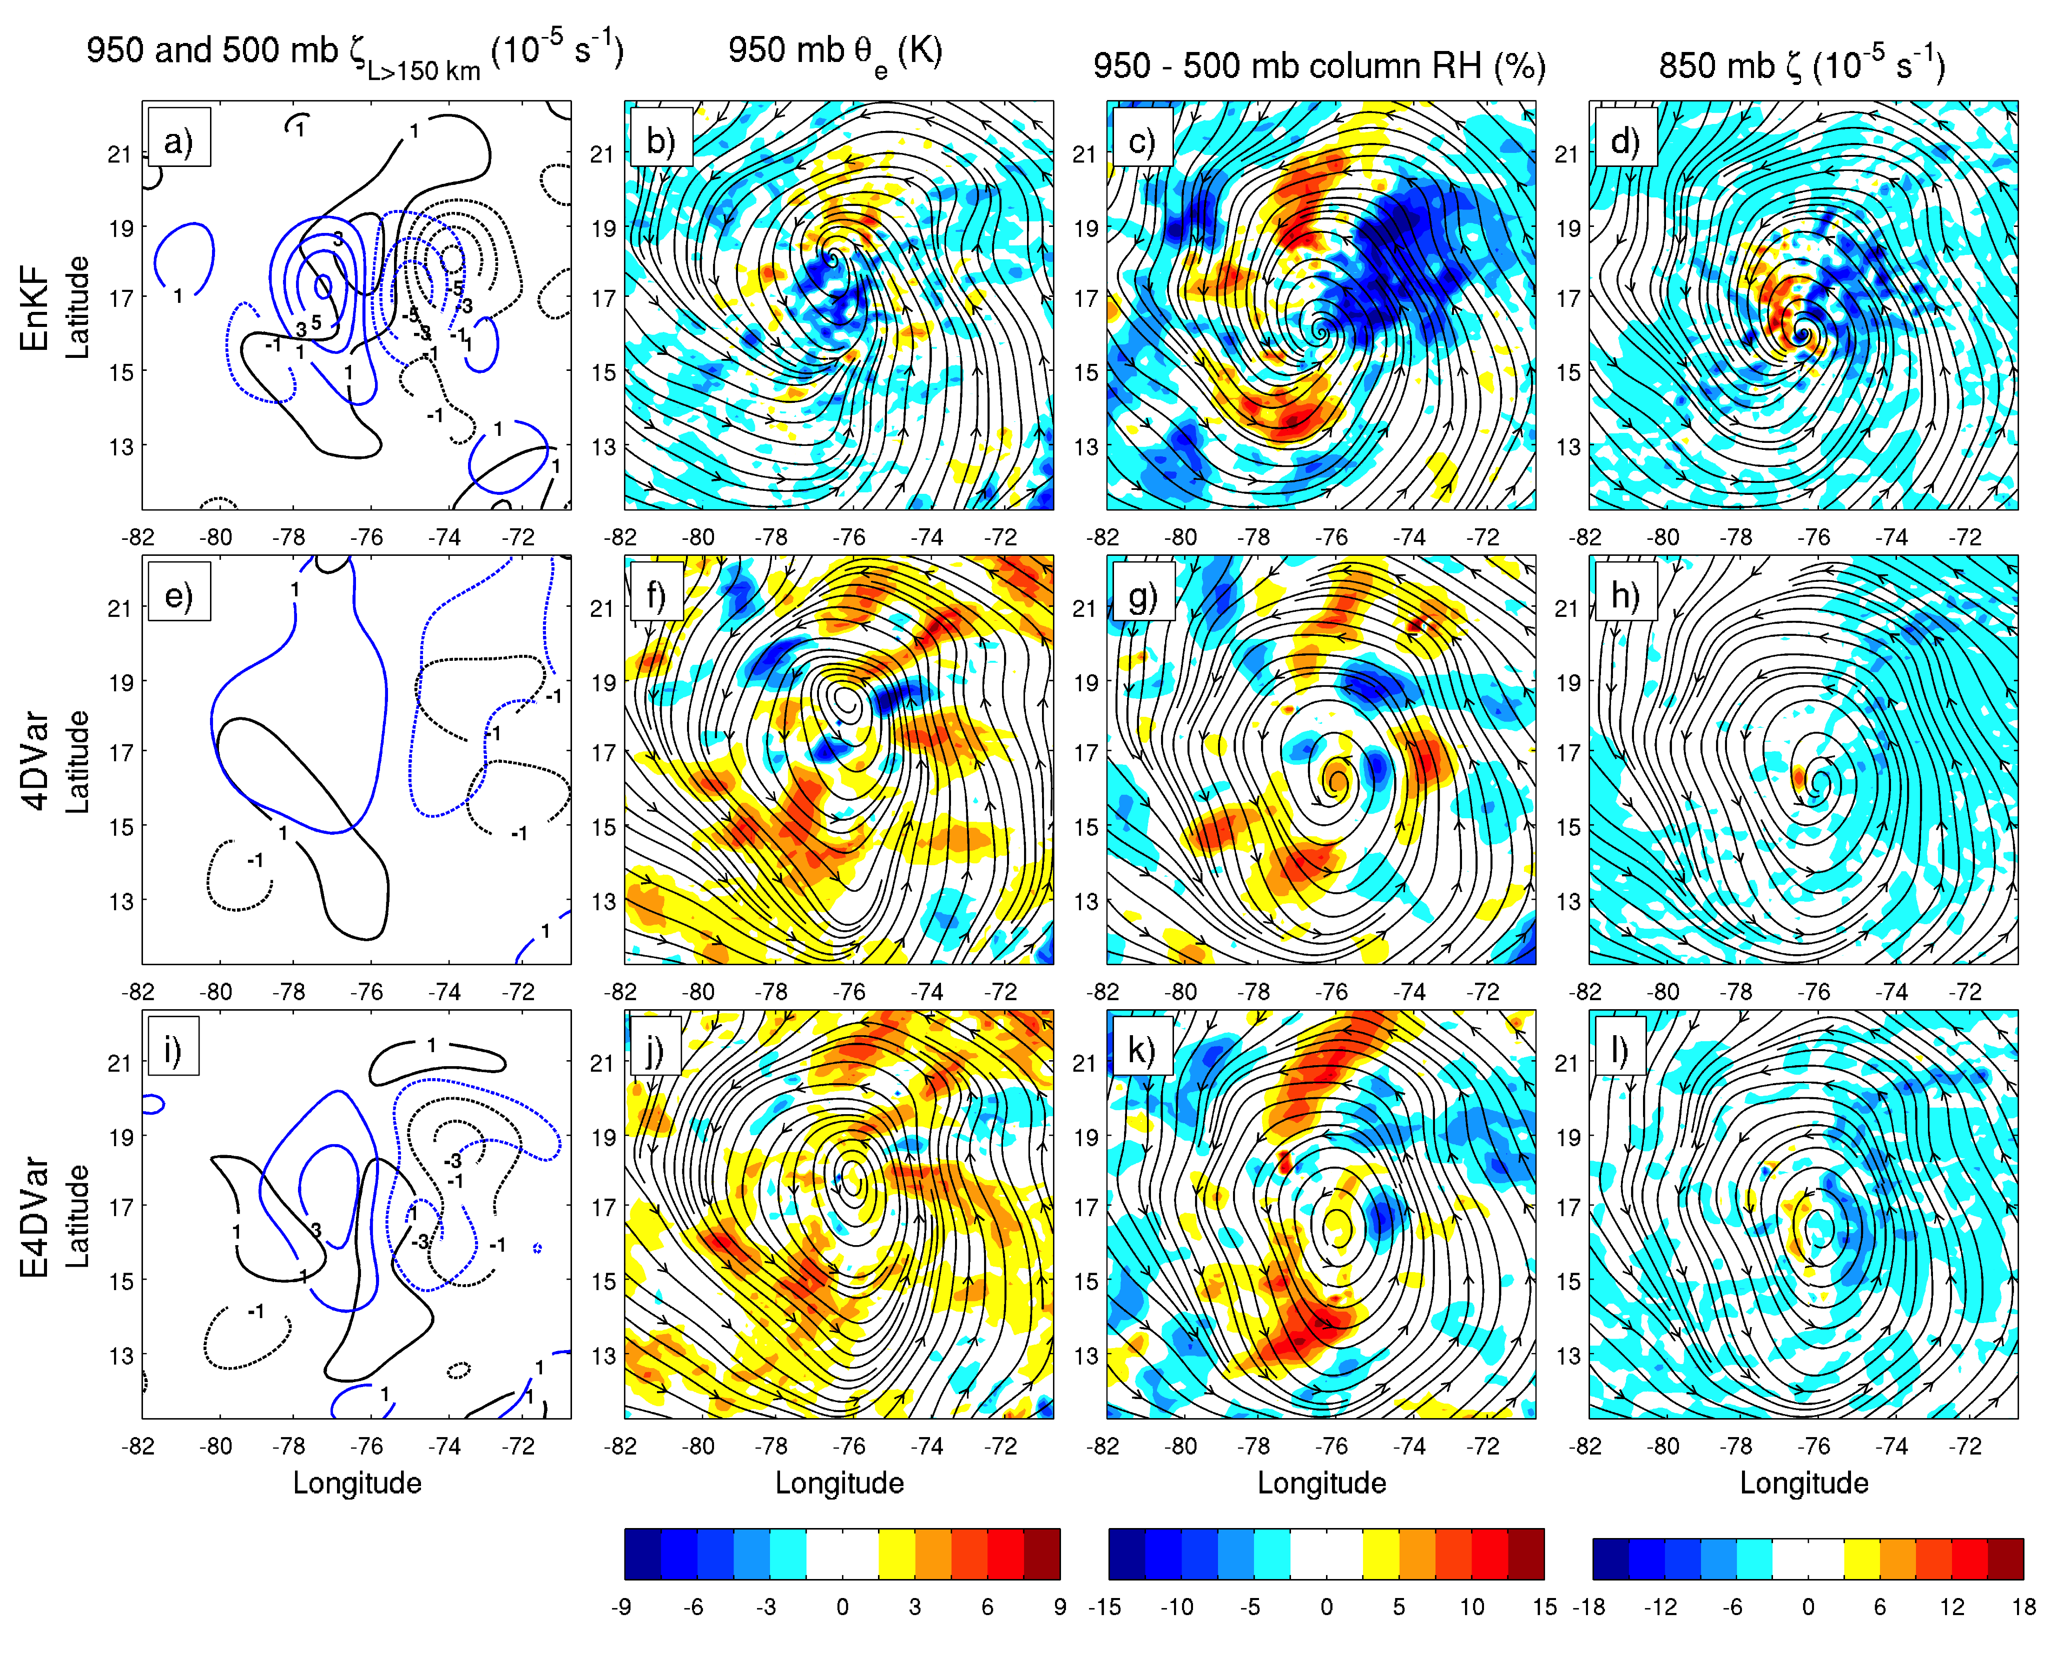
EnKF, 4DVar and E4DVar analysis increments at 12 UTC 13 Sept.
Filtered relative vorticity increments are compared along with increments to 950 mb θ_{e}, column RH and 850 mb (unfiltered) relative vorticity.
The EnKF produces larger increments to the wind field at all levels to move the circulation center farther westward at this time.
The length scale of the 4DVar increments is limited mostly by the parameters used to specify the climatological B.
Moisture is not included as a control variable in 4DVar (using CV5), so increments to θ_{e} and column RH must come from T and P, or adjustments to specific humidity using the adjoint model.

Slide 13
Balance
3-h pressure tendency after initialization
The domain-averaged dry surface pressure tendency is used as a metric for imbalance following each data assimilation cycle.
The pressure tendencies in the E4DVar analyses are comparable to the EnKF case, both of which perform better than 4DVar.
The E4DVar system appears to be the most stable, with fewer spikes in pressure tendency.

Slide 14
Conclusions
EnKF vs. 4DVar
4DVar analyses produce more accurate track forecasts than EnKF for the pre-Karl tropical wave, but, intensity forecasts from the EnKF analyses are much more accurate.
An experiment using EnKF and 4DVar to assimilate the same observations with the same background reveals significant differences in the analyses, namely the location of circulation center in the domain, the length scale of analysis increments, and the horizontal variation of θ_{e} and column RH.
E4DVar
The new E4DVar system outperformed the standalone EnKF and 4DVar methods in terms of forecast error reduction.
The genesis prediction for Karl was improved by a full day over the EnKF and 4DVar methods.
The use of ensemble background information also improved the initial condition balance and preconditioning of the 4DVar cost function (not shown).

