Slide 1
Group meeting:
Summary for HFIP 2012
05/20/2013
Notes:
Good morning. I’ll summarize PSU 2012 work here.

Slide 2
Outline
APSU 2012 stream 1.5 system configuration;
System update before 2012 hurricane season;
Performance of 2012 real-time;
APSU retrospective runs for 2008-2012 TDR cases;
ANPS retrospective runs for 2008-2012 AL storms;
Sensitive experiments on initial fields;
DA Tiger Team Recon experiment.
Notes:
This report will introduce the APSU 2012 stream 1.5 system configuration; what we made for updating this system, the 2012 realtime performance. Also I’ll present the retrospective runs for all 102 applicable TDR cases during 2008 and 2012, and no data assimilation runs for all Atlantic storms during 2008 and 2012. Then I’ll talk about what we are doing and what we will do before this hurricane season.

Slide 3
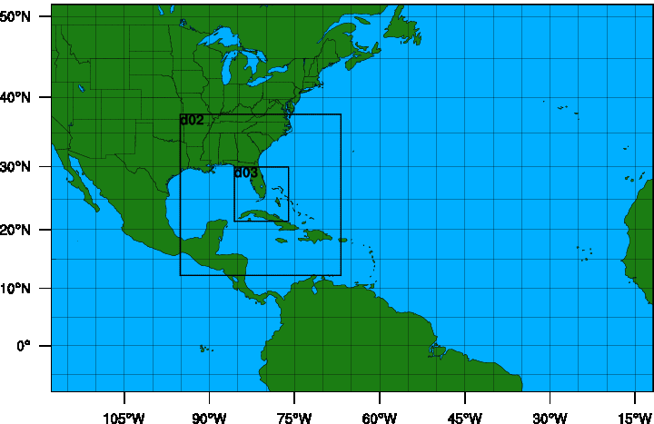
1.1 PSU ARW-EnKF system Configurations
ARW | V3.4.1
Cumulus | Grell-Devenyi ensemble (27 km domain only)
Microphysics | WSM 6-class graupel
PBL | YSU
Surface Layer | Monin-Obukov
Land Surface | thermal diffusion
Radiation | Rrtm / Dudhia
Air-sea flux | Green and Zhang
60-member ensemble
Gaspairi & Cohn 99' covariance localization with varying RoI
IC & BC: GFS using 3DVAR background uncertainty
Hourly assimilation with TDR over all 3 domains
D1: 379x244x27kmx44sigma
D2: 304x304x9km
D3: 304x304x3km
ATCF ID:
APSU: stream 1.5, ARW 3-km deterministic forecast initialized with TDR assimilation;
ANPS: stream 2.0, ARW 3-km deterministic forecast initialized with operational GFS Analysis.
Notes:
There are 2 streams for PSU in 2012. Stream 1.5 named ATCF ID APSU is ARW deterministic forecast initialized with TDR data assimilation, while stream 2.0 ANPS is ARW deterministic forecast initialized with operational GFS analysis. Both of them have the same WRF model configuration. They have 3 domains with 27,9,3 km resolution, the out domain is fixed, the 2 inner domains are centered by the TCVital data. For TDR data assimilation, there are 60 members initialized with operational GFS and perturbed by WRFDA.

Slide 4
1.2 APSU workflow
Deterministic Forecast with fixed domains
Deterministic Forecast with moving nested domains by vortex
Ensemble Forecast
Ensemble Forecast
Ensemble Forecast
SOs from
1st leg
SOs from
legs
The last
leg
00h
-12h
wrf-3dvar produce 60 members from GFS analysis with 3 domains
GFS forecast as BCs
EnKF with radar Vr
EnKF with radar Vr
EnKF with radar Vr
The forecast will be available and verified
since this time.
Usually there are about 2 to 5 legs for one NOAA P3 mission during -3h and 2h
Notes:
The APSU system is initialized 12h early with GFS operational analysis, and then perturbed by WRFDA, and then integrated the 60 members to the time when the 1st leg SO is available. Then the system assimilates TDR hourly till the end of the TDR mission. After the assimilation, the time of the analysis will be shifted to the closet time of 00, 6 12 or 18 Z, and GFS forecasts 6 hour early will be used as the boundary condition.

Slide 5
2.1 APSU system update before 2012 demo:
30 to 60 ensemble member
Track (km)
Pmin (mb)
Vmax (kt)
Red Solid:
30-member
Red dash:
60-member
Mean absolute forecast errors homogeneously averaged for 2008-2010 TDR cases.
BASE: HFIP baseline;
A4PS: 4.5-km EnKF with 30 members;
A4P6: 4.5-km EnKF with 60 members
Notes:
According to our research work on EnKF ensemble number for hurricane Katrina, we found that 60-member EnKF has better covariance and improves EnKF analysis in terms of winds and pressure. So we updated our system to 60 members. This slide shows the comparison between 30- and 60- member EnKF based on 2011 system (A4PS). The 59-case run shows 60-member EnKF improves hurricane intensity forecast between 24~96 hours lead-time.

Slide 6
2.2 APSU system update before 2012 demo:
4.5 km- 35 levels to 3.0 km - 43 levels
Track error
Pmin error
Vmax error
Pink dash:
4.5 km
Red :
3.0 km
Mean absolute forecast errors homogeneously averaged for 2008-2011 TDR cases.
A4PS: 4.5-km EnKF;
APSU: 3.0-km EnKF.
Notes:
to be consistent with the NHC operational Hurricane WRF model. We increased the model resolutions from horizon 4.5 km to 3.0 km and vertical 35 levels to 43 levels. This update seems make smaller pressure error.

Slide 7
2.3 APSU system update before 2012 demo: air-sea surface flux
Track error (km)
Pmin error (mb)
Vmax error (kt)
Solid lines: error
Dash lines: bias
2011 system
2012 system
Mean absolute forecast errors homogeneously averaged for 2008-2011 TDR case.
A4PS-2011system (yellow) : PSU 2011 stream-1.5 system, which has 4.5 km horizontal resolution and Charnock TC surface flux scheme.
APSU: PSU 2012 stream-1.5 system ;
APSU-(Ch+Ga)/2: the scheme by combining the Charnock and the updated Garratt schemes by Fuqing Zhang, where CD was allowed to increase above 2.4x10⁻³ at high wind speeds, but at half the rate of increase that is found at low wind speeds .
Notes:
Surface fluxes are believed to be important in determining tropical cyclone intensity. Here we tested the schemes in WRF version 3.3.1 and 3.4.0, also we tested a uniquely modified version by combining of schemes Charnock and Garratt. This slide shows the forecast error and bias. The result shows that the 2012 “APSU” system has smaller forecast error and bias.

Slide 8
3.1 APSU 2012 stream 1.5: deterministic forecast
2012 NOAA TDR cases:
Alberto (1), Isaac (9), Leslie (3) and Sandy (7).
Due to NOAA Jet computing resource issue, we only operated 16 missions for hurricane Isaac and Sandy in real-time.
Isaac
Track
Vmax
Sandy
Track
Vmax
PSU ARW-EnKF 2012 demo system real-time forecasts for hurricane Isaac (up) and Sandy (down). ANPS is the ARW forecast without data assimilation, while APSU is the PSU ARW-EnKF forecast initialized with the EnKF analysis by assimilating NOAA airborne radar observations.
Notes:
There are 20 available NOAA-P3 airborne radar missions in 2012 hurricane season for Atlantic tropical storm Alberto (1 mission), hurricane Isaac (9 missions), Leslie (3 missions) and Sandy (7 missions). Due to NOAA Jet computing resource issue, we only operated 8 and 7 missions for hurricane Isaac and Sandy in real-time, respectively. This slide shows the track and intensity forecasts for hurricane Isaac and Sandy. The blue lines are for ANPS, which are initialized from GFS without TDR data assimilation, the red lines are APSU which assimilated TDR observation in real-time. For hurricane Isaac, the intensity for both ARW forecasts are much stronger than the best track.

Slide 9
3.1 APSU 2012 stream 1.5: deterministic forecast error
Isaac
+
Sandy
Track error (km)
Vmax error (kt)
Isaac
Track and Intensity forecast error for PSU 2012 stream 1.5 runs.
APSU: PSU stream 1.5 with TDR
ANPS: PSU stream 2.0 with GFS analysis
OFCL, HWRF, GFDL and GFS are operational forecasts.
Sandy
Notes:
Here shows the position and intensity error for 2012 real-time runs. The above panels are total averaged absolute error for hurricane Isaac and sandy, while the bottom smaller figures show them separately. Comparing to the PSU 2 streams, APSU has smaller intensity error than ANPS which doesn’t assimilate TDR observation. For APSU, the forecast for hurricane Sandy is better than those for hurricane Isaac. The APSU forecast error in both position and intensity is one the smallest error products.

Slide 10
3.1 APSU 2012 stream 1.5: ensemble track forecast
00Z/26
12Z/26
00Z/27
12Z/27
00Z/28
12Z/28
APSU Real-time ensemble track forecasts for hurricane Sandy with TDR assimilation.
Notes:
This slide shows the exemplar APSU ensemble track forecasts for hurricane Sandy. It may be difficult to systematically evaluate the performance of any probabilistic forecast with a limited number of cases, the ensemble forecast tracks initialized with the Enkf perturbations provide case-dependent uncertainties associated with the deterministic track, and the ensemble forecast spread covers well the best track and the operational GFDL and HWRF forecasts.

Slide 11
3.1 APSU 2012 stream 1.5: ensemble intensity forecast
00Z/26
12Z/26
00Z/27
12Z/27
00Z/28
12Z/28
APSU Real-time ensemble intensity forecasts for hurricane Sandy with TDR assimilation.
Notes:
For intensity forecasts, the ensemble forecast initialized with EnKF perturbation

Slide 12
3.1 APSU 2012 stream 1.5: wind swatch and probabilities sample
APSU surface wind swatch
APSU deterministic forecast surface wind swatch and ensemble surface wind forecast probability for hurricane Sandy initialized at 00Z/26 Oct 2012.
Probability =
hitted members
/total members
34 kt surface wind probability
50 kt surface wind probability
64 kt surface wind probability
Notes:
This slide shows the spatial distribution of the maximum surface wind speed in the deterministic forecast by the PSU WRF-EnKF system (using hourly output), and Ensemble-derived probabilities of maximum wind speed exceeding (at any time during the forecast) 35, 50 and 64 knots, respectively for hurricane Sandy available at 00Z/26 October 2012.

Slide 13
3.1 APSU 2012 stream 1.5: precipitation forecast sample
NWS 4km 96-h rainfall
APSU 96-h deterministic rainfall forecast
100 mm 96-h rainfall forecast probability derived from APSU ensemble forecast
Spatial distribution of the 96-h (12Z26 to 12Z 30) accumulated rainfall (up) and the ensemble-derived probability of accumulated precipitation exceeding 100 mm (left) for hurricane Sandy initialized at 00Z/26 Oct 2012.
Notes:
This slide shows the 96-h accumulated precipitation for APSU deterministic forecast available at 00Z/26 October 2012, and its ensemble-derived probability of accumulated precipitation exceeding 100 mm. The observation is NWS 4km 24h accumulated precipitation product.

Slide 14
3.2 ANPS 2012 stream 2.0 performance
Track error (km)
Vmax error (kt)
GFS and ANPS
Negative bias –
GFS forecast is weaker than others
ANPS forecast is much stronger than others
ANPS 2012 stream 2.0 system real-time forecasts for Atlantic storms.
Total 762 forecasts were made in 2012 for storms and invests.
Notes:
In 2012, we conducted 762 forecasts in real-time for stream 2 ANPS. The homogenize verification indicates that ANPS has a good track forecast, and ANPS, GFS and official are the 3 smallest position error forecasts. But the intensity forecast error is not we expected. The bias shows that the ANPS intensity forecasts are much stronger than others.

Slide 15
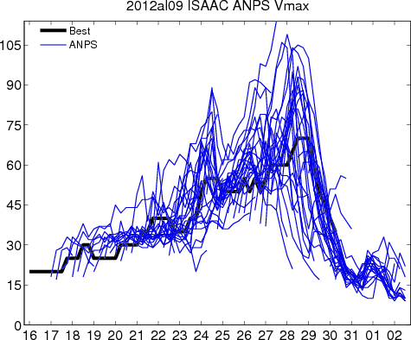
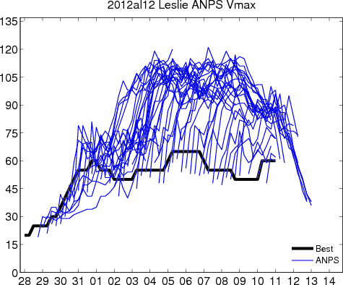
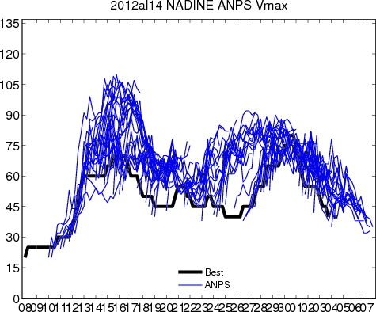
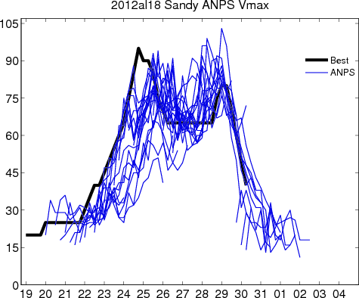
3.2 ANPS cases: intensity forecast
Isaac
Leslie
Nadine
Sandy
Notes:
Here shows

Slide 16
4.1 APSU for 2008-2012 TDR cases
Year | Cases | Storm (cases)
2008 | 35 | Dolly (6), Fay (6), Gustav (6), Ike (6), Kyle(8), Paloma(3)
2009 | 10 | Ana (1), Claudette (4), Danny (5)
2010 | 25 | Alex (1), Two (3), Earl (11), Karl (4), Gaston (1), Tomas (5)
2011 | 13 | Irene (7), Lee (1), Ophelia (1), Rina (4)
2012 | 19 | Isaac (9), Leslie (3), Sandy (7)
Total | 102 | 22 storms

Slide 17
4.1 2008-2012 APSU Errors
Track error (km)
Vmax error (kt) with bias-corrected
APSU forecast error for 102 TDR cases during 2008-2012.
Average uncertainty in Best track:
Landsea, C., and J. Franklin, 2013

Slide 18
5.1 ANPS for 2008-2012 Atlantic Storms
Track error (km)
Vmax error (kt)
ANPS forecast error homogeneously averaged over 2140 cases of 2008-2012 Atlantic storms.
OFCL has the smallest track and intensity error;
ANPS has the same track error as GFS, but has smaller intensity error;
Initial intensity bias for ANPS and GFS are very large;
ANPS is Y2012 system, others are operational systems.

Slide 19
5.1 ANPS yearly track errors during 2008-2012
2008, 398 cases
2009, 167 cases
2010, 481 cases
2011, 470 cases
2012, 624 cases
ANPS track forecast error.

Slide 20
5.1 ANPS yearly intensity errors during 2008-2012
2008, 398 cases
2009, 167 cases
2010, 481 cases
GFS initial bias is more and more smaller in years;
ANPS has smaller intensity error than GFS during 2008-2010;
ANPS after 72h is worse than GFS in 2011;
ANPS is worse than GFS in 2012;
2011, 470 cases
2012, 624 cases
ANPS intensity forecast error.

Slide 21
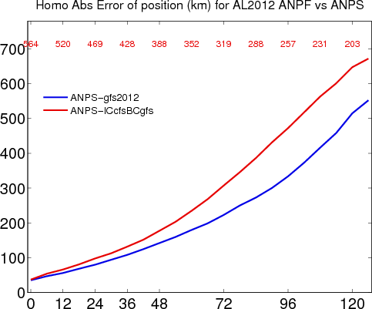
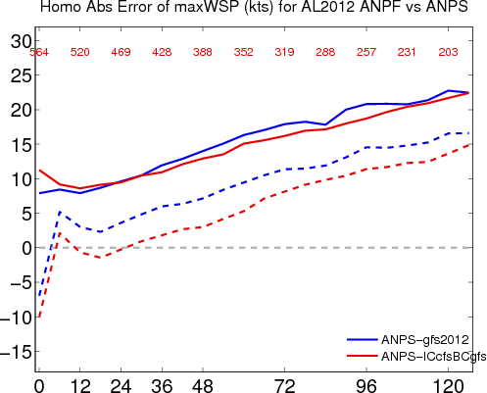
6.1 Different Global Forecasts for ANPS:
GFS vs. CFSRv2 for 2012 Atlantic Storms
Track error (km)
Vmax error (kt)

Slide 22
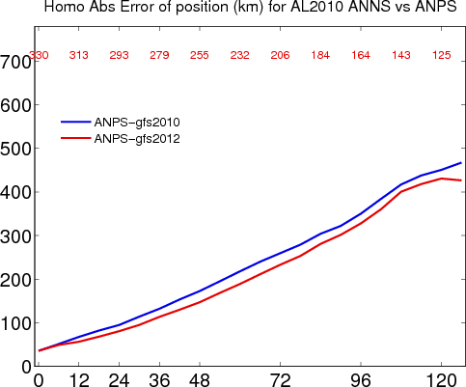
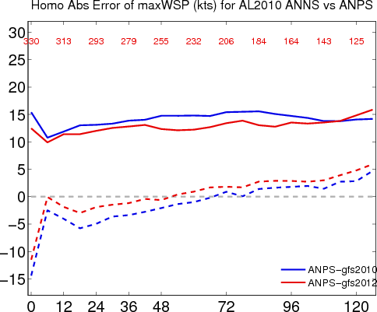
6.2 Different Global Forecasts for ANPS:
GFS_2010 vs. GFS_2012 for 2010 Atlantic Storms
(only some cases during 8/1-9/30/2010)
Track error (km)
Vmax error (kt)
GFS_2012 data are provided by Vijay.
ANPS for all 2010 AL

Slide 23
7 Working and Work Plan:
DA Tiger Team Recon experiment
ATCF ID:
APCT (APCI): ConTrol.
APRC (APRI): ReCon (FL + drops)
APAR (APAI): All Recon (Doppler + FL + drops)
Experiment design:
The system configurations are the same as APSU;
The system is initialized with operational GFS, and cycled every 3 hours till the end of the storm or the storm moves to the north of 45N or the east of 30W ;
The inner domains follow Tcvitals;
Assimilating obs. Within the area of 1200kmx1200km around the storm every 3 hours;
Environment fields (out of the 1200kmx1200km area) are replaced by GFS operational analysis every 6 hours;
Deterministic forecasts are conducted every 6 hours.

Slide 24
7. DA Tiger Team: cases
Year | Storm | CNTL | FLDP | FDTR
2010 | 01-Alex | 062500-070112 | 062518-070100 | 062900
 | 07-Earl | 082600-090400 | 082900-090400 | 082900-090400
 | 13-Karl | 091412-091718 | 091418-091718 | 091300-091618
 | 19-Richard | 102012-102512 | 102018-102500 | 102300
 | 21-Tomas | 102912-110718 | 102918-110700 | 110400-110700
2011 | 09-Irene | 082000-082818 | 082100-082812 | 082400-082712
 | 13-Lee | 090200-090306 | 090200-090306 | 090200
 | 16-Ophelia | 092012-092900 | 092312-092900 | 092418
 | 18-Rina | 102212-102800 | 102312-102800 | 102600-102718
2012 | 09-Isaac | 082000-082900 | 082112-082906 | 082300-082900
 | 12-Leslie | 083000-090812 | 090712-090812 | 090712-090812
 | 14-Nadine | 091000- 100318
 | 18-Sandy | 102100-102918 | 102212-102918 | 102600-102900
Total | 13 | 500 cases
Data source
  GFS: Jet HSMS: /mss/fdr/YYYY/MM/DD/grib/ftp/7/0/96/0_259920_0, grib2.
  Flight level data: ftp://ftp.aoml.noaa.gov/hrd/pub/data/flightlevel, netcdf and ascii formats.
  Dropsonde data: /mss/fdr/2012/10/25/data/dropsonde/netcdf, netcdf.
  TDR: JET: /lfs2/projects/hfip-psu/yweng/Data/Airborne/SO/YYYY.

Slide 25
Plans
Finish the Recon Experiment;
Analysis the inner-core observation impact on hurricane forecast;
Set up the 2013 Demo system;
Analysis the impact of initial fields from different global modes.

Slide 26
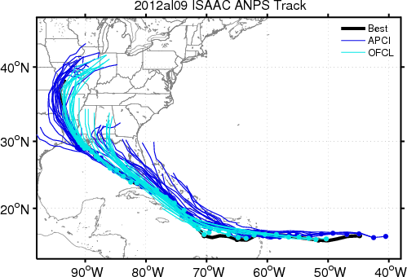
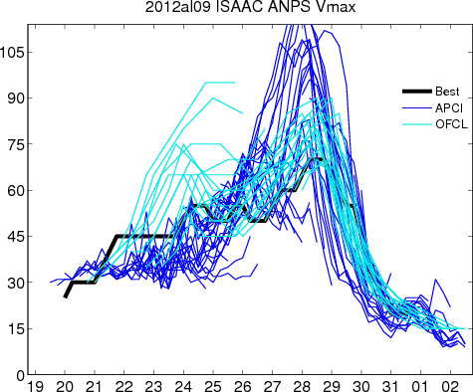
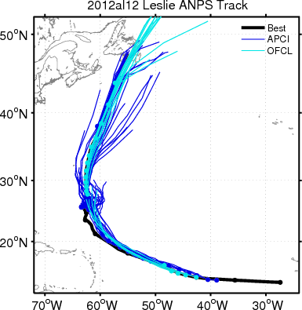
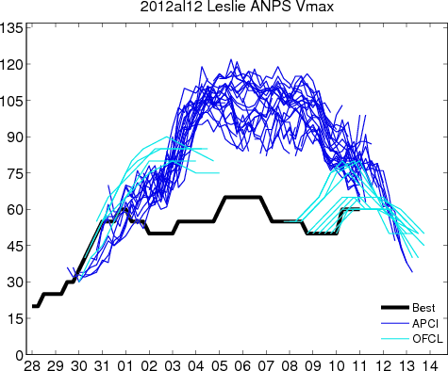
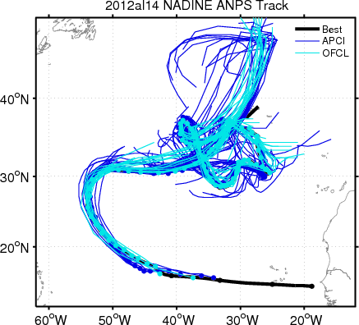
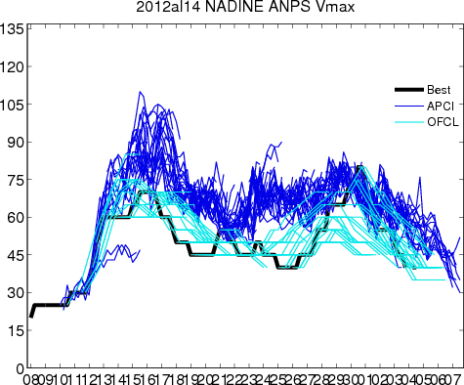
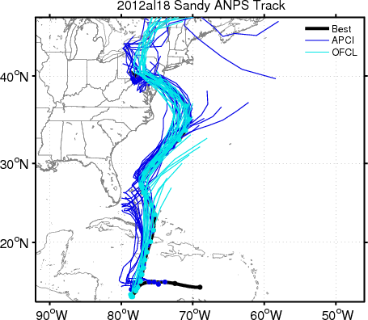
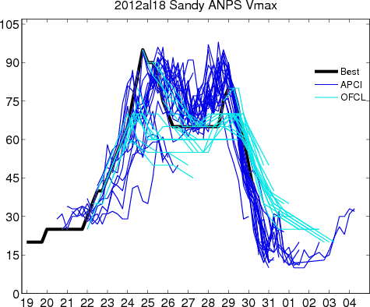
7. DA Tiger Team: APCT for 2012
Track
Vmax
Isaac
Leslie
Sandy
Nadine
APCT track and intensity forecast
ANPS intensity forecast
Isaac
Nadine
Leslie
Sandy

Slide 27
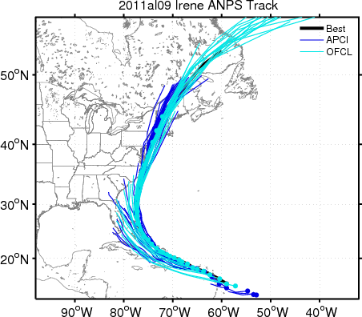
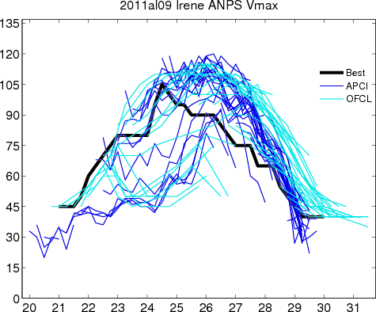
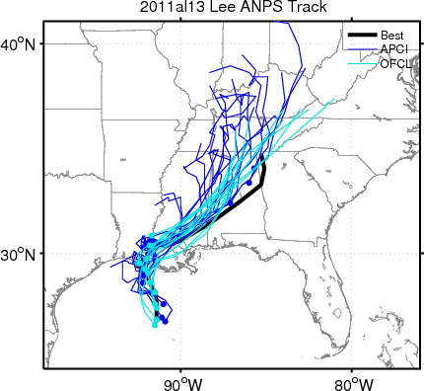
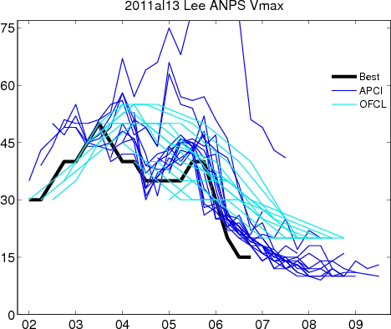
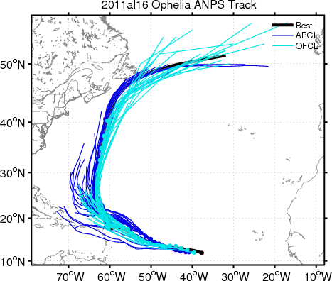
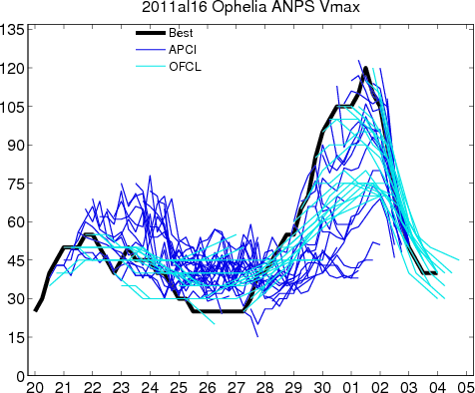
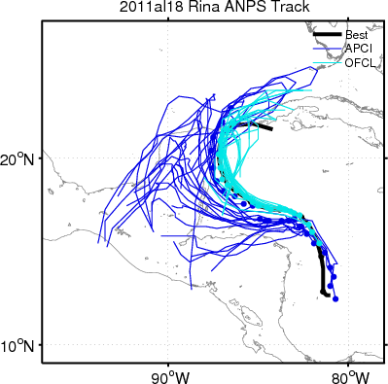
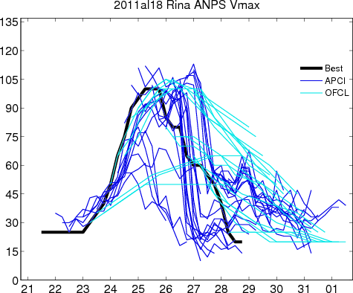
7. DA Tiger Team: APCT for 2011
Track
Vmax
Irene
Lee
Ophelia
Rina

Slide 28
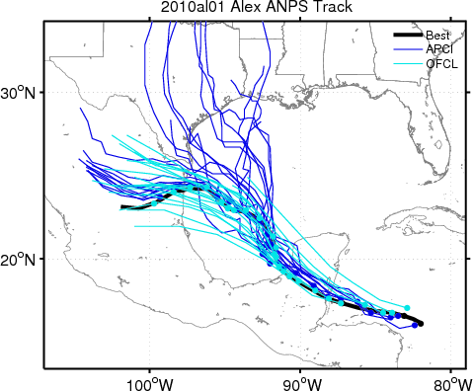
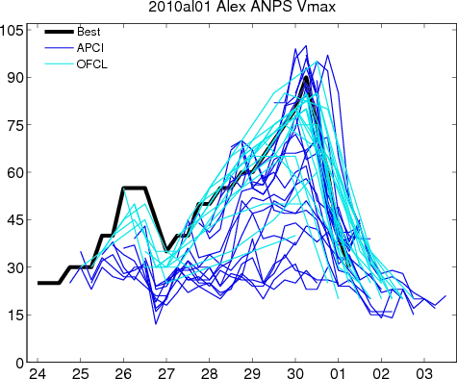
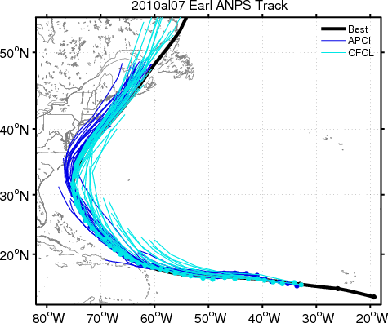
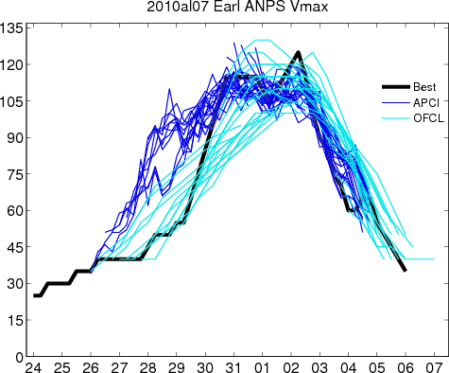
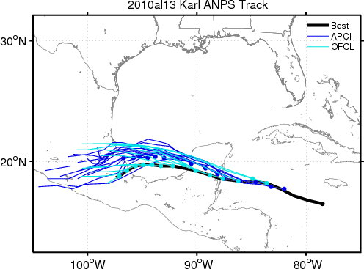
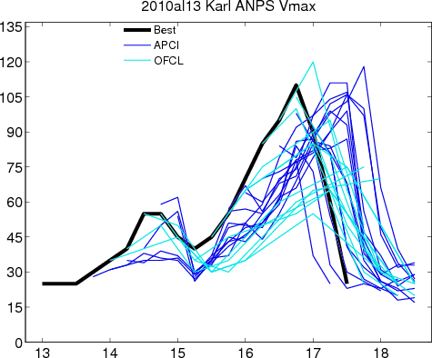
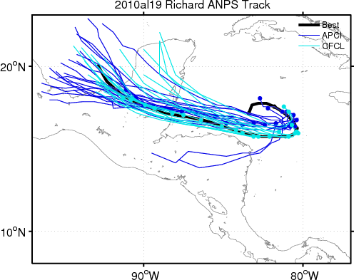
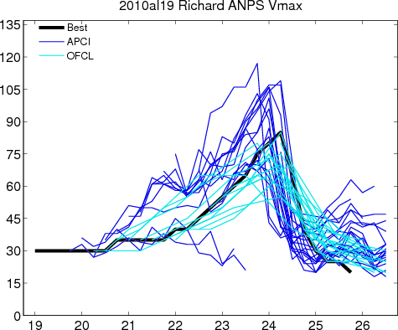
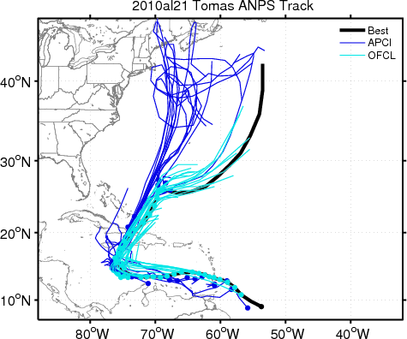
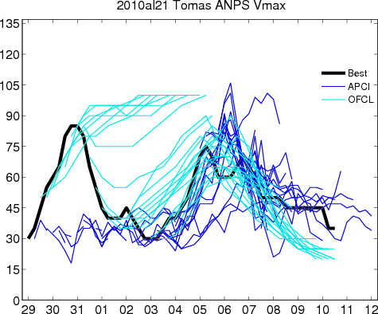
7. DA Tiger Team: APCT for 2010
Alex
Earl
Track
Vmax
Karl
Richard
Tomas

Slide 29
7. DA Tiger Team: APCT errors for 2010-2012
Track error (km)
Vmax error (kt)

Slide 30
7. DA Tiger Team: APCT errors each year
Track error (km)
Vmax error (kt)
2010, 140 cases
2011, 130 cases
2012, 230 cases

