Slide 1
Group meeting 05.20.2013

Slide 2
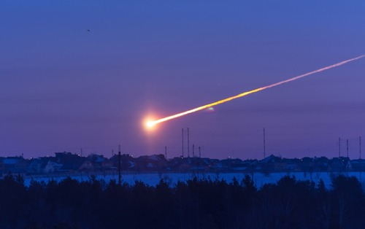
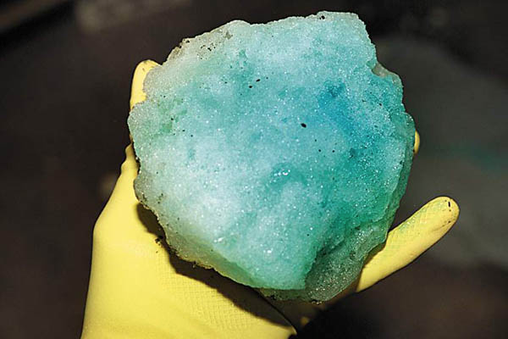
“What if my house is hit by a meteorite?”
Chelyabinsk, Russia: Feb. 15, 2013
“Blue ice”
FAA: planes do not dump waste
Leaks in holding tank RARE
Homeowners Policies
Standard grades HO-1, HO-2, HO-3
HO-2 covers 16 perils including “falling objects”
HO-3 covers everything except a few provisions (i.e. earth movement, nuclear hazard, intentional loss, etc.)
Renters Insurance Policies
HO-4 covers 16 perils including “falling objects”
Integrated energy released from explosion 33x (500 kilotons) Hiroshima, Japan (1945) atomic bomb
Damage estimated at $33 Million
1200 people injured
4000 buildings damaged
100,000 homeowners effected
Notes:
Chino California in 2006.

Slide 3
What has been…
COAMPS-TC
v4.3.2 TCv1.0.0
Modified run scripts/namelists
Tested example data for Hurricane Sandy (2012)
Updated COAMPS v4.3.2 TCv1.0.0 for EnKF update
Included EnKF perturbations
Generated boundary conditions for WRF and COAMPS from GFS
Obtained GFS data
Kept in native grb2 format
Used +/- 60 days 48h-24h GFS forecasts to generate perturbations*
Built library for random sampling
Cohesive perturbations between COAMPS and WRF
* Dr. Jeff Whitaker’s GFS-EnKF Hybrid

Slide 4
What is…
TACC Stampede:
Run COAMPS v4.3.2 TCv1.0.0, COAMPS-EnKF, COAMPS IC/BC programs
Run WRF-PSU-EnKF
Focusing on Karl (2010) ensemble
Testing COAMPS-EnKF code modification
P-3 update
Currently: code runs, assimilates observations, and results are within the “ballpark”
Verify results against PSU-WRF-EnKF
Technical English Exam

Slide 5
What will be…
Set-up and run WRF-EnKF and COAMPS-EnKF experiments
Hurricane Karl (2010)
As close as possible: physics, dynamics, horizontal/vertical grid, domains, etc.
Focus on initial times:
09/12: 00Z/12Z
09/13: 00Z/12Z
Tropical cyclone vortex structure analysis:
Similar to Aksoy et al. 2012, Aksoy 2013

Slide 6
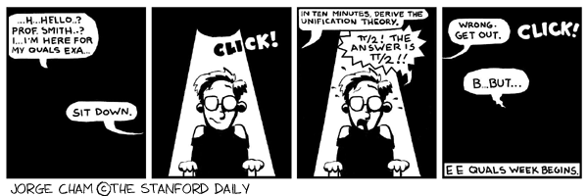
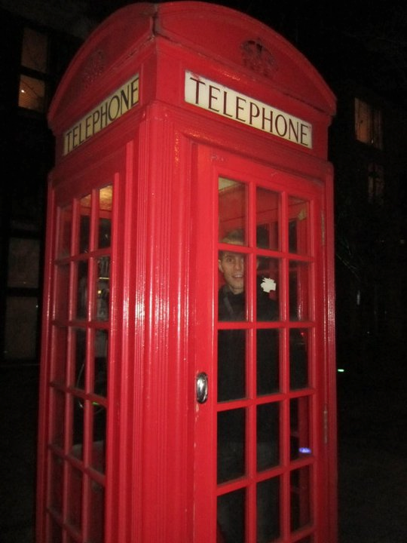
What will be…continued
Candidacy Exam:
Beginning of August
P-3 observation modification?
Coplane “dual-Doppler” observation generation

