Slide 1
The (Possible) Impact of Inertio-gravity waves on the MJO Initiation
Michael Ying
5-20-13

Slide 2
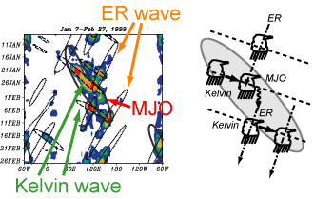
Background
MJO initiation
Current theories
Moist static energy (MSE) discharge-recharge (Blade and Hartman 1993)
Wave packet of equatorial Rossby and Kelvin waves (Masunaga 2008)
What’s the role of waves during the MJO initiation?
charging of MSE
organizing of convection into cluster

Slide 3
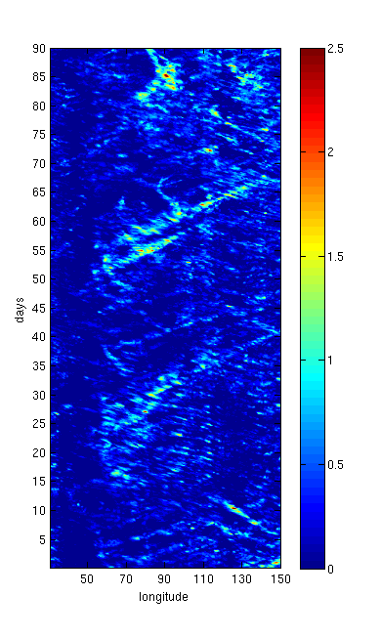
Background
Contribution from high-frequency small-scale waves? (related to diurnal variations)
TRMM smoothed
(Masunaga 2008)
CMORPH
8km unsmoothed

Slide 4
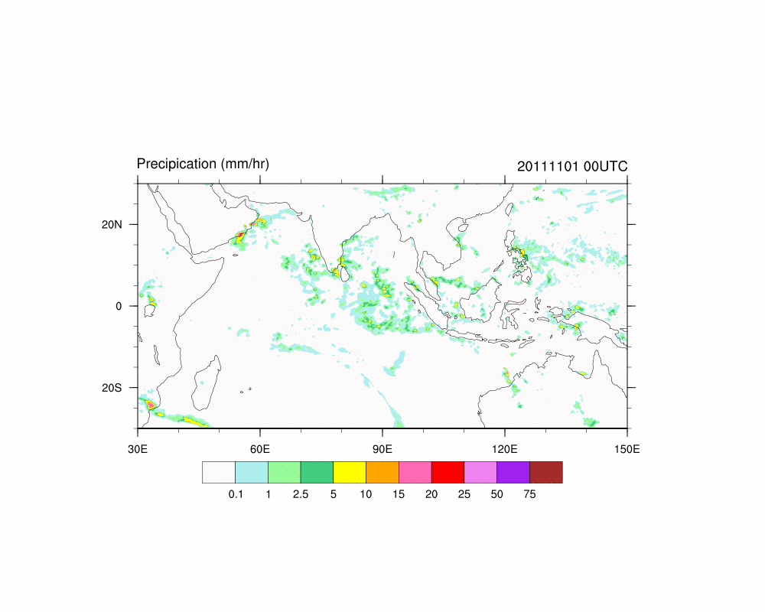
2011
Modes of variability over the Indian Ocean (where MJO initiation takes place)
propagation direction
speed
OCT NOV DEC

Slide 5
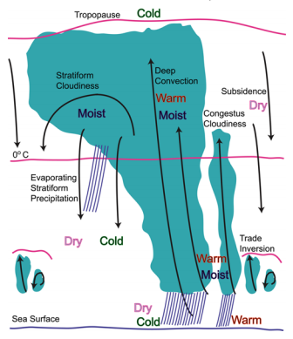
convectively coupled inertio-gravity waves (2-day waves)
Hypothesis on MJO initiation:
The westward propagating inertio-gravity (WIG) waves during the MJO dry phase triggers shallow convection, which moistens the troposphere and pre-conditions for the upcoming wet phase.
-24h -12h 0 12h 24h
lag

Slide 6
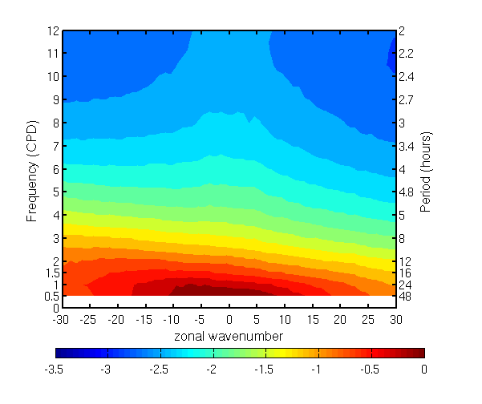
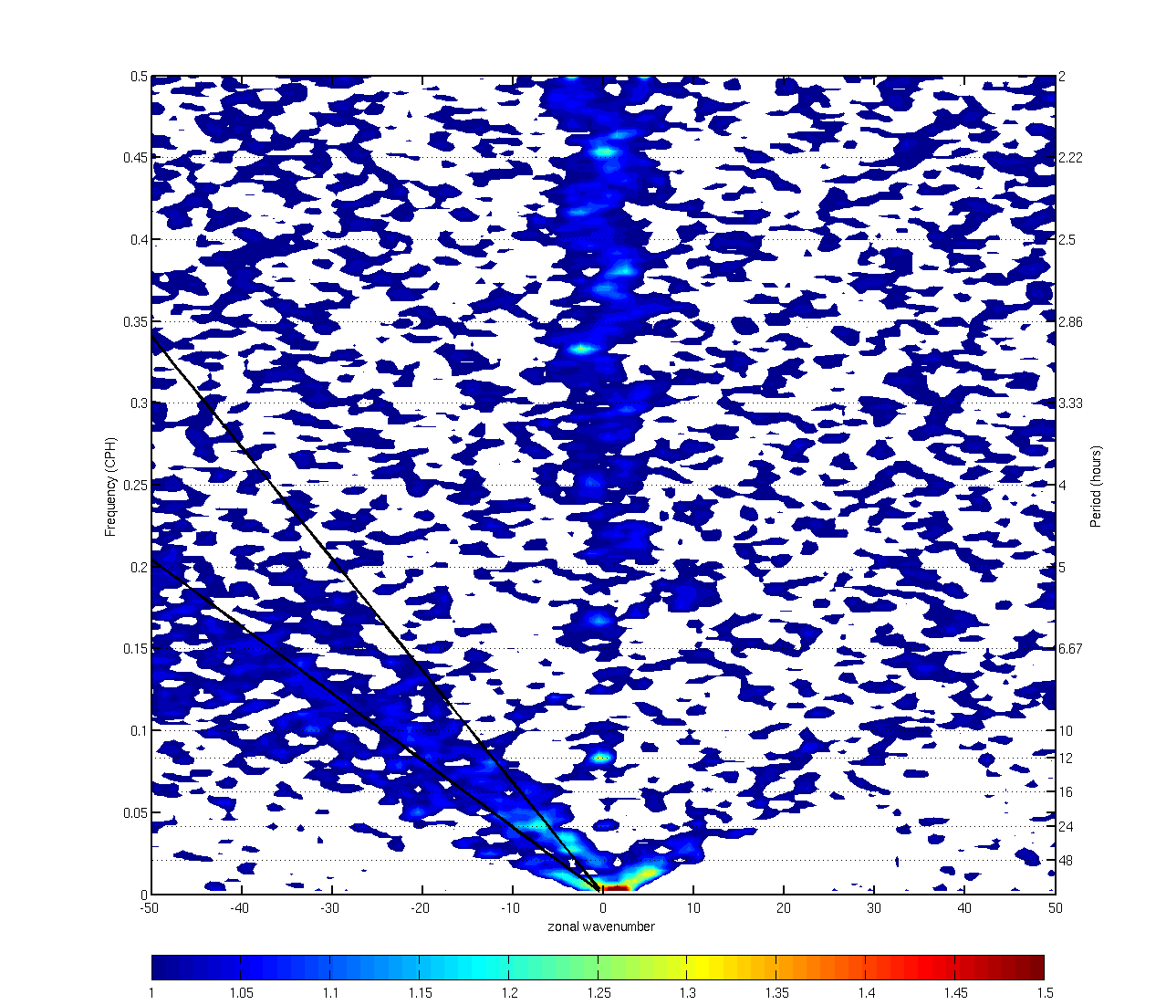
2-D Fourier Transform: Time-longitude => Freq-wavenumber

Slide 7
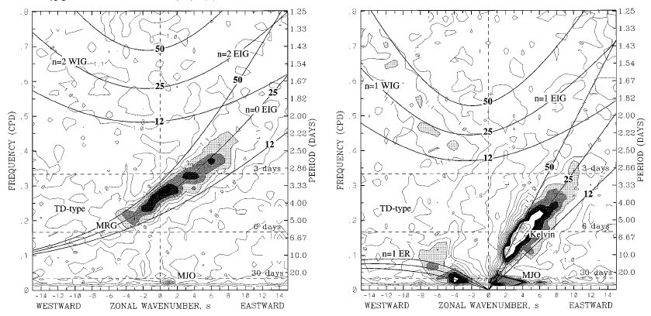
Wheeler and Kiladis 1999

Slide 8
Space-time spectrum
Asymmetric Symmetric
CMORPH 0.25deg, 30E-150E 15S-15N
year 2010, 90 day samples

Slide 9
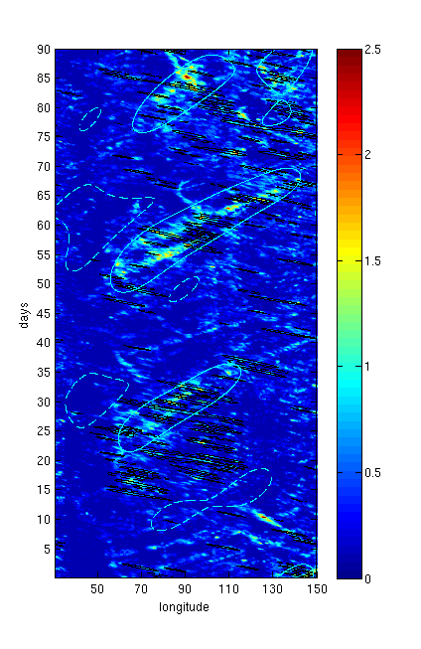
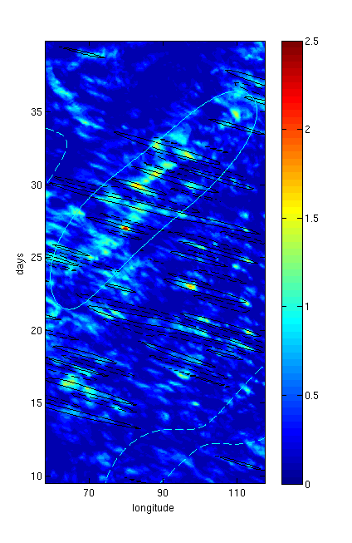
Space-time filtering

Slide 10
To test the hypothesis…
MSE budget
$$\frac{∂\overline{q}}{∂t}=−\overline{u}\frac{∂\overline{q}}{∂x}−\overline{u′\frac{∂q′}{∂x}}−\overline{w}\frac{∂\overline{q}}{∂z}−\overline{w′\frac{∂q′}{∂z}}+res$$
Wave structure from filtering
need 3-D dynamic and thermodynamic fields
model reanalysis
on-going work

Slide 12
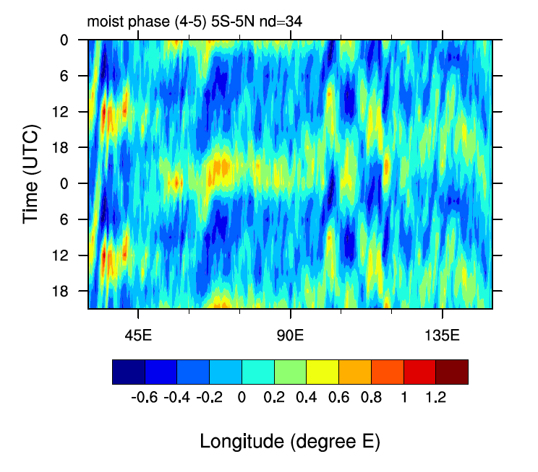
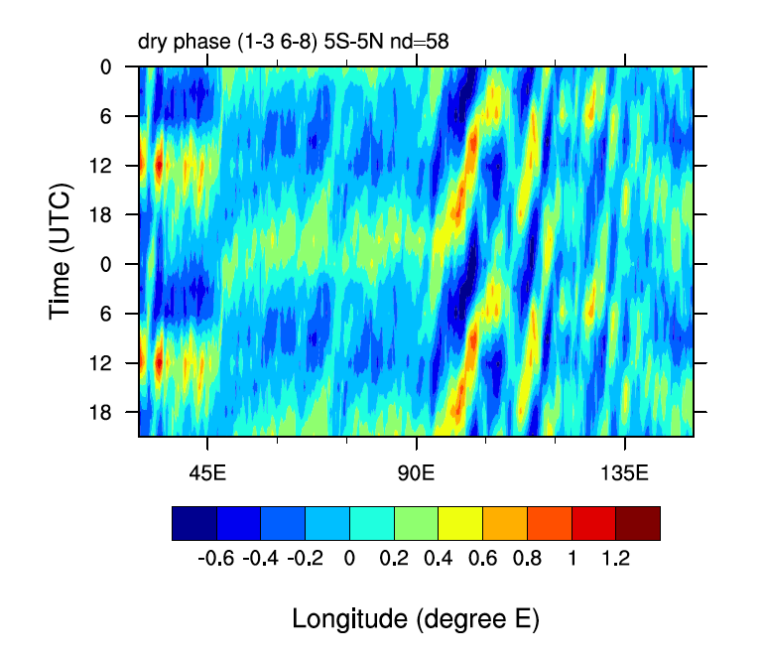
MJO modulating the diurnal cycle…

