Slide 1
Diurnal radiation cycle impact on the genesis of Hurricane Karl (2010)
Christopher Melhauser and Fuqing Zhang
The Pennsylvania State University
Department of Meteorology
Group Meeting – April 11, 2013
Notes:
Focusing on how radiation impacts tropical cyclogenesis
- Using Hurricane Karl (2010) as case study

Slide 2
Focus
How does the diurnal radiation cycle impact the
development of Hurricane Karl (2010)?

Slide 3
Background
Radiation impacts on idealized tropical cyclone development:
  Sundqvist (1970)
    Rate of intensification increased with inclusion of longwave radiative cooling outside core (> 200 km from center); final intensity unaffected
  Hack (1980)
    Earlier intensification and increased intensity with inclusion of shortwave and longwave radiation
  Craig (1996)
    Increased intensification rate and intensity with the inclusion of radiative heating and cooling
Notes:
Sundqvist (1970): (Hilding Sundqvist; Sweden)
Studied various physical processes impact on TC (shifting vortex center further north, sea surface temperature)
Convection parameterized
Axisymmetric 10-level primitive equation model
Haik (1980): PhD Dissertation 1980
- Note: shortwave diurnal cycle not included; only daily shortwave average. Convective and non-convective profiles of LW/SW used in lookup table.
- Focus on interaction of cumulus clouds and large scale characteristics elading to TC
- First to apply convective parameterization of Arakawa and Shubert (1974) to TC development
Craig et al. (1996):
- Axi-symmetric model with explicit convection and detailed microphysics/radiation
- Differential cooling between warm core and cooler environment outside the core.
- Need simulations with heterogeneous environment
All idealized started without cloud; need a long spin-up until a cloud-field becomes well established.
Adjustment process important. Water vapor concentration key to role of radiative cooling.

Slide 4
Background
Radiation impacts on mesoscale convective system evolution in the tropics
  Duhdia (1989)
    Clear air longwave radiative cooling aided convection by continuously destabilizing the troposphere
  Miller and Frank (1993)
    Radiation modulates tropical mesoscale convective system development through large-scale destabilization of the environment
Notes:
Dudhia (1989)
Simulate diurnally occurring convection over South China Sea (using MM5; only 2D)
Focused on stratiform cloud deck
Developed and used shortwave/longwave radiation scheme
Radiative forcing was the main forcing that enabled high level ascent in cirrus decks/cloud anvils
Previous studies (found convective activity largely controlled by the cooling rate → stronger radiative cooling permits stronger convection.
Shortwave radiation reduces the longwave cooling, modulating the net cooling and convective activity.
Miller and Frank (1993)
- Peak in precipitation at night; regardless of initialization time
- More rainfall produced when radiation included; peak rainfalls at night larger than rainfalls during the day

Slide 5
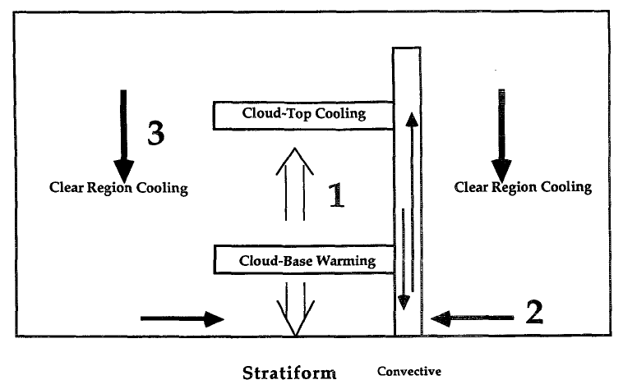
Background
Radiation impacts on mesoscale convective system evolution in the tropics
  Tao et al. (1996):
    Study impact of:
      Cloud-top radiative cooling and cloud-base radiative warming
      Differential radiative heating/cooling between clear and cloudy regions (Gray and Jacobson, 1977)
      (3) Large-scale radiative cooling of environment
    Concluded:
      Large-scale cooling most important mechanism by increasing relative humidity of environment
Tao et al. (1996); Figure 1
Notes:
Tao et al. (1996):
- Nice summary article on past research on clouds and radiation
- 2D Goddard Cumulus Ensemble model
- EMEX (Equatorial Mesoscale Experiment)
Miller and Frank (1993):
Cloud-cloud free radiation gradient and cloud top and cloud bottom differential heating on stratiform clouds had little influence.

Slide 6
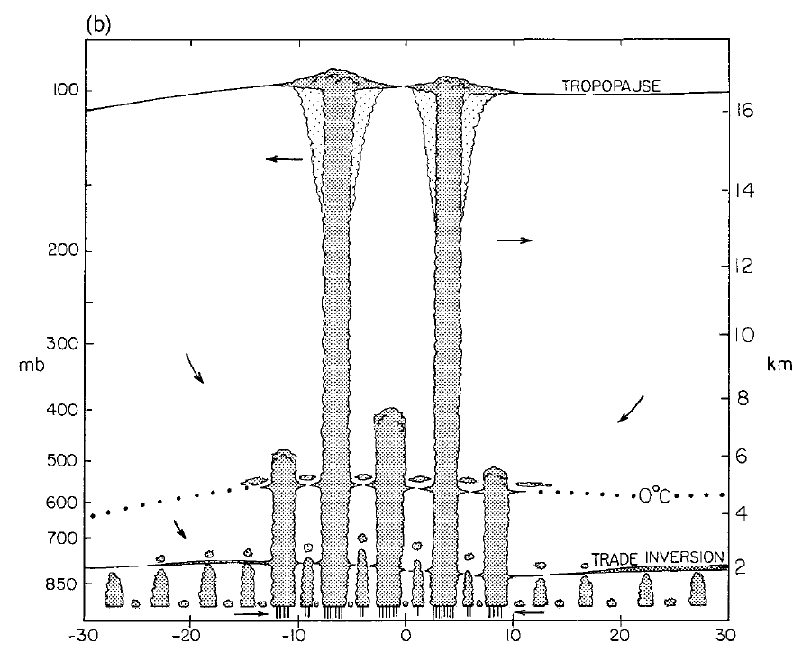
Background
Common cloud layers in the tropical atmosphere
  Johnson et al. (1999):
    Observations from TOGA-COARE → trimodal distribution of clouds in tropics
    Trade cumulus, cumulus congestus, and cumulonimbus
    Tops near the tropical stable layers: trade inversion (~2 km), melting layer (~5 km), and tropopause (~15-16km)
Johnson et al. (1999); Figure 13
Notes:
Johnson et al. (1999):
Tropical Ocean Global Atmosphere Coupled Ocean–Atmosphere Response Experiment
Before → belief bimodal distribution; After → trimodal distribution
Shallower clouds precondition the atmosphere for deep moist convection
Mid and deep clouds produce mid-level cloud layers modifying the radiation budget

Slide 7
Background
Relative humidity gradients and differential longwave heating and cooling
  Mapes and Zuidema (1996)
    Relative humidity gradient at base of dry layers cause differential radiative heating/cooling → stabilization of the associated dry layer base
  Pakula and Stephens (2008)
    Relative humidity gradients at the trade inversion and melting layer (stable layers) cause stabilization of associated stable layers
Notes:
Mapes and Zuidema (1996)
- Studied dry layers in the tropics (warm pool in the western Pacific; data from TOGA COARE field experiment)
- Focused on dry layers
- Dry layers at 925mb, 850mb, and 550mb and sit atop sharp stable layers (inversions)
Pakula and Stephens (2008)
- Radiative convective equilibrium study of cloud distributions in the tropics
- Corroborated the findings of Mapes and Zuidema (1996); convectively active regions: no RH gradient; convectively suppressed regions: sharp RH gradients at stable layers.

Slide 8
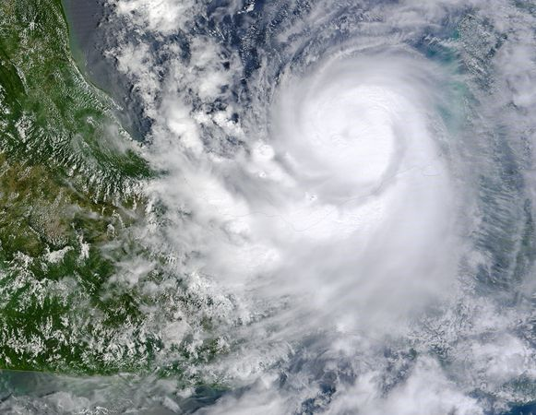
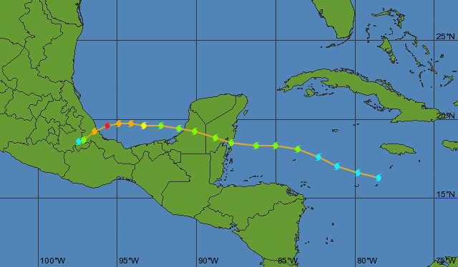
Background
Hurricane Karl (2010)
  September 14-18, 2010
  Observed during PREDICT
Source: Wikipedia
Formed 09/14 1800 UTC
Source: Weather Underground
Notes:
Hurricane Karl (2010)
Predecessor was a broad cyclonic circulation north of South America (Sept 8th) and moved westward into the carribean by 12 september.
System had period convection.
Convection became steadier by September 13th;
TD declared on 1800 UTC 14 September.
PREDICT: Pre-Depression Investigation of Cloud-systems in the Tropics field experiment
Obtain extensive pre-genesis environmental measurements of forming tropical cyclones

Slide 9
Background
Strong diurnal oscillations found in Karl’s deep moist convection (Davis and Ahijevych 2012)
Adapted from: Davis and Ahijevych (2012) Figure 3b
Notes:
Steranka et al. (1984):
- Observational study of GEOS satellite imagery
- Found significant diurnal and semidiurnal cloud cycles analyzing observations of satellite derived cloud top temperatures.
Kossin et al. (2002):
- Confirmed the diurnal oscillations
- Hypothesized that radiative cooling induced subsidence at night in the region of the hurricane canopy reduces the spatial coverage of high cirrus clouds producing the observed reduction in cloud top temperatures

Slide 10
Focus
How does the diurnal radiation cycle impact the
development of Hurricane Karl (2010)?

Slide 11
Model Setup
WRF-ARW v3.1.1
Domains:
  D01: 40.5km, D02: 13.5km, D03: 4.5km
Radiation:
  SW: Dudhia shortwave radiation scheme (Dudhia (1989))
  LW: Rapid radiation transfer model (RRTM)
WRF-EnKF Cycling Assimilation System
  30 members
  All observations used by NCEP, excluding satellite radiances
Initial Conditions
  Analysis from cycling WRF-EnKF
  September 12th, 2010 @ 0000 UTC
Boundary Conditions
  GFS deterministic forecast
  September 12th, 2010 @ 0000 UTC
Notes:
D01 not shown. Covers the Atlantic Basin (~110ºW to 10ºW and 5ºS to 50ºN). More information: Zhang et al. 2009; Montgomery et al. 2012

Slide 12
Sensitivity Experiments
Performed for 4 members of ensemble (2 developing, 2 non-developing)
  Control (C)
    No modification
  Day Only (D)
    SW set @ local noon
  Night Only (N)
    No SW
  No Radiation (NR)
    No SW or LW
  Offset (O)
    SW offset 12 hours
Day Only
Initial SI
Offset
Initial SI
Night Only
Initial SI
Control
Initial SI
Solar Insolation (SI)
0500
UTC
(Local
Midnight)
1700
UTC
(Local
Noon)
0000
UTC
(Local
1900)
Time
(Local
Time)
1200
UTC
(Local
0700)

Slide 13
Simulation Performance
Original Ensemble
Member 16
Member 39
NHC Best Track
Dev. Members
Initial ensemble:
  17 developed
  13 non-developed (not shown)
Wind Speed [ms⁻¹]
12/00 UTC
14/00 UTC
16/00 UTC
What develops?
  Developed Members 16 & 39:
    Night Only: stronger
    Day Only: no development
    No Radiation: no development
    Offset: similar to Control
  Non-developed Members 11 & 37:
    None develop
What causes development differences?
- Focus on Member 16
Member 16
CNTL
DayOnly
NightOnly
Offset
NoRad
Wind Speed [ms⁻¹]
Member 11
Wind Speed [ms⁻¹]
12/00 UTC
14/00 UTC
16/00 UTC
Notes:
Vortex Center → Average of 850- and 500-hPa vorticity centers (filtered < 300 km wavelengths w/ FFT)
Storm intensity → maximum 10-m wind speed within 225 km of the vortex center
Tropical storm: Saffir-Simpson scale: (34 knots → 18 m/s)
What causes development differences?
- Focus on Member 16

Slide 14
Member 16 Development
Clear diurnal cycle
Dry air aloft
Lack of deep moist convection
Interaction with land modified environment (~36 hours)
Continual deep moist convection:
  Depletes instability
  Increased clear-air radiative cooling → increased convective activity
NightOnly Experiment
  Stronger final storm
Member 16
CNTL
DayOnly
NightOnly
Offset
NoRad
Relative Vorticity [x10⁻⁴ s⁻¹]
12/00 UTC
13/00 UTC
14/00 UTC
15/00 UTC
Notes:
Focusing on Member 16

Slide 15
Clouds and Stable Layers
Cumulonimbus
(Deep moist convection)
Common stable layers atmosphere (Johnson et al. (1999))
  Trade inversion
  Melting/Freezing layer
  Tropopause
Cumulus congestus
Trade cumulus
Stable layers can cap convection
Focus on first day of integration (September 12 0000 UTC → September 13 0000 UTC)
Source: Johnson et al. (1999): Figure 13b
Notes:
How does radiation/deep moist convection effect these layers?

Slide 16
CNTL
NightOnly
DayOnly
Offset
NoRad
Higher tropospheric relative humidity → more conducive for convective development (Tao et al. 1996)
Day Only and Offset
  →Enhanced RH gradient
  Increased stability @ trade inversion
Control and Night Only
  Detrainment @ melting layer
  Enhanced RH gradient and stability
12/1500 to 12/2100
Height [km]
12/0000 to 13/0000
Height [km]
Relative Humidity [%]
Environmental Lapse Rate [ºC km⁻¹]
Notes:
Focus: first day of integration
Relative humidity (RH) gradients can stabilize layers (Mapes and Zuidem (1996); Pakula and Stephens (2009))

Slide 17
Trade inversion
  Day Only: shortwave warming
  Day Only/Offset: enhanced longwave warming
Melting Layer:
  Control: minimal shortwave warming
  Control/Night Only: enhanced longwave warming
Overall:
  Night Only: environmental cooling
  Day Only: net environmental warming
(a)
(b)
(c)
12/1500 to 12/2100
Height [km]
(e)
(f)
(g)
CNTL
NightOnly
DayOnly
Offset
NoRad
12/0000 to 13/0000
Height [km]
Net Radiative Heating [K day⁻¹]
LW Radiative Heating [K day⁻¹]
SW Radiative Heating [K day⁻¹]

Slide 18
KEY:
LONGWAVE
SHORTWAVE
* length of arrow indicates magnitude
DayOnly
Net environmental warming
Net decrease in relative humidity throughout the troposphere
Net environmental stabilization
Large trade inversion stabilization
NightOnly
Net environmental cooling
Net increase in relative humidity throughout the troposphere
Net environmental destabilization
Small melting layer stabilization
Storm Intensity
Net environmental cooling
  (1) Increased tropical cyclone intensity
  (2) Inconclusive impact on intensification rate
  (3) No apparent impact on timing
Notes:
FULL DIURNAL CYCLE
- Net increase in relative humidity
- Net low-level destabilization
- Neutral mid-level stability
- Melting layer stabilization

Slide 19
Acknowledgements
Dr. Yonghui Weng
  Performing the real-time ensemble data assimilation and forecasts
Dr. Xiaqiong Zhou:
  Initiating preliminary analysis of the diurnal cycle and sensitivity
Research Partially Supported by:
  ONR (Grant N000140910526)
  NOAA (HFIP)
  NASA (NNX12AJ79G)
  NSF (Grant 0840651)
Texas Advanced Computing Center (TACC):
  Computing resources for sensitivity experiments

Slide 20
References
Hack, J. J., 1980: The role of convective-scale processes in tropical cyclone development. PhD thesis, Colorado State University.
Davis, C. A. and D. A. Ahijevych, 2012: Mesoscale structural evolution of three tropical weather systems observed during PREDICT. J. Atmos. Sci., 69, 1284-1305.
Dudhia, J., 1989: Numerical Study of Convection Observed during the Winter Monsoon Experiment Using a Mesoscale Two-Dimensional Model. J. Atmos. Sci., 46, 3077–3107.
Hack, J. J., 1980: The role of convective-scale processes in tropical cyclone development. PhD thesis, Colorado State University.
Johnson, R., T. Rickenbach, S. Rudledge, P. Ciesielske, and W. Schubert, 1999: Trimodal characteristics of tropical convection. J. Climate, 12, 2397-2418.
Mapes, B., and P. Zuidema, 1996: Radiative-dynamical consequences of dry tongues in the tropical atmosphere. J. Atmos. Sci., 53, 620-638.
Miller, R. A., and W. M. Frank, 1993: Radiative Forcing of Simulated Tropical Cloud Clusters. Mon. Wea. Rev., 121, 482–498.
Pakula, L., and G. L. Stephens, 2009: The Role of Radiation in Influencing Tropical Cloud Distributions in a Radiative-Convective Equilibrium Cloud-Resolving Model. J. Atmos. Sci., 66, 62-76.
Sundqvist, H. 1970: Numerical simulation of the development of tropical cyclones with a ten-level model. Part II., Tellus, 22, 504-510.
Tao W.-K, S. Lang, J. Simpson, C.-H. Sui, B. Ferrier and M.-D. Chou, 1996: Mechanisms of Cloud-Radiation Interaction in the Tropics and Midlatitudes. J. Atmos. Sci., 53, 2624-2651.

Slide 21
Questions?

Slide 25
CNTL
12/1200 UTC
DayOnly
Notes:
- At 12km.

