Slide 1
Progress Report
11/01/2012- 04/30/2013
Retrospective runs with 2012 APSU system; (submitted)
Global model impacts on regional hurricane prediction; (not finished)
Global Hawk dropsonde data impact on hurricane prediction; (failed)
Recon data impact on hurricane prediction. (working)

Slide 2
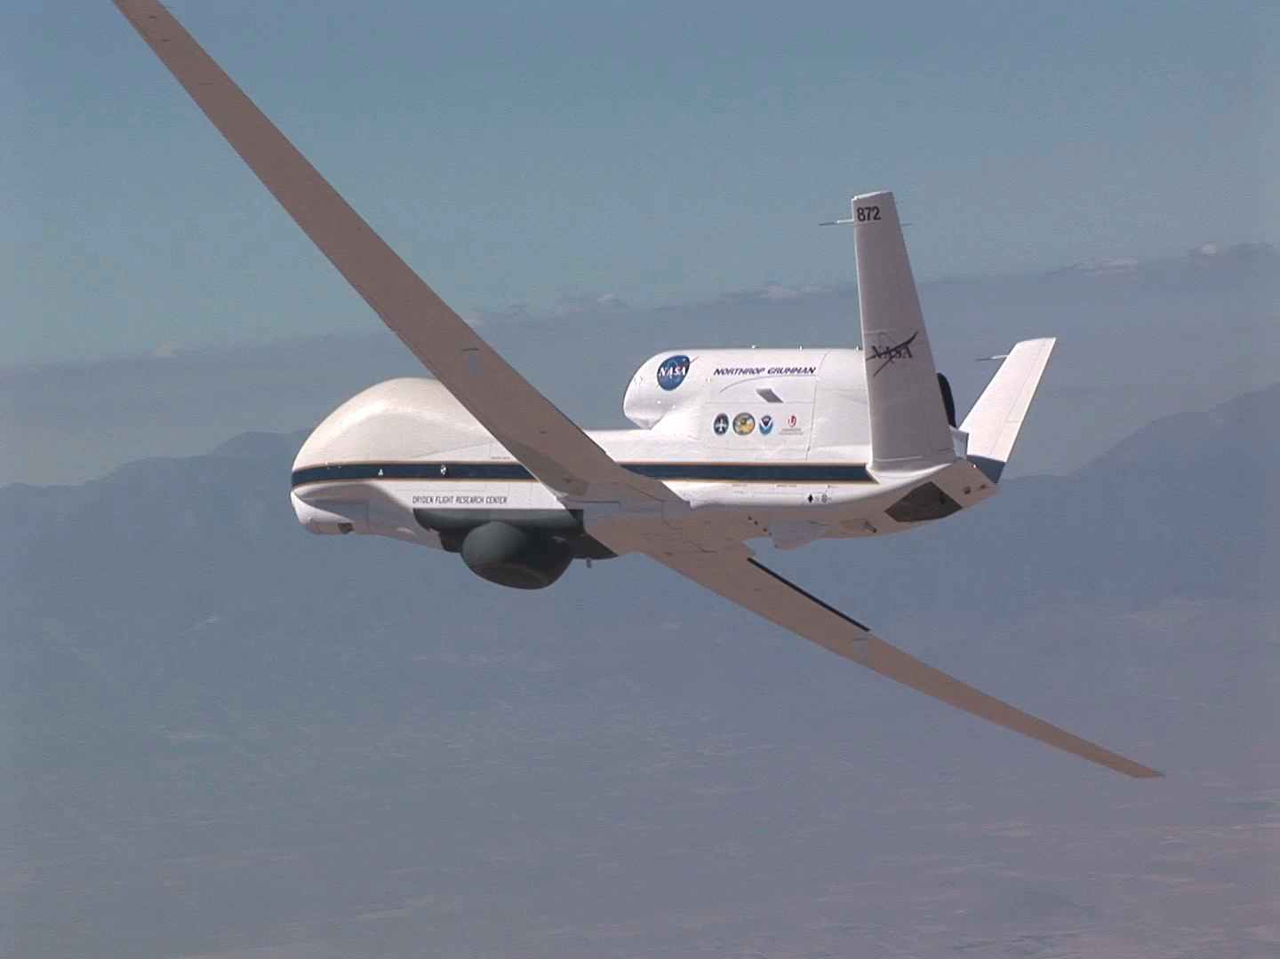
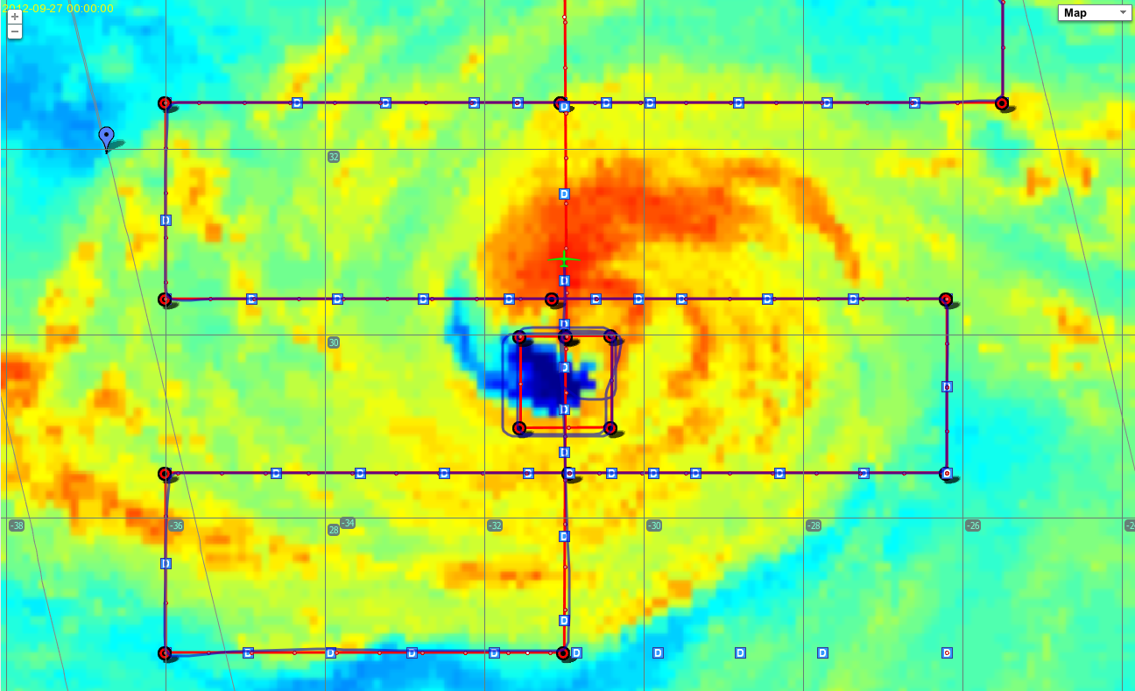
GH DropSonde
Total 247 sondes
09/26: 73 sondes

Slide 3
FAIL: GH DropSonde Assimilation
Track
Pmin
Vmax

Slide 4
Recon Data Impact

Slide 5
Plan
05/01/2013- 07/31/2013
Recon data impact on hurricane prediction;
4DVar learning;
Global Hawk dropsonde data impact on hurricane prediction;
Global model impacts on regional hurricane prediction;
H2013 real-time system.

